Slide 1
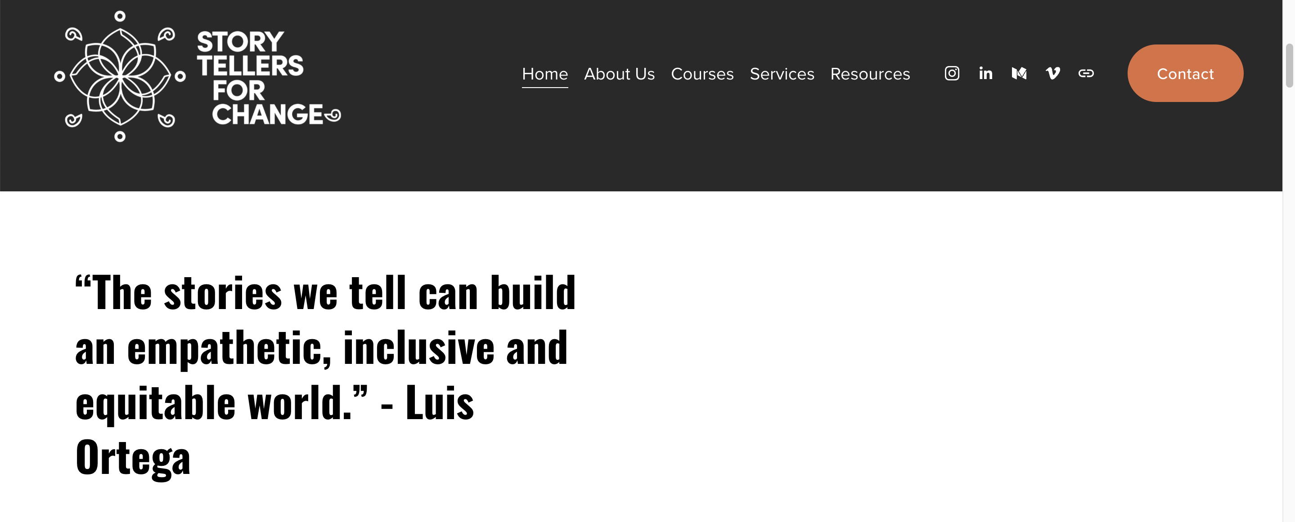
Racial Equity in Educare
October CoP 10/10/2025
Adapted and facilitated by Dr. Allison De Marco, of the Educare National Evaluation Partner at the Frank Porter Graham
Child Development Institute, University of North Carolina – Chapel Hill. ©2025
Notes:
Content adapted from: Luis Ortega at Storytellers for Change: https://www.storytellersforchange.com/

Slide 2
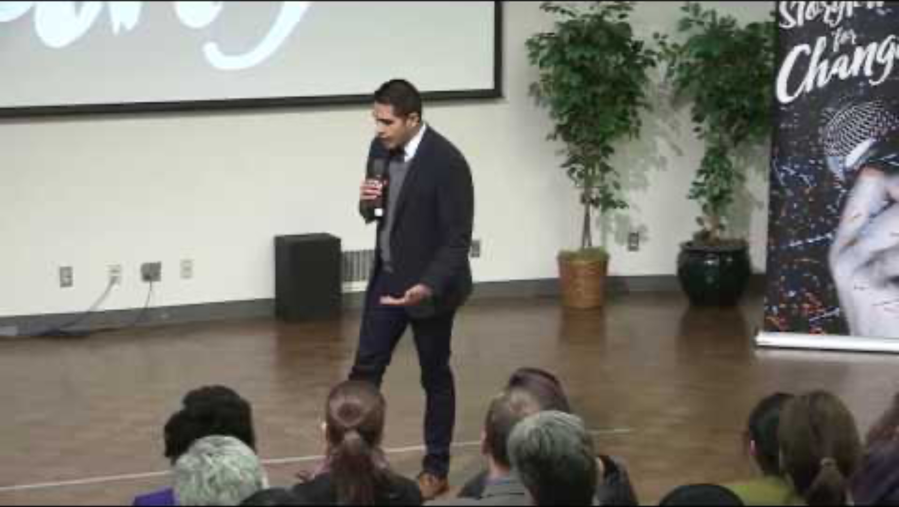
In Lak’ech - you are the other me
Notes:
https://youtu.be/dPoqG7y5HSc?si=tsBveiu167Q1QeQ5

Slide 3

Asset-Based Story-telling
Practice of examining, crafting, and sharing stories, through an approach focused on individuals’ and communities’ strengths
Notes:
Thinking of this in terms of narrative shift, and research agenda principles:
4. Move away from a deficit-lens that casts blame on individuals rather than interrogating systemic inequities
5. See children and families of color in a holistic way and leverage a strengths-based approach
6. Ensure research priorities, questions, design, and processes reflect lived experiences
7. Actively and meaningfully involve community
11. Leverage channels and mechanisms for communicating and disseminating research findings in ways that are accessible

Slide 4

Connection to Research Agenda
4. Move away from a deficit-lens that casts blame on individuals rather than interrogating systemic inequities
5. See children and families of color in a holistic way and leverage a strengths-based approach
6. Ensure research priorities, questions, design, and processes reflect lived experiences
7. Actively and meaningfully involve community
11. Leverage channels and mechanisms for communicating and disseminating research findings in ways that are accessible
Notes:
Thinking of this in terms of narrative shift, and research agenda principles:
4. Move away from a deficit-lens that casts blame on individuals rather than interrogating systemic inequities
5. See children and families of color in a holistic way and leverage a strengths-based approach
6. Ensure research priorities, questions, design, and processes reflect lived experiences
7. Actively and meaningfully involve community
11. Leverage channels and mechanisms for communicating and disseminating research findings in ways that are accessible
Full report: https://eln.fpg.unc.edu/wp-content/uploads/Educare-Research-Agenda-on-Racial-Equity_Final.pdf

Slide 5


Asset v. Problem v. deficit Based
1. Asset-Based
Strength-driven, opportunity-focused, internally focused
What exists we can build on?
2. Problem-Based
Needs-driven, problem focused, externally focused
What is missing we need to go find?
3. Deficit-Based
Risk and deficit driven, pathology, blame and responsibility
Why is this always a problem?
“Who are we benefitting if we remain problem-focused?” Shola, workshop participant
Notes:
Content adapted from: Luis Ortega at Storytellers for Change: https://www.storytellersforchange.com/
Fits with our research agenda

Slide 6
Story Prompts
  Dreaming Prompt: Tell us a story about a time you glimpsed a future that felt just, joyful, or free.
  Designing (Presencing) Prompt: Tell us a story about a moment when you sensed something meaningful beginning to take shape through your (individual and collective) efforts.
  Envisioning Prompt: Tell us a story or memory that reminds you of the future you’re working toward.
  3-5 minutes to reflect
  Small groups to share, 4 minutes each
  Invitation to share back
Notes:
Invite us to think of a story that reflects the work we’ve been doing together.
Reflect/journal
Break-outs of 3 people (ok to have a lot of groups)
Share out time

Slide 7

Closing question: Any reflections to share about this process or how you might adapt in your work?

