Slide 1



Racial Equity in Educare
(AKA …)
June CoP 6/13/2025
Adapted and facilitated by Dr. Allison De Marco, of the Educare National Evaluation Partner at the Frank Porter Graham
Child Development Institute, University of North Carolina – Chapel Hill. ©2025

Slide 2


Overview
Critical Hope as an Antidote for Overwhelm
Discussion & application to our work
Community building through story-telling activity

Slide 3
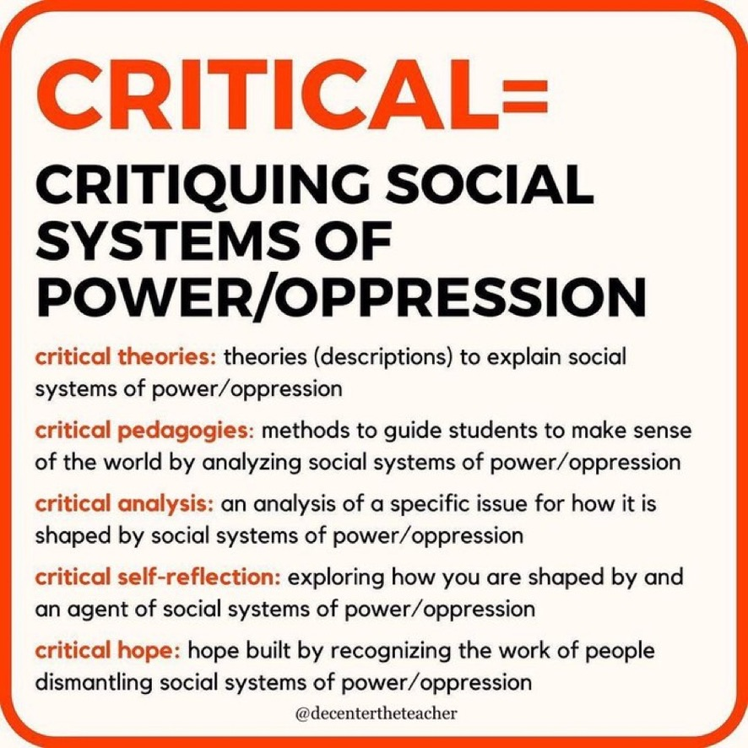
Critical Hope as an Antidote for Overwhelm
Seven Principles of Critical Hope (term coined by Paulo Freire)
1. Hope is necessary, but alone, it’s not enough
2. Critical hope is not something you have; it’s something you practice
3. Critical hope is messy, uncomfortable, and full of contradictions
4. Critical hope is intimately entangled with the body and the land
5. Critical hope requires bearing witness to social and historical trauma
6. Critical hope requires interruptions and invitations
7. Anger and grief have a seat at the table
Notes:
Source: Freire, P. (2021). Pedagogy of hope: Reliving pedagogy of the oppressed. Bloomsbury Publishing.
Take 10 minutes to read the brief article.
Drop in chat:
https://docs.google.com/document/d/12tyOqGuTK1JRUTWKwcS8XsAAauGIxEZB8UTkpgZIl7E/edit?usp=sharing

Slide 4

Reflect on these questions
What are your thoughts on the concept of critical hope?
How does it apply to your own social justice work?
How does it apply to our LEP work?
Notes:
Reflect/journal
Share out time

Slide 5

“The shortest distance between two people is a story.”
CJ Suitt, former Chapel Hill Poet Laureate and Restorative Practices Associate, Dispute Settlement Center
Small groups of 3, each take 3 minutes to share a story in response to these prompts:
Tell us a story about a time when you experienced a sense of hope? What made this experience possible? Who was there with you? When and where did it happen?
Notes:
Share plan
Give folks 3-5 minutes to reflect
Launch breakouts.
~12 minutes
Not sharing back our stories!

Slide 6

Closing question: What do you want to take with you from this time together?

