Slide 1

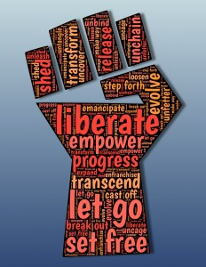
Racial Equity in Educare
June CoP 6/9/2023
Adapted and facilitated by Dr. Allison De Marco, of the Educare National Evaluation Partner at the Frank Porter Graham
Child Development Institute, University of North Carolina – Chapel Hill. ©2023

Slide 2



Overview
Re-visit co-created community commitments
Talk through article & practices for accountability
Guest presentation: Early Childhood Technical Assistance Center
Questions for discussion: Where to begin, level to engage, how this fits with Educare Network’s Research Agenda: Advancing Racial Equity?

Slide 3
Community Commitments
[co-created Feb-Mar 2021]
Make space and take space
Create safe & supportive space – listen actively, be present, be respectful
Share authentic selves
Consider other viewpoints
Assume best intentions (assume everything is a first draft)
Commit to co-creation
Be accountable
Commit to pushing through discomfort

Slide 4
Building a Culture of Accountability
(P. Anderson, 2021)
Self-accountability: practice of taking responsibility for your actions and consequences of those actions. Every team member must recognize they have a role to play in building a culture committed to inclusion, belonging, and equity, and recognition begins with taking responsibility for own contributions to culture.
Mutual accountability: based on defining shared agenda for change, rather than top-down policing model rooted in punishment. Requires a commitment to putting relationships ahead of need to be right or be perceived as a “good person.”
Community accountability: approach pioneered by feminists of color working to end gender-based violence in the early 2000s. INCITE! Women of Color Against Violence defined as a process in which a community—in this case, a workplace—works together to do the following:
Notes:
Source: Anderson, P. (2021). Building a culture of accountability. Stanford Social Innovation Review (SSIR). Retrieved October, 31, 2021.
Self-accountability: the practice of taking responsibility for your actions and the consequences of those actions. Every single member of a team must recognize that they have a role to play in building a culture committed to inclusion, belonging, and equity, and this recognition begins with taking responsibility for their own contributions to that culture.
Mutual accountability, which is based on defining a shared agenda for change, rather than using a top-down policing model rooted in punishment. Mutual accountability requires a commitment to putting relationships ahead of the need to be right or be perceived as a “good person.”
Community accountability, an approach pioneered by feminists of color working to end gender-based violence in the early 2000s. INCITE! Women of Color Against Violence defines it as a process in which a community—in this case, a workplace—works together to do the following:

Slide 5

Community accountability
Provide safety and support to those targeted.
Create values & practices that resist abuse and oppression, and encourage safety, support, and accountability.
Develop strategies to address the abusive behavior and facilitate a process to account for actions and transform behavior.
Commit to ongoing development of all community members and community itself to transform the conditions that reinforce oppression.
Notes:
Provide safety and support to those who have been targeted.
Create and affirm values and practices that resist abuse and oppression, and encourage safety, support, and accountability.
Develop sustainable strategies to address the abusive behavior of community member(s) and facilitate a process for them to account for their actions and transform their behavior.
Commit to the ongoing development of all members of the community and the community itself to transform the conditions that reinforce oppression.

Slide 6
7 Practices for Building a Culture of Accountability
Acknowledge harm | Acknowledge that when harm happens, it doesn’t just affect the individuals involved but everyone within the organization.
Establish a set of internal anti-racist norms | Organizations must define internal behavioral norms that inform how staff treat each other, norms must set standard for anti-racism practice and set clear boundaries in relationships.
Work to repair the harm | Repairing damaged relationships and broken trust requires time and regular check-ins to understand what people need and how those needs can be met.
Skilled facilitation | Bring in a skilled facilitator to lead a process of conflict transformation with parties involved or of community restoration w/entire organization.
Racial affinity groups | Can create space for peer learning, healing, and mutual accountability. White affinity groups have an explicit agenda focused on anti-racism learning and practice. For employees of color, affinity groups provide space to process instances of racial harm, offer mutual support, and identify strategies to eliminate conditions that made racial harm possible.
Create feedback loops | Creating accessible structures for giving and receive feedback
Practice generative conflict | Understand difference between generative conflict, harm, and abuse. Conflict—not harm or abuse—is natural and necessary part of relationships. Team members don’t avoid conflict or hide behind professional standards rooted in white supremacy that prioritize politeness and impassivity over being clear and direct.
Notes:
Acknowledge harm | First, you have to acknowledge that when harm happens, it doesn’t just affect the individuals involved but everyone within the organization. An acknowledgement of harm is clear, direct, and focuses on the impact, not the intent.
Establish a set of internal anti-racist norms | Organizations must also define the internal behavioral norms that inform how staff treat each other. While values represent ideals that we want to live up to, norms are acceptable behaviors and attitudes that are socially enforced. In a culture of accountability, norms must set the standard for anti-racist practice and set clear boundaries in relationships.
Work to repair the harm | Repairing damaged relationships and broken trust will require time and regular check-ins to understand what people need and how those needs can be met. It’s important to center the needs of the person who has experienced the harm while also engaging others in thinking about what change needs to look like. What does redress for this particular act look like? Repairing harm may require an apology, paid leave for the harmed staff person, and moving one person to a new office or team.
Skilled facilitation | Bring in a skilled facilitator to lead a process of conflict transformation with the parties involved or of community restoration with the entire organization.
Racial affinity groups | The formation of racial affinity groups can create space for peer learning, healing, and mutual accountability. White affinity groups must have an explicit agenda focused on anti-racist learning and practice. In this group, white staff can reflect on the ways they will participate in dismantling white supremacy and be more effective allies to their colleagues of color. For employees of color, affinity groups can provide a space to process instances of racial harm, offer mutual support, and identify strategies to eliminate conditions that made racial harm possible.
Create feedback loops | Creating accessible structures for giving and receive feedback is another vital component. These might range from anonymous surveys to a regular practice of mutual feedback in supervisory meetings.
Practice generative conflict | Organizations with a culture of accountability understand the difference between generative conflict, harm, and abuse. Conflict—not harm or abuse—is a natural and necessary part of all relationships, including our professional ones. At work, team members don’t avoid conflict or hide behind professional standards rooted in white supremacy that prioritize politeness and impassivity over being clear and direct.

Slide 7
What an accountability document might look like – Example from ECTA
Early Childhood Technical Assistance Center – ECTA Project Presentation
Schatzi H. McCarthy
Associate Director of Evaluation
Technical Assistance Specialist
Adam L. Holland, Ph.D.
Chair, International Early Childhood Inclusion Institute
Core Competencies from the Center for the Study of Social Policy
  https://cssp.org/our-work/project/equity-justice/#core-competencies
Notes:
Schatzi H. McCarthy – Presentation and Q&A
Associate Director of Evaluation
Technical Assistance Specialist
Early Childhood Technical Assistance Center – ECTA and time for Q & A
Drop to chat:
https://cssp.org/our-work/project/equity-justice/#core-competencies

Slide 8
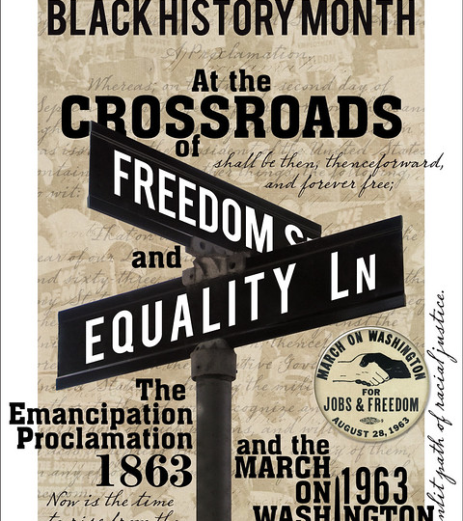

Discussion Questions:
1) How might we proceed?
2) What level do we want to engage (LEP group, Educare schools, LEP’s orgs)?
3) How might this fit with the Educare Network’s Research Agenda: Advancing Racial Equity?
This Photo by Unknown Author is licensed under CC BY-ND
Notes:
If folks have great examples of any policies, please email to me.
Small groups to talk through and then share ideas back.

