Slide 1

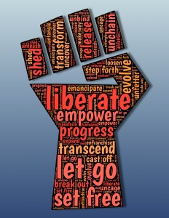

Racial Equity in Educare
July CoP (9/7/2021)
Creado y facilitado por la Dra. Allison De Marco, socia nacional de evaluación de Educare en el Frank Porter Graham Child Development Institute de la Universidad de Carolina del Norte en Chapel Hill.
Notes:
**Ask folks to rename selves and pronouns. White folks please add a W next to your name. This will help us create breakout groups.
RE Reports: MIL, NOL, OKL
Kira – NOL
Karen – MIL
Dana – OKL?
Next month – Jolene/OMA, Tiffany/Jeanie/PHX, Miriam/Sue/SEA

Slide 2


Overview - Anti-racist research, CRT, and data use
Key points – Do No Harm Guide
Small group discussion
Report back
Notes:
Do No Harm guide: Schwabish, J., & Feng, A. (2021). Applying Equity Awareness in Data Visualization. Urban Institute. Access: Web https://www.urban.org/research/publication/do-no-harm-guide-applyingequity-awareness-data-visualization

Slide 3
antiracist research is:
Race- and racism-conscious,
Strengths-based,
Humanizing,
Co-constructed, and
Community-centered
Source: Doucet, 2021
Notes:
Doucet, F. (2021). Identifying and testing strategies to improve the use of antiracist research evidence through critical race lenses. William T. Grant Foundation. Access: Web https://wtgrantfoundation.org/wp-content/uploads/2021/01/Doucet_Digest_Issue-6.pdf

Slide 4


Critical Race Theory as a framework for research
  Racism is permanent
  Need for historical context and critique of ahistoricism
  Interest convergence
  Race is a social construct
  Property value of whiteness
  Intersectionality
  Unique voice of color and counternarrative
  Critique of liberalism
Notes:
Dudziak, M. L. (1988). Desegregation as a cold war imperative. Stanford Law Review, 41(1), 61−120.
McDowell, T., & Jeris, L. (2004). Talking about race using critical race theory: Recent trends in the Journal of Marital and Family Therapy. Journal of Marital and Family Therapy, 30(1), 81-94.
Williams, R. (1989). Documents of barbarism: The contemporary legacy of European Racism and colonialism in the narrative traditions of federal Indian law. Arizona Law Review, 95, 237–278.

Slide 5
Critical Race Theory as a framework for research
Include the voices of historically marginalized or traditionally excluded
Acknowledge that all research is shaped through the lens of the researcher
Examine power, privilege, and oppression
Consider race and racism in every aspect of the research process
Consider how design honors perspectives of participants/communities
Ground study in particular space and time
Reveal and disrupt oppressive conditions within systems/institutions
Conclude with a call for action with specific recommendations
Consider dissemination avenues to maximize impact.
Notes:
Bell, D. A. (1995). Who’s afraid of critical race theory? University of Illinois Law Review, 1995 (4), 893–910.
Lawless, J. J., Brooks, S., & Julye, S. (2006). Textual representation of diversity in COAMFTE accredited doctoral programs. Journal of Marital and Family Therapy, 32(1), 3–15. doi:10.1111/j.1752-0606.2006.tb01584.x
Daftary, A. M. H. (2018). Critical race theory: An effective framework for social work research. Journal of Ethnic & Cultural Diversity in Social Work, 1-16.

Slide 6
Urban Institute
Do No Harm Guide for Data Visualization
Put people first – help readers/viewers recognize the people behind the numbers.
  Use icons instead of abstract shapes to allow readers to empathize
  Recognize how racism and injustice serve as the background for many of the issues we analyze and visualize.
  Work with communities, not on behalf of them.
  Questions to ask about products:
    Are we using language consistent with how community members refer to themselves and others?
    What in our visuals is inconsistent with a DEI framework?
    How does the community prefer to have the research results presented?

Slide 7
(4) Engaging or reflecting lived experiences
Use personal connections to help readers better connect with material.
  Pair data-driven charts with personal stories of individual experiences
  Techniques = photography, illustrations, pull quotes, and oral histories.
  Allow users to find themselves by being able to search for their city or county
Use a mix of quantitative and qualitative approaches to tell a story.
Create a platform for engagement
Consider how issue framing can create a biased emotional response.
Recognize audience needs.
  Consider accessibility for those with low sight, difficulty accessing web-based content,
  Avoid jargon and technical terminology, translation
  Add labels and annotations to assist viewer

Slide 8
(5) Assessing the data behind the visualization
  How were data generated?
  Are they demographically representative?
  Who is included/excluded?
  Whose voices, lives, and experiences are missing?
  How much can be disaggregated by race, gender, ethnicity, etc.?
  Why were these data collected?
  Who stands to benefit from these data?
  Who might be harmed by the collection or publication of these data?

Slide 9
(6) Using Language with a Racial Equity Awareness
Name forces of oppression, how they are operating, and historical context should directly in the chart through titles, annotations, labels, and notes
Labels = use people-first language (“people with disabilities” rather than “disabled people,” or “people in prison” instead of “inmate,” (Bartley, 2021)
Labels = refer to people, not to skin color (for example, “Black people” rather than “Blacks”).
Ask the community what terms they would like used.
Notes:
Bartley, L. (2021). I Am Not Your Inmate. The Marshall Project, 12. Available: https://www.themarshallproject.org/2021/04/12/i-am-not-your-inmate

Slide 11
(7) Ordering Data Purposefully
Always starting with “white” or “men” makes these groups appear as the default/most important.
Also reflects who we consider to be the audience.
Consider:
  Does your study focus on a particular community? If yes, present that group first.
  Particular argument/story to tell? If so, order to reflect argument.
  Is there a quantitative relationship to guide order? Alphabetically, population size, sample size, or magnitude or effect of the results?

Slide 12
(8) Considering Missing Groups
Groups whose data are/are not collected or shown reflects who is deemed as most important or valuable (Ex. Not displaying US territories on US maps)
Lumping – Can mask important variation e.g., Native Hawaiian Pacific Islander community vulnerability lost in AAPI aggregate.
Small sample sizes – consider how to achieve better representation at design phase.
Gender binary – how to be inclusive? Is this question relevant?
Instead of “other” consider more inclusive terms: another race, additional groups, all other self-descriptions, people identifying as other or multiple races

Slide 13
Notes:
Schwabish, J., & Feng, A. (2021). Applying Equity Awareness in Data Visualization. Urban Institute. Access: Web https://www.urban.org/research/publication/do-no-harm-guide-applyingequity-awareness-data-visualization

Slide 14
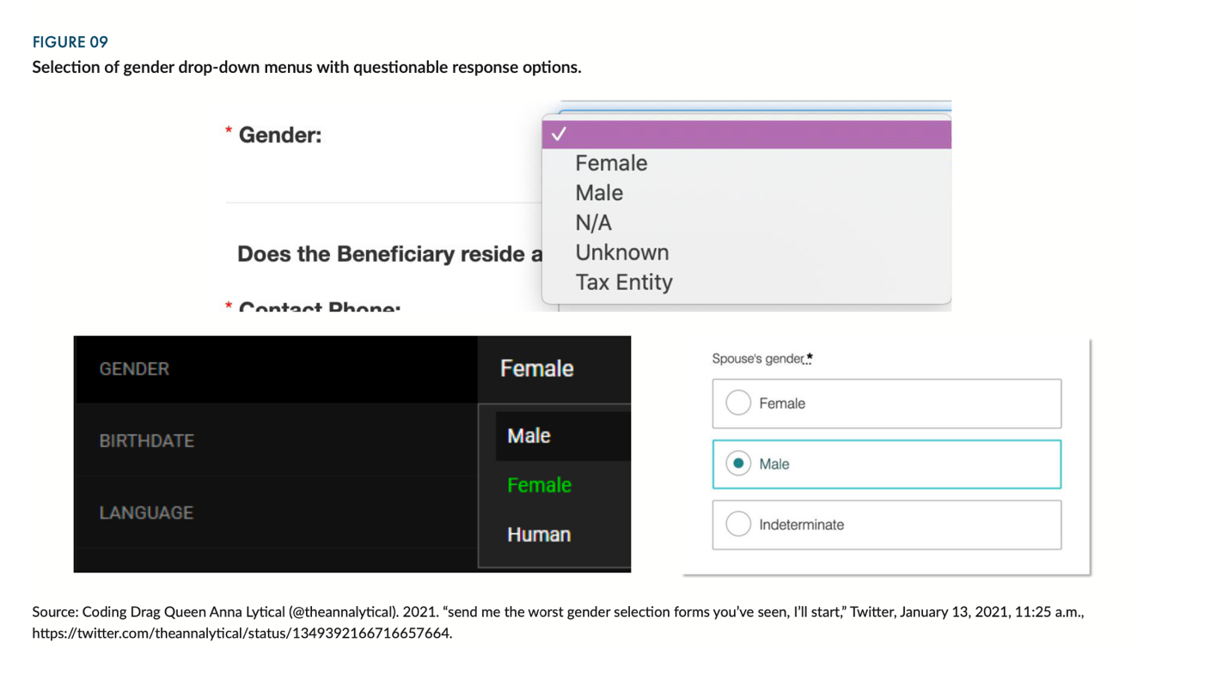

Slide 15
(9) Using Colors with a Racial Equity Awareness
Good color palettes should, at minimum, meet basic accessibility guidelines (WebAIM 2020) and offer sufficient contrast
Color choices = avoid reinforcing gender or racial stereotypes, such as
  Pink and blue to represent women and men
  Colors associated with skin tones or racial stereotypes (e.g., black to represent Black people, yellow to represent Asian people).
Avoid incremental color palettes (e.g., light to dark) to represent different demographic groups
Notes:
(WebAIM 2020)

Slide 16
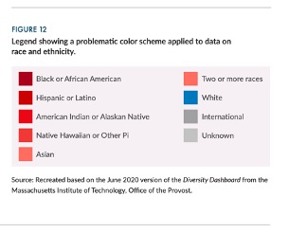
What isn’t good here? What could you do instead?

Slide 17
(10) Using Icons and Shapes with a racial Equity Awareness
When using icons, consider whom we are presenting, our results, anticipate how icons might be perceived, and ensure they do not perpetuate harmful stereotypes.
Avoid images that reinforce racial or ethnic stereotypes or power hierarchies
Solicit feedback about the visuals to make sure they are not offensive and to identify problematic cultural associations that were missed.

Slide 18
(11) Embracing Context and Complexity
Structural racism and other inequities and the mechanisms by which they may be operating should be woven into framing of the research and the chart (Schwabish and Kijakazi 2021).
Too much simplicity can strip context and inherent complexity of social issues that cannot be boiled down to a simple chart.
Charts may be less effective for forming an empathetic connection than other visual or storytelling methods (Correll 2019).
Provide sufficient historical context to mitigate the possibility of a deficit-based interpretation.
Notes:
Schwabish, J., & Kijakazi, K. (2021). Rethinking Economics in the Black Lives Matter Era. Urban Institute, online https://www. urban. org/sites/default/files.
Correll, M. (2019, May). Ethical dimensions of visualization research. In Proceedings of the 2019 CHI conference on human factors in computing systems (pp. 1-13).

Slide 19
(12) Building Diverse and Inclusive Data Communication Teams and Organizations
Diverse teams are critical to creating communication products that apply a racial equity lens and fight other forms of oppression.
Internal org culture should also value, promote, and embody DEI
Ground-up approach with buy-in from leadership
Processes for incorporating equity and inclusiveness need to be codified.
Guidelines should be actionable and instill accountability.
Reevaluate and update regularly

Slide 20
(13) The Feedback Loop
Team members from different races and ethnicities review each product
Solicit feedback from audiences
Build community relationships and seek feedback
Solicit feedback as part of communication (feedback form, how to contact team)
Reciprocal research - create immediate, concrete benefits participants can receive while participating in the study rather than waiting until the project is over (Hanrahan et al., 2020)
Value time and compensate accordingly
Notes:
Hanrahan, B. V., Ma, N. F., Betanzos, E., & Savage, S. (2020, June). Reciprocal research: Providing value in design research from the outset in the rural united states. In Proceedings of the 2020 International Conference on Information and Communication Technologies and Development (pp. 1-5).

Slide 21
(14) The Gatekeepers - funders, project officers, editors, peer reviewers, federal agencies
Editors/peer reviewers
  Attributing findings to structural racism not yet common in scholarly writing
  If editors and reviewers asked questions about racial equity for each manuscript, we would see a shift in how race is analyzed, visualized, and written about
  Require a positionality statement = describes an individual’s or team’s or institution’s social and political context that shapes identity in terms of race, class, gender, sexuality, and ability status
Government agencies, regulations, & directives
  OMB & Census define how race and ethnicity categorized and collected
Funders
  Held to similar account in the funds they disburse and their requests for analysis.

Slide 22
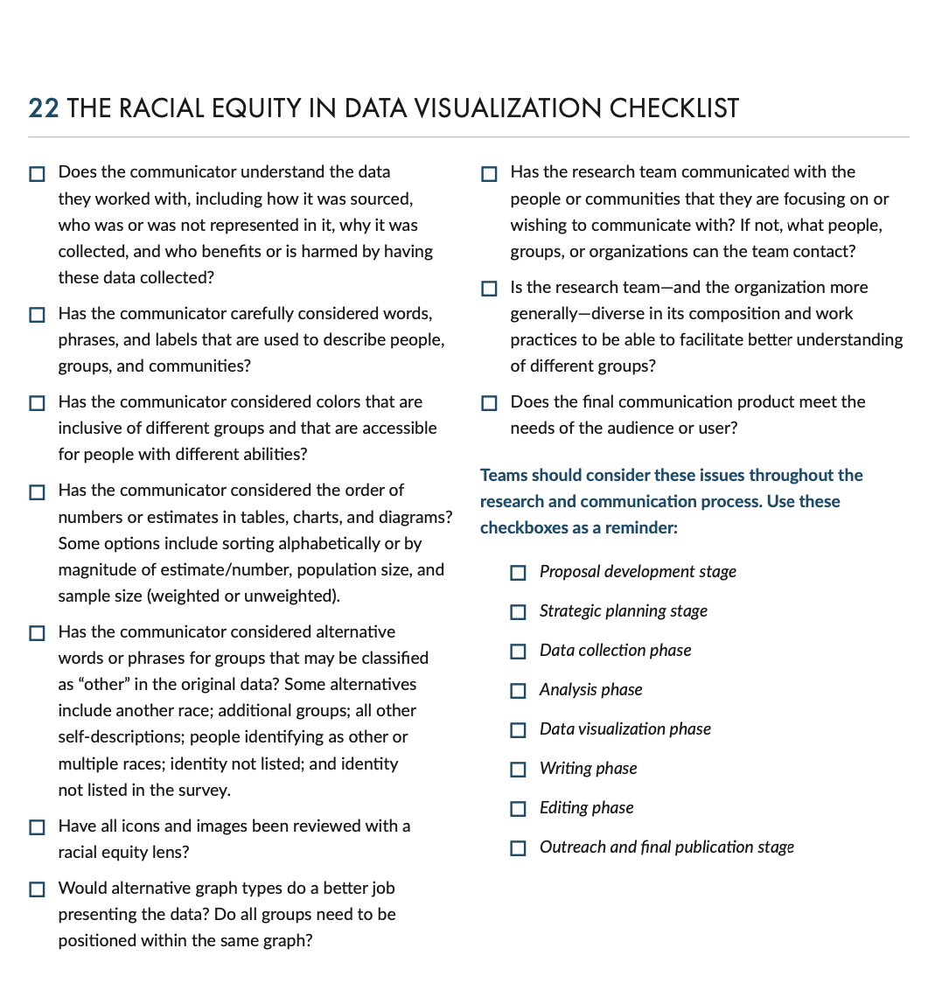
Notes:
Schwabish, J., & Feng, A. (2021). Applying Equity Awareness in Data Visualization. Urban Institute. Access: Web https://www.urban.org/research/publication/do-no-harm-guide-applyingequity-awareness-data-visualization

Slide 23
Small group discussion
Assign sections to each group.
Where do you see these issues in your work?
What are some changes you might make?
Who will record and report back for your group?

