Slide 1
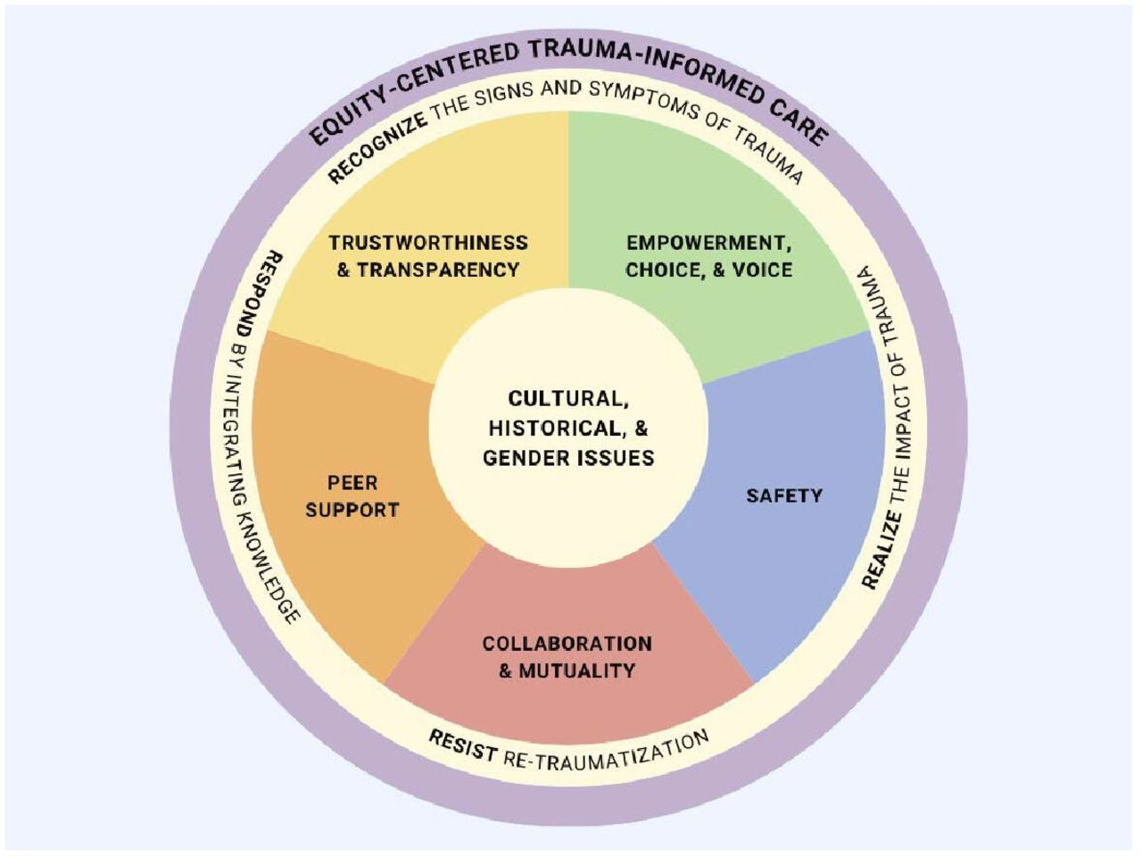
Introduction to a Trauma-Informed Social Justice Research Framework
Racial Equity in Educare
January 2026 CoP 1/09/26

Slide 2
Overview
What is trauma?
What does it mean to be trauma-informed?
What is a trauma-informed social justice research framework?
How might we apply it?
Adapted from: Voith, L. A., Hamler, T., Francis, M. W., Lee, H., & Korsch-Williams, A. (2020). Using a trauma-informed, socially just research framework with marginalized populations: Practices and barriers to implementation. Social Work Research, 44(3), 169-181.
Notes:
Voith, L. A., Hamler, T., Francis, M. W., Lee, H., & Korsch-Williams, A. (2020). Using a trauma-informed, socially just research framework with marginalized populations: Practices and barriers to implementation. Social Work Research, 44(3), 169-181.

Slide 3

Connection to Research Agenda
3. Consider power dynamics and the white supremacy culture of funding, research processes, and ways of knowing
6. Ensure research priorities, questions, design, and processes reflect lived experiences
7. Actively and meaningfully involve community
8. Examine whether the measures and assessments used in research or the data collected are culturally relevant and meaningful to the communities that are part of the research.
11. Leverage channels and mechanisms for communicating and disseminating research findings in ways that are accessible
Notes:
Thinking of research agenda principles:
3. Consider power dynamics and the white supremacy culture of funding, research processes, and ways of knowing
6. Ensure research priorities, questions, design, and processes reflect lived experiences
Actively and meaningfully involve community
8. Examine whether the measures and assessments used in research or the data collected are culturally relevant and meaningful to the communities that are part of the research.
11. Leverage channels and mechanisms for communicating and disseminating research findings in ways that are accessible
Full document: https://eln.fpg.unc.edu/wp-content/uploads/Educare-Research-Agenda-on-Racial-Equity_Final.pdf

Slide 4
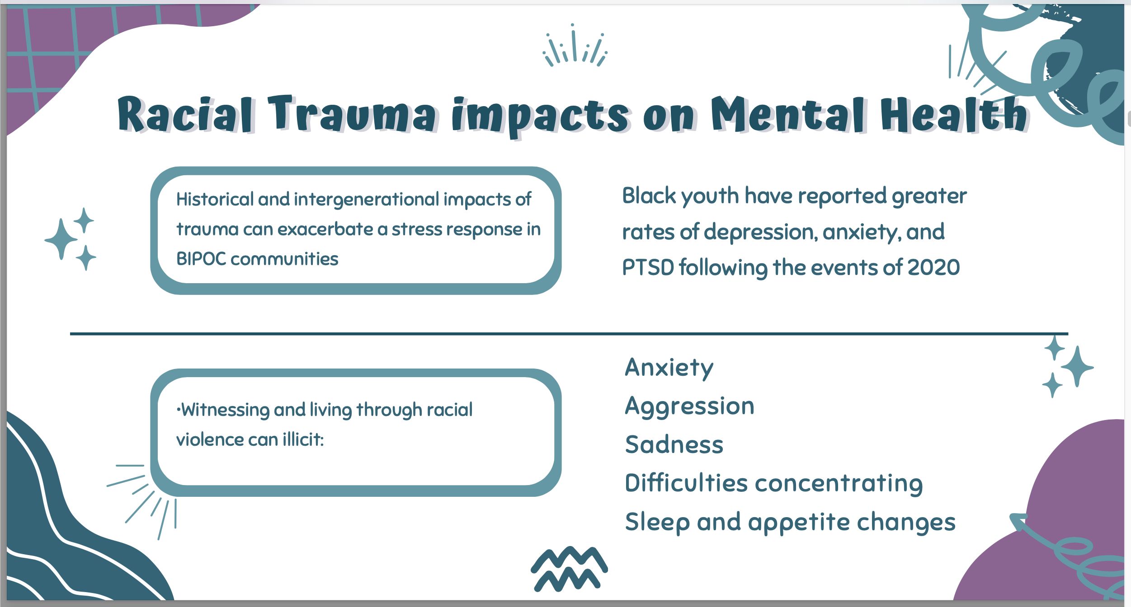
Building on Dr. Anjali Ferguson’s November CoP Presentation

Slide 5
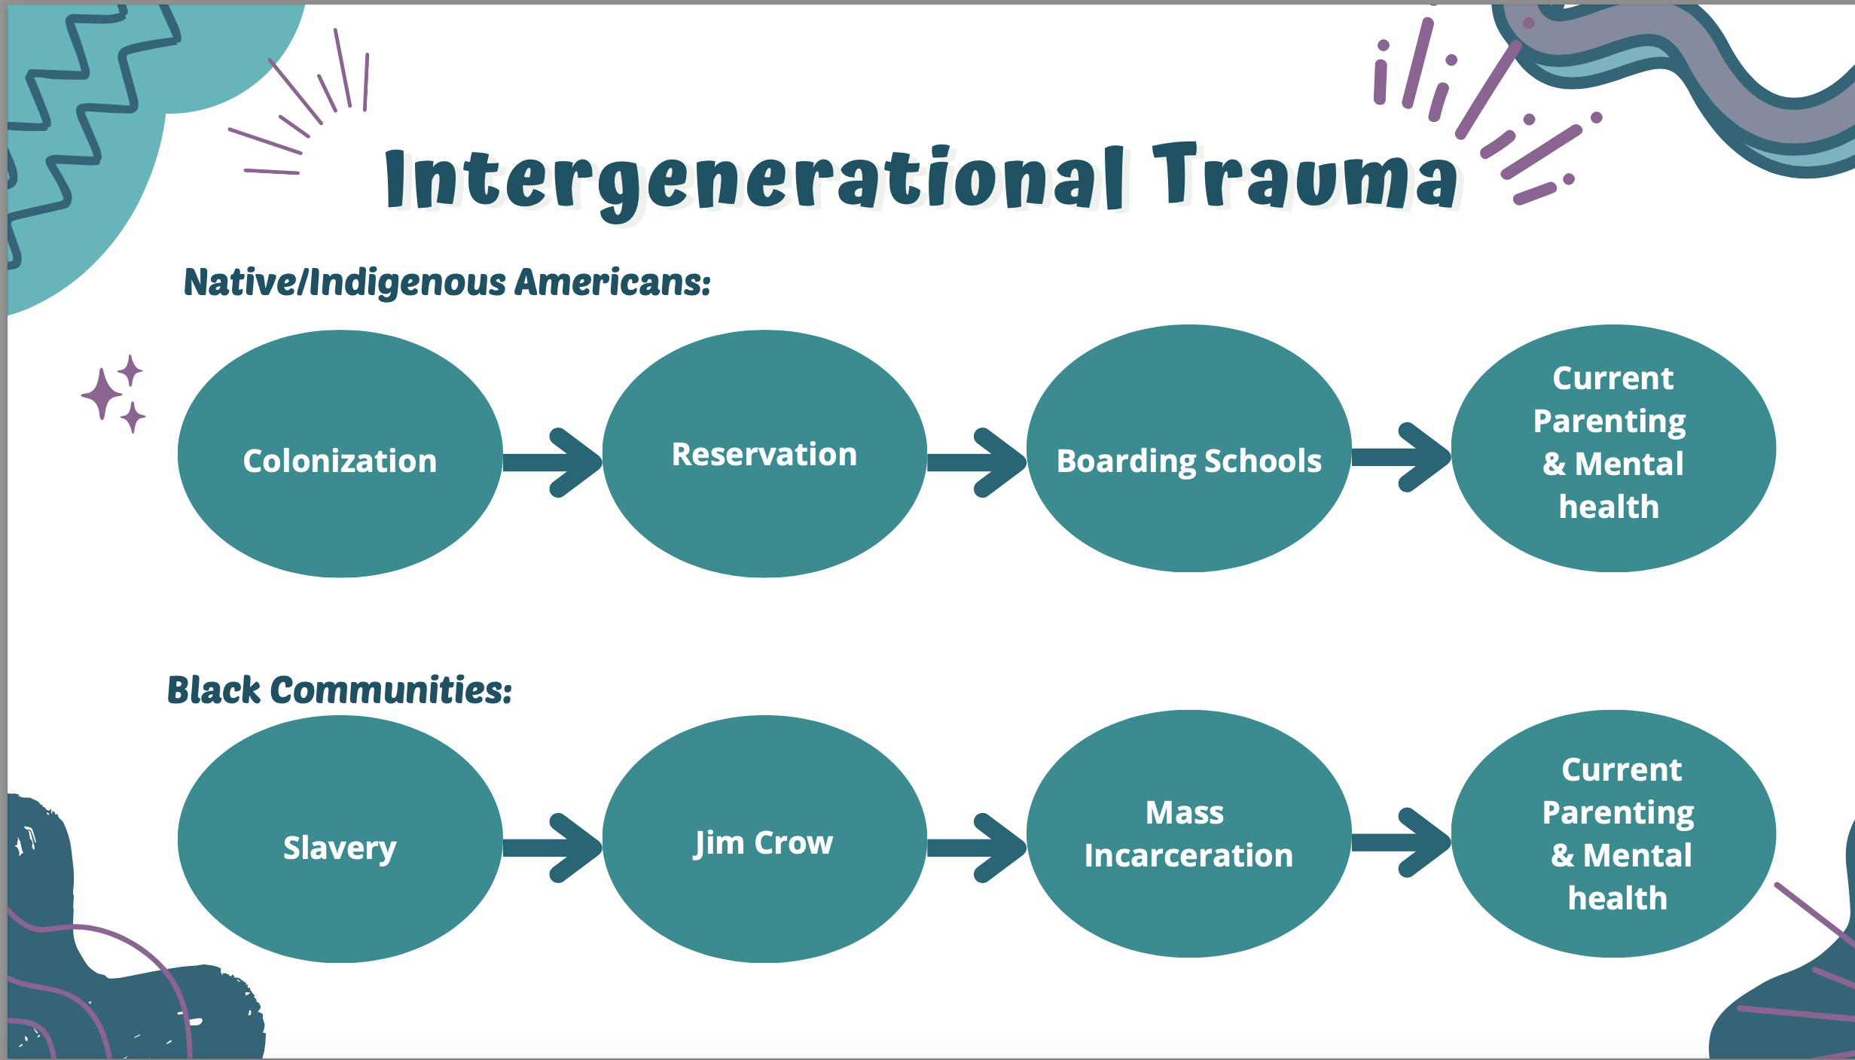

Slide 6
What is trauma? (1)
  Results from a singular event, series of events, or set of circumstances experienced as physically or emotionally harmful or life-threatening w/lasting adverse effects on functioning and overall well-being (Substance Abuse and Mental Health Services Administration [SAMHSA], 2014).
  Uncontrollable characterized by potential to overwhelm sense of coping skills (Briere & Scott, 2015).
  Examples: natural disasters, violence, and war (American Psychological Association, 2017); child abuse and household dysfunction (Felitti et al., 1998); and community exposures (Cronholm et al., 2015).
Notes:
Has anyone taken a trauma-informed care workshop?
> Individual trauma results from a singular event, series of events, or set of circumstances that are experienced as physically or emotionally harmful or life threatening and that have lasting adverse effects on an individual’s functioning and overall well-being (Substance Abuse and Mental Health Services Ad- ministration [SAMHSA], 2014).
> uncontrollable in nature and characterized by the potential to overwhelm one’s sense of coping skills (Briere & Scott, 2015).
Examples include natural disasters, violence, and war (American Psychological Association, 2017); child abuse and household dysfunction (for example, parent with a mental illness or substance abuse issue; Felitti et al., 1998); and community exposures (for example, community violence, bullying, chronic poverty; Cronholm et al., 2015)
Briere, J., & Scott, C. (2015). Complex trauma in adoles- cents and adults. Psychiatric Clinics, 38, 515–527.
American Psychological Association. (2017). Trauma. Retrieved from http://www.apa.org/topics/trauma/
Felitti, V. J., Anda, R. F., Nordenberg, D., Williamson, D. F., Spitz, A. M., Edwards, V., & Marks, J. S. (1998). Relationship of childhood abuse and house- hold dysfunction to many of the leading causes of death in adults: The Adverse Childhood Experiences (ACE) Study. American Journal of Preventive Medicine, 14, 245–258.
Cronholm, P. F., Forke, C. M., Wade, R., Bair-Merritt, M. H., Davis, M., Harkins-Schwarz, M., et al. (2015). Adverse childhood experiences: Expanding the concept of adversity. American Journal of Preventive Medicine, 49, 354–361.

Slide 7
What is trauma? (2)
  Marginalized groups more likely to experience traumatic events from community or sociopolitical violence throughout life span (Koenen et al., 2017).
  Impact amplified by socio-cultural contexts of discrimination and structural inequalities (Quiros & Berger, 2015; Seng, Lopez, Sperlich, Hamama, & Reed Meldrum, 2012).
  Exposed individuals may experience changes in cognition and memory, and experience heightened or hypo physiological arousal (van der Kolk, 2003).
  More vulnerable to toxic stress
Notes:
> As Dr. Feguson described, marginalized groups are more likely to experience traumatic events by way of community or sociopolitical violence throughout the life span (Koenen et al., 2017).
> impact of traumatic events is augmented by socio- cultural contexts that involve discrimination and structural inequalities, which are a daily reality for some groups (Quiros & Berger, 2015; Seng, Lopez, Sperlich, Hamama, & Reed Meldrum, 2012), pointing to the intersection and complexity of trauma experienced by marginalized populations.
> Individuals exposed to a significantly traumatic event may experience alterations in cognition (that is, perceptions of oneself, relationships with others and the world) and memory (for example, intrusive thoughts or fragmented memory), and experience heightened physiological arousal (for example, easily startled, impulse control) or hypo arousal (numbing, low affect or dissociation) (van der Kolk, 2003). If unresolved, can become maladaptive.
> More vulnerable to toxic stress, which can alter stress response system (fight or flight)
Koenen, K., Ratanatharathorn, A., Ng, L., McLaughlin, K., Bromet, E., Stein, D., et al. (2017). Posttraumatic stress disorder in the World Mental Health Surveys. Psychological Medicine, 47, 2260–2274.
Quiros, L., & Berger, R. (2015). Responding to the socio- political complexity of trauma: An integration of the- ory and practice. Journal of Loss and Trauma, 20(2), 149–159.
Seng, J. S., Lopez, W. D., Sperlich, M., Hamama, L., & Reed Meldrum, C. D. (2012). Marginalized identi- ties, discrimination burden, and mental health: Em- pirical exploration of an interpersonal-level approach to modeling intersectionality. Social Science & Medi- cine, 75, 2437–2445.
van der Kolk, B. A. (2003). The neurobiology of childhood trauma and abuse. Child and Adolescent Psychiatric Clin- ics of North America, 12, 293–318.

Slide 8
What does it mean to be trauma-Informed?
  Center survivors’ well-being in all interactions, decisions, and program practices
  (Campbell et al., 2019)
    SAMHSA (2014) proposed six guiding tenets of Trauma-informed care (TIC):
      Safety of all people served;
      Trustworthiness and transparency of operations and decisions;
      Peer support and mutual self-help;
      Collaboration and leveling of power differentials;
      Empowerment, voice, and choice; and
      Addressing cultural, historical, and gender issues.
Notes:
> service providers must center survivors’ well-being in all interactions, decisions, and program practices (Campbell et al., 2019)
Trauma-informed care (TIC)
SAMHSA (2014) proposed six guiding tenets for the implementation of TIC in clinical settings: (1) the safety of all people within and served by the agency; (2) trustworthiness and transparency of operations and decisions; (3) peer support and mutual self-help; (4) collaboration and leveling of power differentials across the agency; (5) empowerment, voice, and choice; and (6) addressing cultural, historical, and gender issues that may affect services.
Campbell, R., Goodman-Williams, R., & Javorka, M. (2019). A trauma-informed approach to sexual violence research ethics and open science. Journal of interpersonal violence, 34(23-24), 4765-4793.

Slide 9
Research modification: What does it mean to use a trauma-Informed Social Justice Research Framework?
  Empowerment. Voice. Choice. Transparency.
    Realize the widespread impact of trauma;
    Recognize signs and symptoms of trauma in all involved in the research study;
    Respond by integrating knowledge about trauma into research policies, procedures, and practices;
    Seek to actively resist re-traumatization.
      Emphasize potential for emotional distress during informed consent, assessment of participant reactions, and close examination of study phases most likely to revictimize participants, such as eligibility screening (Carlson et al., 2003).
Notes:
Empowerment. Voice. Choice. Transparency.
- key tenets of TISJR
Modifying for research: (1) realizing the widespread impact of trauma and understanding potential paths for healing and recovery; (2) recognizing the signs and symptoms of trauma in all of those involved in the research study (participants and researchers); (3) responding by fully integrating knowledge about trauma into research policies, procedures, and practices; and (4) seeking to actively resist re-traumatization.
Current guidelines to minimize re-traumatization include emphasizing the potential for emotional distress during informed consent, assessment of participant reactions, and close examination of study phases most likely to revictimize participants, such as eligibility screening (Carlson et al., 2003).
Carlson, E. B., Newman, E., & Loewenstein, R. J. (2003). Distress in response to and perceived usefulness of trauma research interviews. Journal of Trauma & Disso- ciation, 4(2), 131–142.

Slide 10
Realize, Recognize, Respond
  .
    Center participant’s voices – qual and mixed methods (Voith et al.)
    Understand historical, sociopolitical, and cultural context of the impact of individual, community, and historical trauma. [Like CRT research framework]
      Elicit insights from community partners or advisory board
      Use program data
      Certificate of confidentiality
Notes:
Work to center participant’s voices to build platforms for disempowered groups to speak their truth (Voith et al) – pointing to importance of qual and mixed methods research
Researchers must first understand the historical, sociopolitical, and cultural context of the population of interest to realize the widespread impact of individual, community, and historical trauma through a social justice lens. [This is very similar to CRT research framework]
> Bullets of ways to do this
Case study example – accessed program data on participants exposure to ACEs and PTSD to inform study design
Certificate of confidentiality option
Voith, L. A., Hamler, T., Francis, M. W., Lee, H., & Korsch-Williams, A. (2020). Using a trauma-informed, socially just research framework with marginalized populations: Practices and barriers to implementation. Social Work Research, 44(3), 169-181.

Slide 11
    Seek to actively resist re-traumatization
    Issue of cognition overload for those who’ve experienced trauma
      Order of high intensity questions
      “Refuse to answer” option
      How administered – by researcher or self?
      Location
      Use of language
      Closing – debrief, grounding, referrals
    Assess power differentials
      Roles
      Openly acknowledge potential mistrust
      Own affect & affirming statements
  Favor co-production of knowledge and solutions with communities.
Notes:
Issue of cognition overload for those who’ve experienced trauma – how can study procedures account for this?
Order – high intensity when not yet fatigued
Location – safe, comfortable, convenient, can control environment, snacks, checking in if self-administered, protocols to address distress
Language should be short and simple, check for understanding, ask before moving on to give choice and power
Closing
Assess power differentials – who is recruiting (in case study limited role of probation officers), who is collecting data?
Tuskegee as example of why there may be mistrust

Slide 12
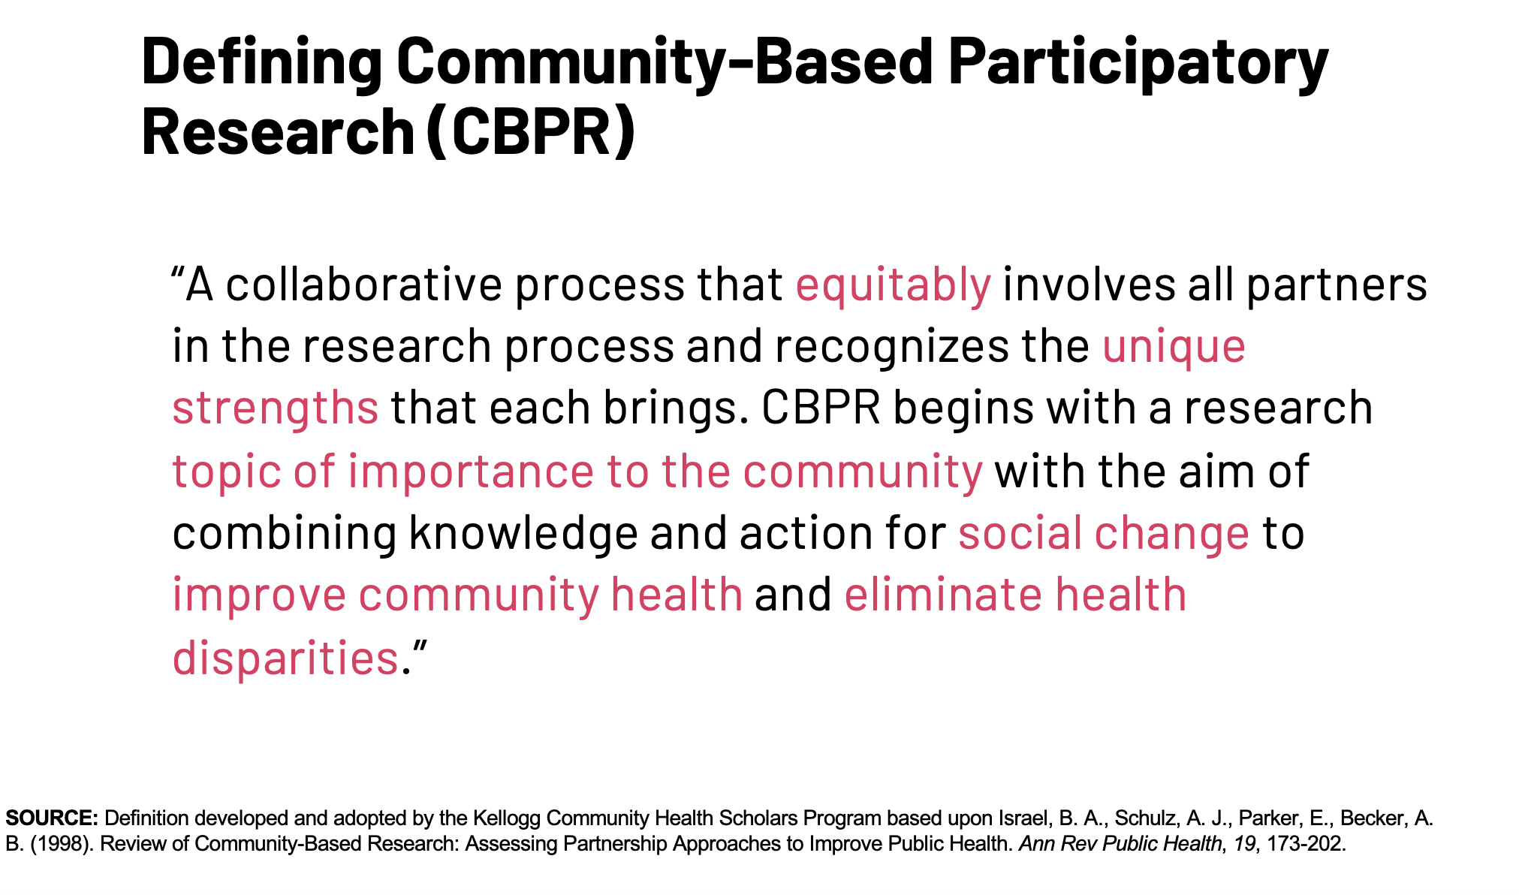
Recommends use of participatory action research methods, as we
learned about with Dr. Kristin Black during our April 2024 CoP!
Notes:
Reminder of Dr. Black’s workshop!

Slide 13
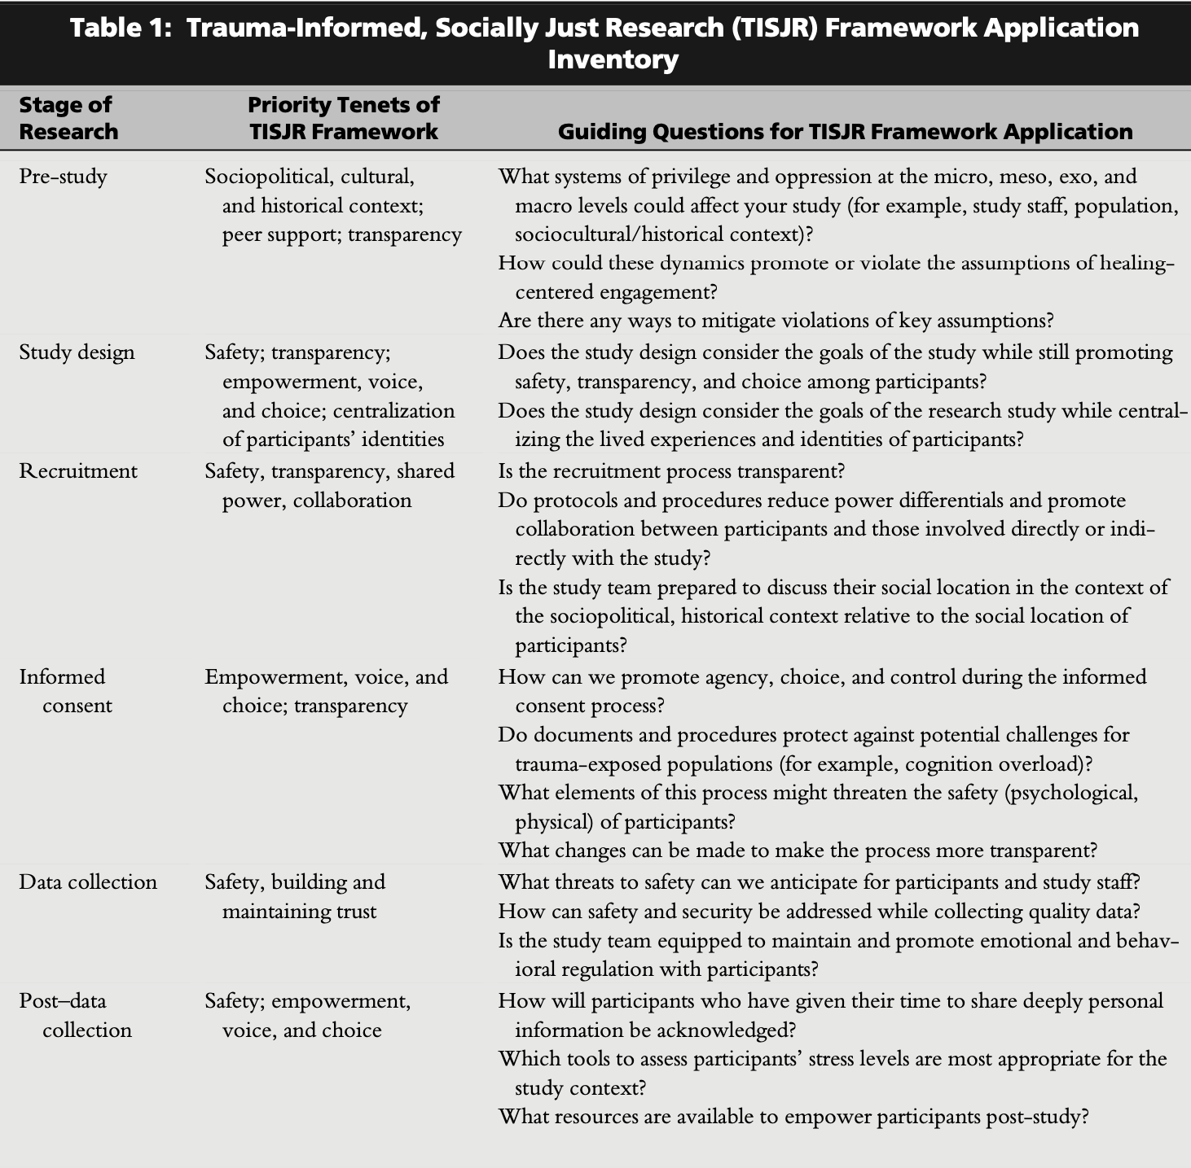
Source: Voith et al., 2020
Notes:
Idea: Workshop participants could be broken into 6 small groups and assigned a research stage, respond to the questions for their setting, and share back
Drop table in chat for reference.
Voith, L. A., Hamler, T., Francis, M. W., Lee, H., & Korsch-Williams, A. (2020). Using a trauma-informed, socially just research framework with marginalized populations: Practices and barriers to implementation. Social Work Research, 44(3), 169-181.

Slide 14

Closing question: How can we put some of these ideas into action?
Notes:
Share key ideas from groups, if time.
Ask closing question – respond verbally and/or in chat
Will share this and some other resources out in a follow-up message.

