Slide 1
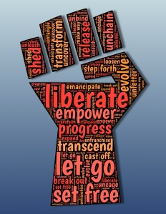
Racial Equity in Educare
February CoP 2/10/2023
Adapted and facilitated by Dr. Iheoma Iruka and Dr. Allison De Marco, of the Educare National Evaluation Partner at the
Frank Porter Graham Child Development Institute, University of North Carolina – Chapel Hill. ©2023

Slide 2

Overview
Brief discussion about plans for next few sessions
Social identity mapping and research/evaluation

Slide 3
social identity mapping
“The use of the Social Identity Map promotes social justice–oriented research by encouraging researchers to deeply reflect on how their positionality impacts the individuals they directly work with, the research they produce, and how that research impacts the studied populations and societal perceptions of them.” (Jacobson & Mustafa, 2019)
Source: Jacobson, D., & Mustafa, N. (2019). Social Identity Map: A Reflexivity Tool for Practicing Explicit Positionality in Critical Qualitative Research. International Journal of Qualitative Methods, 18. https://doi.org/10.1177/1609406919870075

Slide 4
refresh
What is positionality?
The ‘position’ from which we see and interpret the world (and how the world sees and interprets us)
Our position is affected by how, where and when we are located in society.
Understanding our social positions helps us to understand our relations with and to others, especially the community members we may work with through our research and evaluation activities.
We are better able to understand the power dynamics that operate in these relationships when we understand our own position in society.
Notes:
Our positionality is fluid. Some of our identities have more sociopolitical weight at different times.

Slide 5
Social identity wheel
Create a visual of your identity wheel (~ 7mins)
  make smaller the identities that you are most aware of
  make bigger the identities you are least aware of
Answer the self-reflection questions by yourself to think about how your unique characteristics (and their associated emotions) impact your life and research/evaluation practices (~8 mins)
Small group discussion about how your social identity may impact your research/evaluation (~10 mins)
Group share & close out (~ 8 mins)
Notes:
Mapping your social identity will help you to understand your position in a social context.

Slide 6
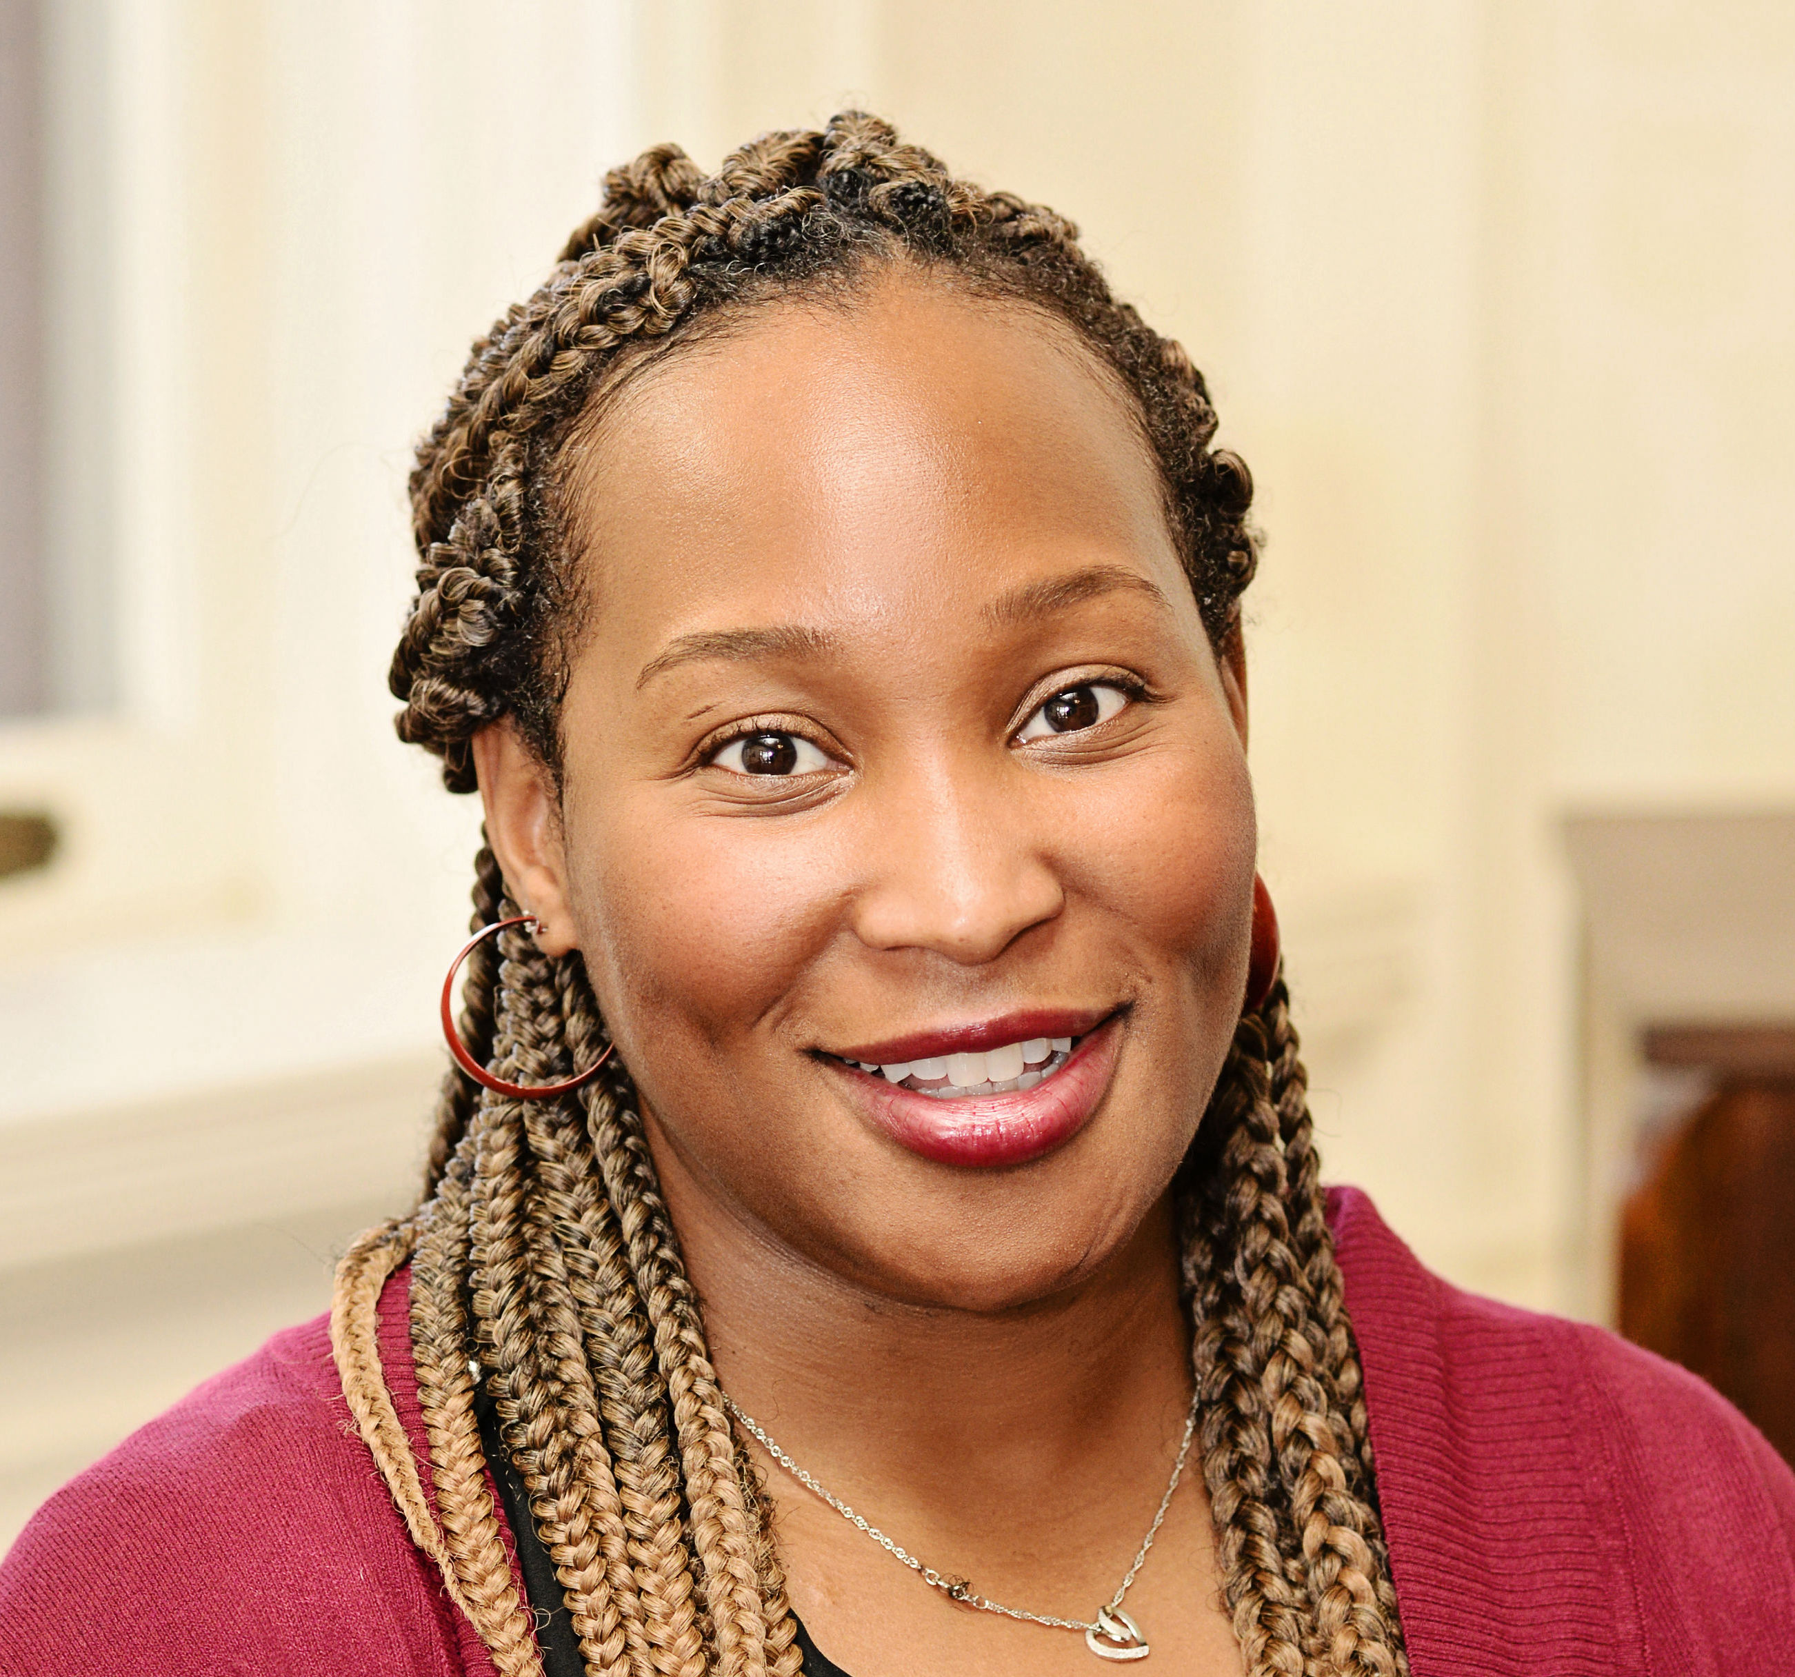
Example: My Intersecting social identities
Educated
Able
Age
US Citizen
Heterosexual
Female
Black
Mother
Christian
Wife
PhD
Food Secure
English Speaker
Middle-income

Slide 7
Self-reflection Questions
The part of my identity that I am most aware of on a daily basis is __________.
The part of my identity that I am the least aware of on a daily basis is __________.
The part of my identity that was most emphasized or important in my family growing up was __________.
The part of my identity that I wish I knew more about is ________.
The part of my identity that I believe is the most misunderstood by others is __________.
The part of my identity that I feel is difficult to discuss with others who identify differently is ________________________.
The part of my identity that aligns with privilege and power is ____________?

Slide 8
Group discussion Questions
Who are you?
How does your identity shape your research/evaluation role, such as your interaction with participants or community members?
How do your experiences, beliefs, and ideology impact the way you approach the evaluation, including questions, theoretical framework, methodology, and dissemination?
Do you have blind spots?

Slide 9



small group share out
This Photo by Unknown Author is licensed under CC BY-ND

