Slide 1

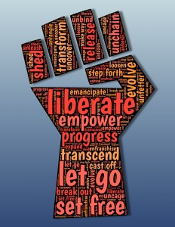
Racial Equity in Educare
February 2025 CoP
2/14/2025
Accountability & White Supremacy Culture Revisited

Slide 2



Community Commitments
[co-created Feb-Mar 2021, revisited June 2023]
Make space and take space
Create safe & supportive space – listen actively, be present, be respectful
Share authentic selves
Consider other viewpoints
Assume best intentions (assume everything is a first draft)
Commit to co-creation
Be accountable
Commit to pushing through discomfort

Slide 3

REMINDER: OUR PROGRESS-
Paired T-tests for Anti-Bias Knowledge, Attitudes, Beliefs, and Practices
 | Baseline Mean | SD | Follow-up Mean | SD | t | Sig (2-tailed)
Knowledge about Race, Racism, and Racial Equity Survey (K3RS) | 3.47 | 0.44 | 3.49 | 0.42 | 0.39 | 0.70
Color-Blind Racial Attitudes Scale (CoBRAS) | 5.56 | 0.35 | 5.48 | 0.36 | -1.10 | 0.29
Teacher Beliefs about Race and Culture | 5.04 | 0.50 | 5.13 | 0.37 | 1.34 | 0.20
Culturally Responsive Anti-Bias Practices (with families) | 2.65 | 1.23 | 3.22 | 0.96 | 2.59 | 0.02*

Slide 4
Changes over time
Between the baseline and the follow-up:
There was a significant increase in participation in racial equity training from 56% to 89%.
The percentage of CoP members who engaged in equity work outside Educare also rose from 76% to 84%, and
Members reported an increased occurrence of racial equity activities (17% to 26%) as part of their annual review.

Slide 5
“[N]ow that we know better, we have to do better,”
02
Having a more critical eye towards equitable practice: included increased personal reflection and intentionality to address harm and provide support and address bias
01
Changes to research methods or process
Four themes emerged from responses to how research practices have changed
03
04
More education for oneself and team
More equitable hiring/creating more inclusive teams
Notes:
Qualitative analysis – thanks Zach! Four key themes emerged from responses to how research practices have changed from the open-ended questions: changes to research methods or process (20), having a more critical eye towards equitable practice (8), more education for oneself and team (8), and more equitable hiring/creating more inclusive teams (4).

Slide 6
Recruitment and Retention (n=20)
 | Yes | Successful?
Recruitment practices been updated to seek more inclusive staff | 14 (70%) | 11/14 (79%)
Retention practices been updated to retain diverse staff | 13 (65%) | 10/13 (77%)
Notes:
Informal follow-up data collection last to understand progress – Last spring. Will revisit in March.

Slide 7
Equitable Practices
(n=19-21)
Notes:
Pink = review publications to make sure to cite scholars of color
Orange = Disaggregate data by race/ethnicity

Slide 8
CoP and racial equity training participation (n=21)
 | Yes | No
All LEP staff participate in CoP (or are invited) | 11 (52%) | 10 (48%)
LEP staff including data collectors participate in racial equity training | 17 (81%) | 4 (19%)

Slide 9
Family engagement with data
Of the 20 responses, 15 sites have ways for families to engage with the data (75%).

Slide 10
How often dissemination of products includes (n=21)
Notes:
Pink = community
Orange – School staff (teachers, directors, family engagement specialists)
Yellow = Families

Slide 11
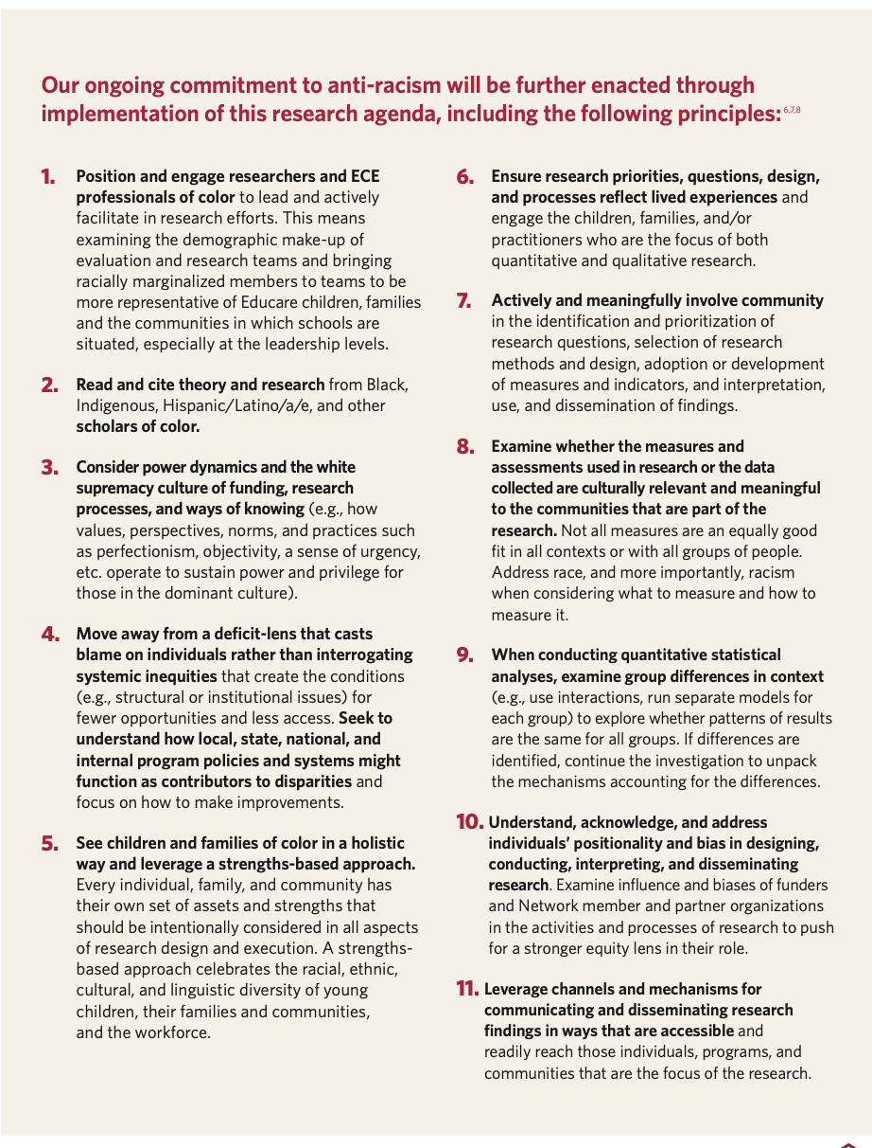


Educare Network’s Research Agenda: Advancing Racial Equity
Notes:
https://www.educareschools.org/app/uploads/2023/09/Educare-Research-Agenda-on-Racial-Equity_Final.pdf

Slide 12
White Supremacy Culture
[Source: Tema Okun, dRworks]
Culture = Shared patterns of behaviors and interactions, cognitive constructs, and affective understanding that are learned through a process of socialization (Center for Advanced Research on Language Acquisition).
White supremacy = A system that maintains legal, political, and economic privilege for white people (PBS Learning Media)
Manifestations aren’t good or bad per se but they are accepted without question or negotiation and can lead to oppression.
Notes:
culture is defined as the shared patterns of behaviors and interactions, cognitive constructs, and affective understanding that are learned through a process of socialization. These shared patterns identify the members of a culture group while also distinguishing those of another group.
- the term white supremacy refers to a system that maintains legal, political, and economic privilege for white people. It includes, for example, discriminatory laws against African Americans and other people of color; an absence of protection for such groups; police and other public servants who enforce discriminatory laws; and individual citizens who obey those laws.
- codified in our institutions…”institutional racism is often evident as inaction in the face of need”
combination of historical events and contemporary structural factors
- Because we all live in a white supremacy culture, these characteristics show up in the attitudes and behaviors of all of us – people of color and white people. Therefore, these attitudes and behaviors can show up in any group or organization, whether it is white-led or predominantly white or people of color-led or predominantly people of color. It is our unwitting perpetuation of these behaviors that maintains our racial hierarchy.

Slide 13

Manifestations of White Supremacy Culture
Perfectionism
Sense of Urgency
Defensiveness
Quantity over Quality
Worship of the Written Word
Only One Right Way
Paternalism
Either/Or Thinking
Power Hoarding
Fear of Open Conflict
Individualism
I’m the Only One
Progress is Bigger, More
Objectivity
Right to Comfort
Notes:
Summarize
Instances
Antidotes

Slide 14
Activity: Manifestations of White
Supremacy Culture
  Manifestations
  How they are oppressive
  Antidotes
https://www.dismantlingracism.org/uploads/4/3/5/7/43579015/okun_-_white_sup_culture.pdf
Notes:
Each team of 4-5 will have several items from the Okun article
Summarize your characteristic
note three ways they’ve seen this manifest then
provide concrete areas for action
Try to be succinct! We have 15 to learn about
Take notes to enter in the chat during report back.
https://www.dismantlingracism.org/uploads/4/3/5/7/43579015/okun_-_white_sup_culture.pdf

Slide 15
Group assignment
Group 1: Perfectionism to Defensiveness
Group 2: Perfectionism to Defensiveness
Group 3: Defensiveness to Worship of the Written Word
Group 4: Worship of the Written Word to Paternalism
Group 5: Paternalism to Power Hoarding
Group 6: Power Hoarding to Individualism
Group 7: Power Hoarding to Individualism
Group 8: Individualism to Progress is Bigger, More
Group 9: Progress is Bigger, More to Right to Comfort
Group 10: Progress is Bigger, More to Right to Comfort
Notes:
Please note your group #
Group 1: Perfectionism to Defensiveness
Group 2: Perfectionism to Defensiveness
Group 3: Defensiveness to Worship of the Written Word
Group 4: Worship of the Written Word to Paternalism
Group 5: Paternalism to Power Hoarding
Group 6: Power Hoarding to Individualism
Group 7: Power Hoarding to Individualism
Group 8: Individualism to Progress is Bigger, More
Group 9: Progress is Bigger, More to Right to Comfort
Group 10: Progress is Bigger, More to Right to Comfort

Slide 16
  Report out
  Reflection:
  What resonated with me?
  What can I do in my work?
  Where are my spheres of influence?
Notes:
Silent reflection
end with silent free write about what I can do, what I can do in my work, where are my spheres of influence – this can be about any of this that resonated with you and not just the characteristic that your group shared about.
Use your reflection to guide your homework – what do you notice?

Slide 17
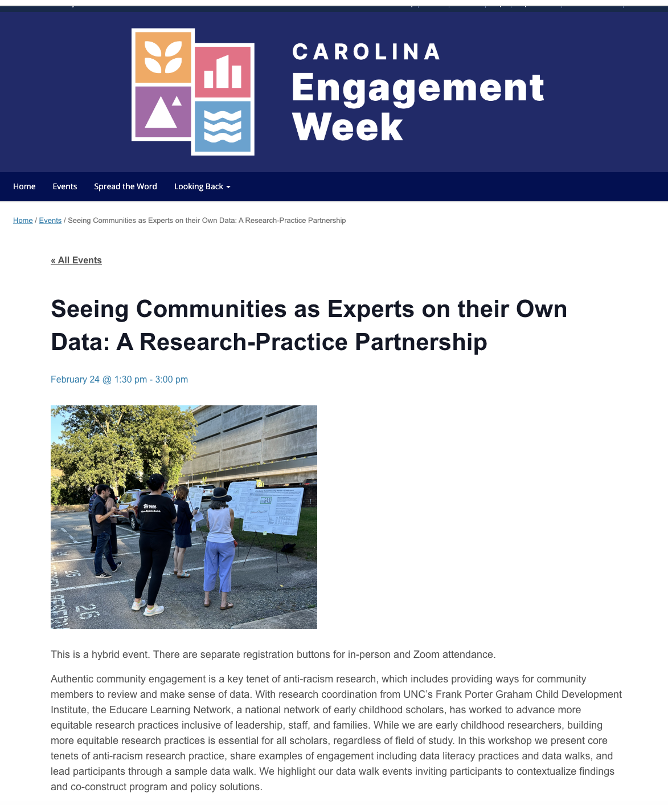

Disseminating our work!
Notes:
https://engagementweek.unc.edu/event/seeing-communities-as-experts-on-their-own-data-a-research-practice-partnership/

