Slide 1
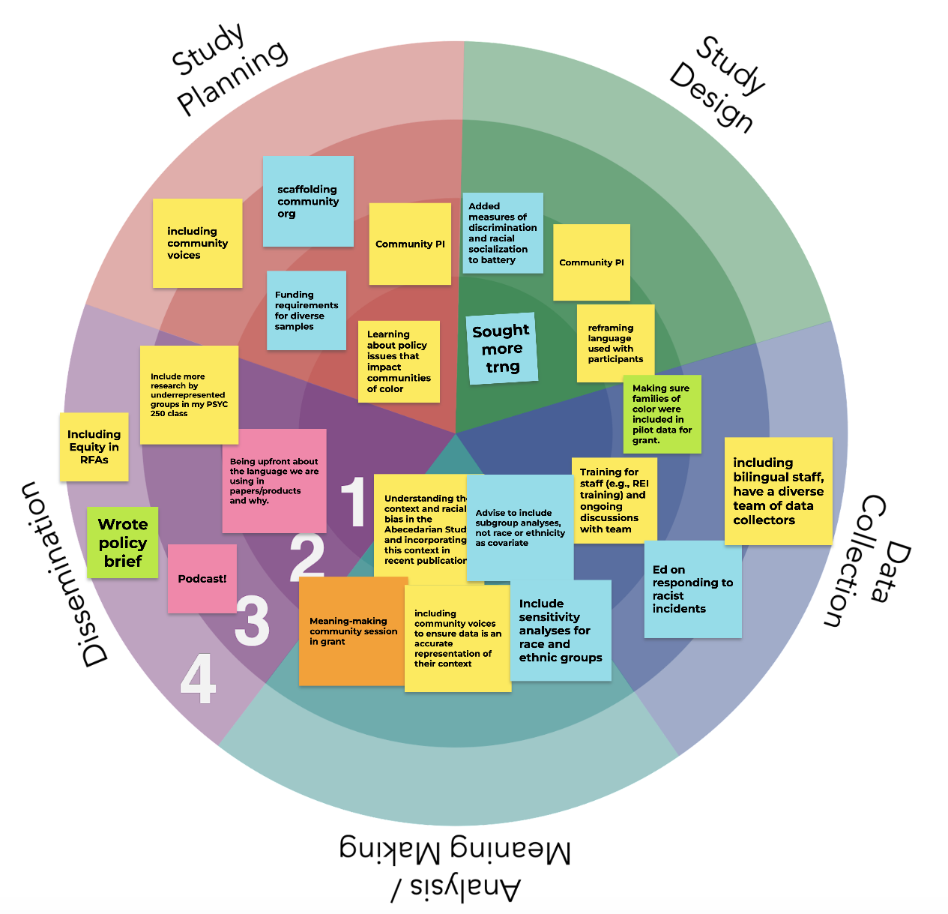
Using Ripple Effects Mapping (REM) Summary
Racial Equity in Educare
July 2026 LEP CoP
7/10/26

Slide 2
Recap: Racial Equity Programming
July 2026 LEP Cop
September 2020: Started our programming with Racial Equity Goal-setting activity
Guest speakers: Dawn A. Yazzie, Navajo Nation; Paul Gorski, Equity Literacy Institute; Fabienne Doucet, Metropolitan Center for Research on Equity and the Transformation of Schools (x2); Kristin Black, UNC Gillings School of Public Health; Anjali Ferguson, Parenting Culture; Amber Sansbury-Scott, Institute for Research on Poverty
Monthly reports from LEPs
Operationalizing and implementing principles from our Research Agenda: Advancing Racial Equity
Creating our Logic Model
Collecting and sharing results of data collection on our progress
Key topics: Practices for accountability, identity mapping, measurement of race, positionality statements, 21-Day Racial Equity Challenge & Processing
Sharing Language Summit Learning – Why Inclusive Language Matters, How we Talk about Race/Ethnicity, Gender-Inclusive Language, Person-first and Identity-first language
Notes:
Drop/remind folks of full inventory

Slide 3
Topics Over Last 18 months
June 2026 LEP Cop
Year | Month | Topic
2025 | January | RPP work
 | February | Revisit community commitments, accountability, and white supremacy culture
 | March | RPP work
 | April | Discussion about current work and strategies for moving forward
 | May | Network Meeting
 | June | Critical Hope Activity
 | July | Discussion of Tableau reports and closing out the year
 | August | Pre-empted for leadership conversation, to pick up in September
 | September | Language revisions for our current times
 | October | Storytelling activity
 | November | Workshop with Dr. Anjali Ferguson on cultural humility in practice with children and families.
 | December | Data Camp
2026 | January | Trauma-Informed Social Justice Research Framework
 | February | RPP toolkits & Community-engaged research accountability systematic review opportunity
 | March | Paper group reports
 | April | Introduction to the REACH Tool: Report of Engagement in Community Research
 | May | RPP practices
 | June | Ripple Effects Mapping (REM) to document impacts of CoP activities

Slide 4
Recap: Ripple Effects Mapping (REM; Emery et al, 2015)
July 2026 LEP Cop
  A participatory approach to evaluate complex interventions
  Map the impacts of an intervention at various levels (ripples)
    first ripple: personal
    second ripple: team/interpersonal
    third ripple: organization/community
    (fourth ripple: policy)
  Use community process to brainstorm impacts
  Explore unintended or distal impacts
  Consensus to add impacts to map
  Members vote on biggest impact(s)
  Source: Emery, M., Higgins, L., Chazdon, S., & Hansen, D. (2015). Using ripple effect mapping to evaluate program impact: Choosing or combining the methods that work best for you. Journal of Extension, 53(2).
Notes:
Note we did not need to do the final 2 bullets in our process.

Slide 5
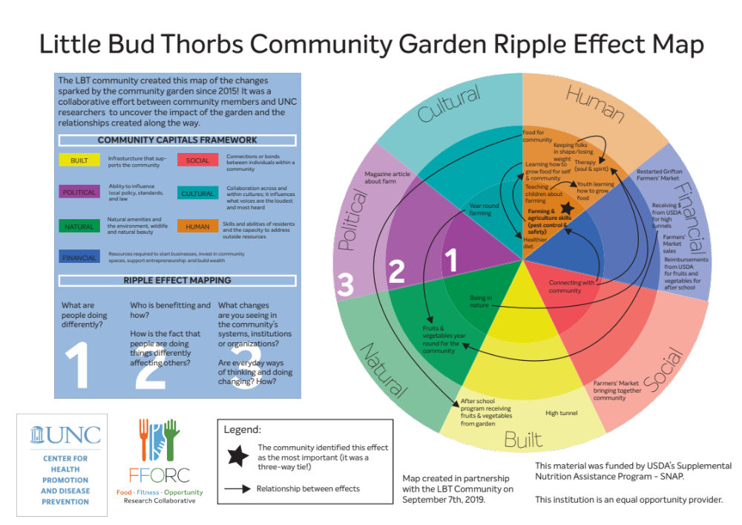
REM Example
June 2026 LEP Cop
Notes:
Describe community garden example
Social/community systems: Farmer’s Markets Bringing together community
Human/level 2 (who is benefitting): Youth learning how to grow food
Big star – community identified the most important effect
Arrows = relationships between effects

Slide 6
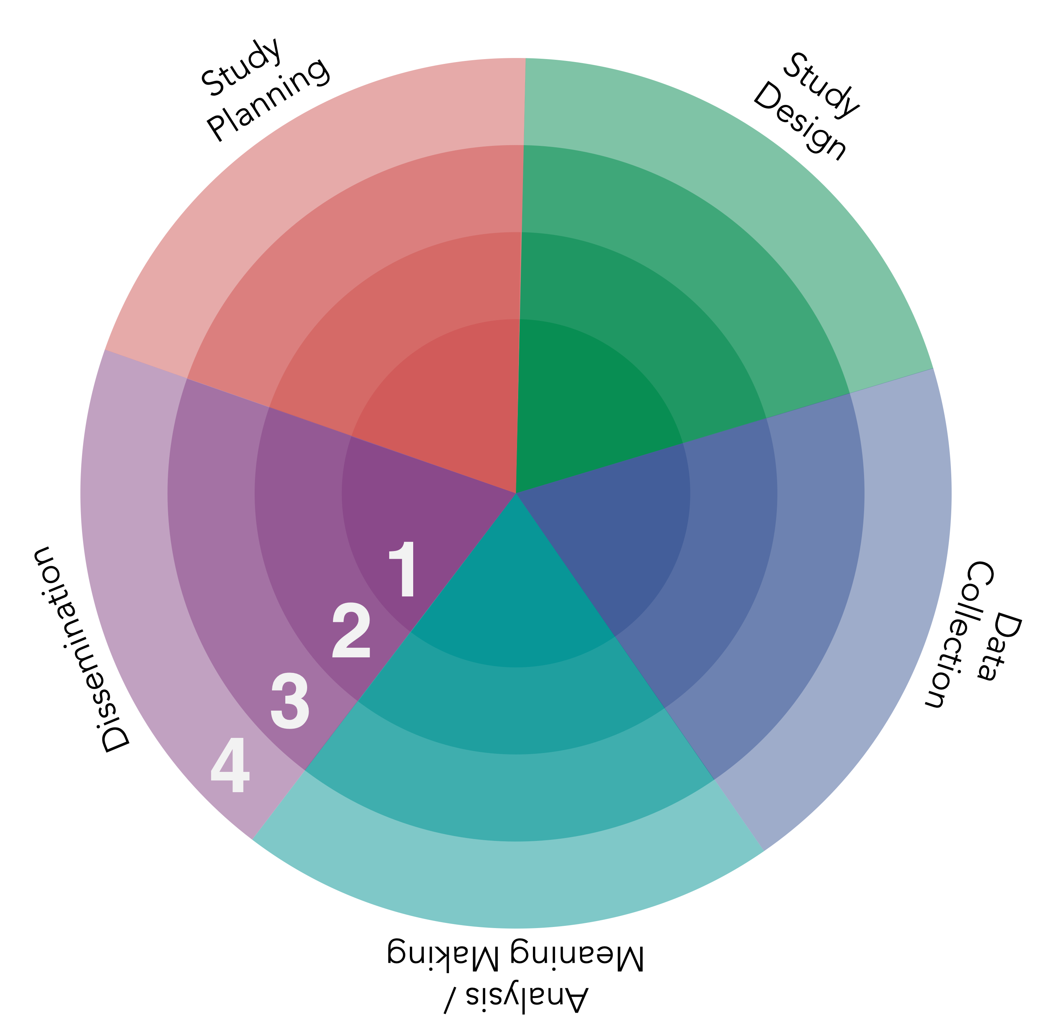
July 2026 LEP Cop
Recap: Small group discussion questions
  Where have you seen impacts in each ripple?
  What unexpected things have happened as a result of your involvement in these efforts?
Ripples:
1 = Self
2 = Team
3 = Organization
4 = Community & Policy
Notes:
Describe
https://canva.link/rzbvzo1f5x0l0td

Slide 7
REM Mapping Process
June 2026 LEP Cop
Small group discussion questions
  Where have you seen impacts in each ripple?
  What unexpected things have happened as a result of your involvement in these efforts?
Notes:
Brainstorm with each other looking at REM map
To drop in chat: Thanks Kalen!
https://canva.link/rzbvzo1f5x0l0td
Break outs of 2-4 (depending on #s) and 12-15 minutes.

Slide 8
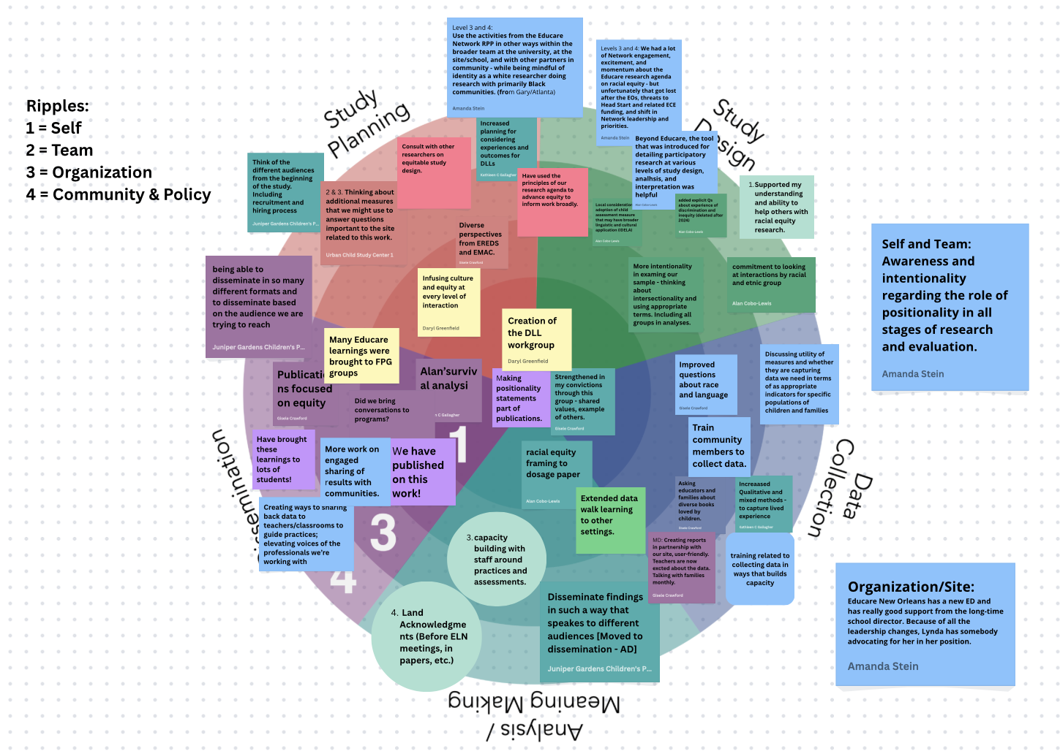

Slide 9
Ripple Summary
July 2026 LEP Cop
  Self ripple, the dissemination stage = most impacts (3; “Making positionality statements part of publications.”).
  Team ripple, most common = study design (3; “More intentionality in examining our sample - thinking about intersectionality and using appropriate terms. Including all groups in analyses.”).
  Organization ripple, study planning = most impacts (5; “Use the activities from the Educare Network RPP in other ways within the broader team at the university, at the site/school, and with other partners in community - while being mindful of identity as a white researcher doing research with primarily Black communities.”).
  Community/policy ripple, dissemination = most impacts (5; “Sharing back data to teachers/classrooms to guide practices; elevating voices of the professionals we’re working with”).
Notes:
>For the self ripple, the dissemination stage had the most impacts (3; “Making positionality statements part of publications.”).
> For the team ripple, the most common was study design (3; “More intentionality in examining our sample - thinking about intersectionality and using appropriate terms. Including all groups in analyses.”).
> For the organization ripple, study planning saw the most impacts (5; “Use the activities from the Educare Network RPP in other ways within the broader team at the university, at the site/school, and with other partners in community - while being mindful of identity as a white researcher doing research with primarily Black communities.”).
> community/policy ripple, dissemination, again, saw the most impacts (5; “Sharing back data to teachers/classrooms to guide practices; elevating voices of the professionals we’re working with”).

Slide 10
Additional Ripple Summary
July 2026 LEP Cop
The organization level and the community/policy level were where the most impacts were identified with 14 each.
  Org: “Beyond Educare, the tool that was introduced for detailing participatory research at various levels of study design, analysis, and interpretation was helpful [REACH Tool].”
  Community/policy level: “Have used the principles of our research agenda to advance equity to inform work broadly.”
Self ripple least mentioned with just 9 impacts:
  “Strengthened in my convictions through this group - shared values, example of others.”
Notes:
The organization level and the community/policy level were where the most impacts were identified with 14 each.
self ripple received the least mention with just 9 impacts, though they were key to our work, like this one: “Strengthened in my convictions through this group - shared values, example of others.”

Slide 11
Research Phase Summary
July 2026 LEP Cop
Most impacts reported at the study planning phase (13) and the dissemination phase (11)
For study design there were 9 impacts
7 for data collection
5 for analysis/meaning-making
Notes:
Most impacts were reported at the study planning phase (13) and the dissemination phase (11)

Slide 12
Research Phase Key Themes
July 2026 LEP Cop
Study planning: creation of DLL group, positionality/identity awareness, infusion of culture and equity, new measures, additional perspectives, increased support.
Study design: better/new measures and tools, implementation of research agenda, provision of technical assistance, intentional/intersectional analysis
Data collection: Stronger connections, training of community to collect data, improved equity-related questions, methods to increase community voice
Data analysis/meaning-making: using equity framing, extension of methods to other settings, building staff capacity, use land acknowledgements
Dissemination: Publishing, additional methods, additional audiences, elevating voices
Notes:
These were the key themes at each research stage.

Slide 13
July 2026 LEP Cop
Ripple | Stage of Research | Impact
Self/Person (9) | Study Planning (2) | Creation of the DLL workgroup
 |  | Making positionality statements part of publications.
 | Study Design (1) | Creation of DLL workgroup
 | Data Collection (1) | Strengthened in my convictions through this group - shared values, example of others.
 | Data Analysis/Meaning-Making (1) | racial equity framing to dosage paper
 | Dissemination (3) | Making positionality statements part of publications.
 |  | Alan’s survival analysis
 |  | Did we bring conversations to programs?
 | Cross-cutting (1) | Awareness and intentionality regarding the role of positionality in all stages of research and evaluation.
Notes:
Give folks a chance to read over.

Slide 14
July 2026 LEP Cop
Team (10)
 | Study Planning (2) | Infusing culture and equity at every level of interaction
 |  | Thinking about additional measures that we might use to answer questions important to the site related to this work.
 | Study Design (3) | Local consideration of adoption of child assessment measure that may have broader linguistic and cultural application (IDELA)
 |  | More intentionality in examining our sample - thinking about intersectionality and using appropriate terms. Including all groups in analyses.
 |  | commitment to looking at interactions by racial and ethnic group
 | Data Collection (2) | Improved questions about race and language
 |  | Train community members to collect data.
 | Data Analysis/Meaning-Making (1) | Extended data walk learning to other settings.
 | Dissemination (1) | We have published on this work!
 | Cross-cutting (1) | Awareness and intentionality regarding the role of positionality in all stages of research and evaluation.
Notes:
Give folks a chance to read over.

Slide 15
July 2026 LEP Cop
Organization (14)
 | Study Planning (5) | Thinking about additional measures that we might use to answer questions important to the site related to this work.
 |  | Diverse perspectives from EREDS and EMAC.
 |  | Use the activities from the Educare Network RPP in other ways within the broader team at the university, at the site/school, and with other partners in community - while being mindful of identity as a white researcher doing research with primarily Black communities.
 |  | Educare New Orleans has a new ED and has really good support from the long-time school director. Because of all the leadership changes, Lynda has somebody advocating for her in her position.
 |  | Increased planning for considering experiences and outcomes for DLLs
 | Study Design (3) | We had a lot of Network engagement, excitement, and momentum about the Educare research agenda on racial equity - but unfortunately that got lost after the EOs, threats to Head Start and related ECE funding, and shift in Network leadership and priorities.
 |  | Beyond Educare, the tool that was introduced for detailing participatory research at various levels of study design, analysis, and interpretation was helpful [REACH Tool]
 |  | added explicit Qs about experience of discrimination and inequity (deleted after 2024)
 | Data Collection (2) | Increased Qualitative and mixed methods - to capture lived experience
 |  | Asking educators and families about diverse books loved by children.
 | Data Analysis/Meaning-Making (2) | capacity building with staff around practices and assessments.
 |  | Creating reports in partnership with our site, user-friendly. Teachers are now excited about the data. Talking with families monthly.
 | Dissemination (2) | being able to disseminate in so many different formats and to disseminate based on the audience we are trying to reach
 |  | Many Educare learnings were brought to FPG groups
Notes:
Give folks a chance to read over.

Slide 16
July 2026 LEP Cop
Community/Policy (14) | Study Planning (4) | Consult with other researchers on equitable study design.
 |  | Have used the principles of our research agenda to advance equity to inform work broadly.
 |  | Think of the different audiences from the beginning of the study. Including recruitment and hiring process
 |  | Use the activities from the Educare Network RPP in other ways within the broader team at the university, at the site/school, and with other partners in community - while being mindful of identity as a white researcher doing research with primarily Black communities.
 | Study Design (2) | We had a lot of Network engagement, excitement, and momentum about the Educare research agenda on racial equity - but unfortunately that got lost after the EOs, threats to Head Start and related ECE funding, and shift in Network leadership and priorities.
 |  | Supported my understanding and ability to help others with racial equity research.
 | Data Collection (2) | training related to collecting data in ways that builds capacity
 |  | Discussing utility of measures and whether they are capturing data we need in terms of as appropriate indicators for specific populations of children and families
 | Data Analysis/Meaning-Making (1) | Land Acknowledgments (Before ELN meetings, in papers, etc.)
 | Dissemination (5) | Disseminate findings in such a way that speaks to different audiences
 |  | Publications focused on equity
 |  | Have brought these learnings to lots of students!
 |  | More work on engaged sharing of results in communities.
 |  | Sharing back data to teachers/classrooms to guide practices; elevating voices of the professionals we’re working with
Notes:
Give folks a chance to read over.

Slide 17
Thoughts?

Slide 18
What will be a next step for you? Add to chat and/or share

