Slide 1
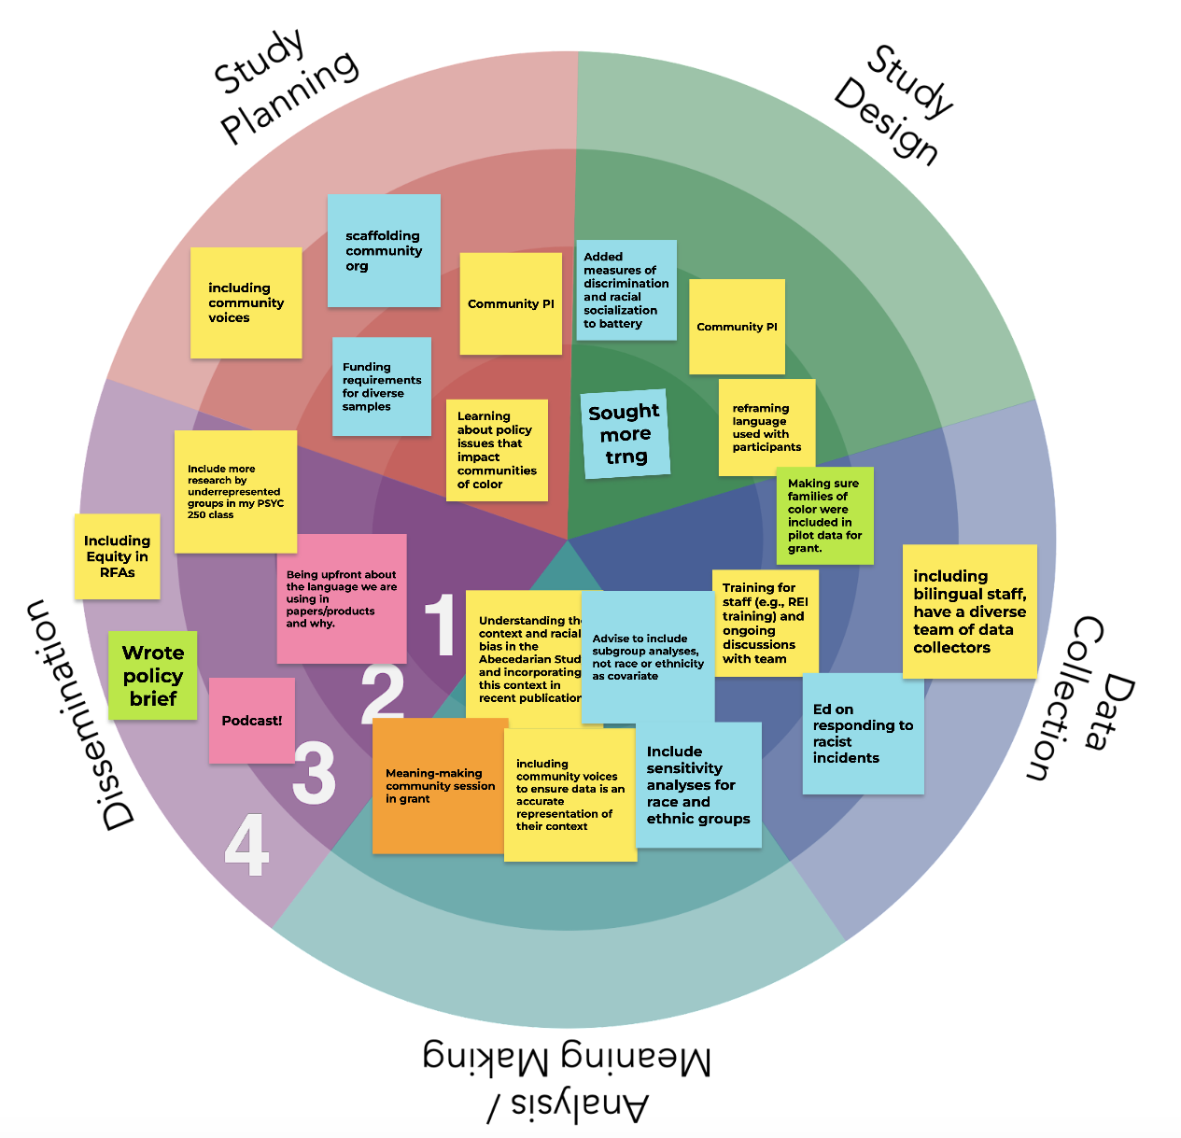
Using Ripple Effects Mapping (REM) to Document Impacts
Racial Equity in Educare
June 2026 LEP CoP
6/12/26

Slide 2
Racial Equity Programming
June 2026 LEP Cop
September 2020: Started our programming with Racial Equity Goal-setting activity
Guest speakers: Dawn A. Yazzie, Navajo Nation; Paul Gorski, Equity Literacy Institute; Fabienne Doucet, Metropolitan Center for Research on Equity and the Transformation of Schools (x2); Kristin Black, UNC Gillings School of Public Health; Anjali Ferguson, Parenting Culture; Amber Sansbury-Scott, Institute for Research on Poverty
Monthly reports from LEPs
Operationalizing and implementing principles from our Research Agenda: Advancing Racial Equity
Creating our Logic Model
Collecting and sharing results of data collection on our progress
Key topics: Practices for accountability, identity mapping, measurement of race, positionality statements, 21-Day Racial Equity Challenge & Processing
Sharing Language Summit Learning – Why Inclusive Language Matters, How we Talk about Race/Ethnicity, Gender-Inclusive Language, Person-first and Identity-first language
Notes:
Drop/remind folks of full inventory

Slide 3
Topics Over Last 18 months
June 2026 LEP Cop
Year | Month | Topic
2025 | January | RPP work
 | February | Revisit community commitments, accountability, and white supremacy culture
 | March | RPP work
 | April | Discussion about current work and strategies for moving forward
 | May | Network Meeting
 | June | Critical Hope Activity
 | July | Discussion of Tableau reports and closing out the year
 | August | Pre-empted for leadership conversation, to pick up in September
 | September | Language revisions for our current times
 | October | Storytelling activity
 | November | Workshop with Dr. Anjali Ferguson on cultural humility in practice with children and families.
 | December | Data Camp
2026 | January | Trauma-Informed Social Justice Research Framework
 | February | RPP toolkits & Community-engaged research accountability systematic review opportunity
 | March | Paper group reports
 | April | Introduction to the REACH Tool: Report of Engagement in Community Research
 | May | RPP practices
 | June | Ripple Effects Mapping (REM) to document impacts of CoP activities

Slide 4
Ripple Effects Mapping (REM; Emery et al, 2015)
June 2026 LEP Cop
  A participatory approach to evaluate complex interventions
  Map the impacts of an intervention at various levels (ripples)
    first ripple: personal
    second ripple: team/interpersonal
    third ripple: organization/community
    (fourth ripple: policy)
  Use community process to brainstorm impacts
  Explore unintended or distal impacts
  Consensus to add impacts to map
  Members vote on biggest impact(s)
  Source: Emery, M., Higgins, L., Chazdon, S., & Hansen, D. (2015). Using ripple effect mapping to evaluate program impact: Choosing or combining the methods that work best for you. Journal of Extension, 53(2).

Slide 5
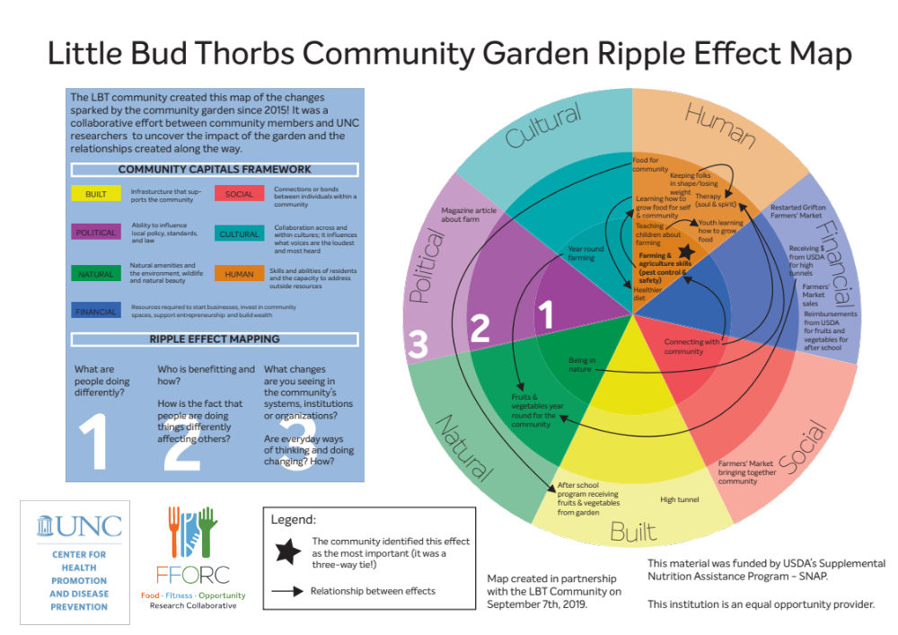
REM Example
June 2026 LEP Cop
Notes:
Describe community garden example
Social/community systems: Farmer’s Markets Bringing together community
Human/level 2 (who is benefitting): Youth learning how to grow food
Big star – community identified the most important effect
Arrows = relationships between effects

Slide 6
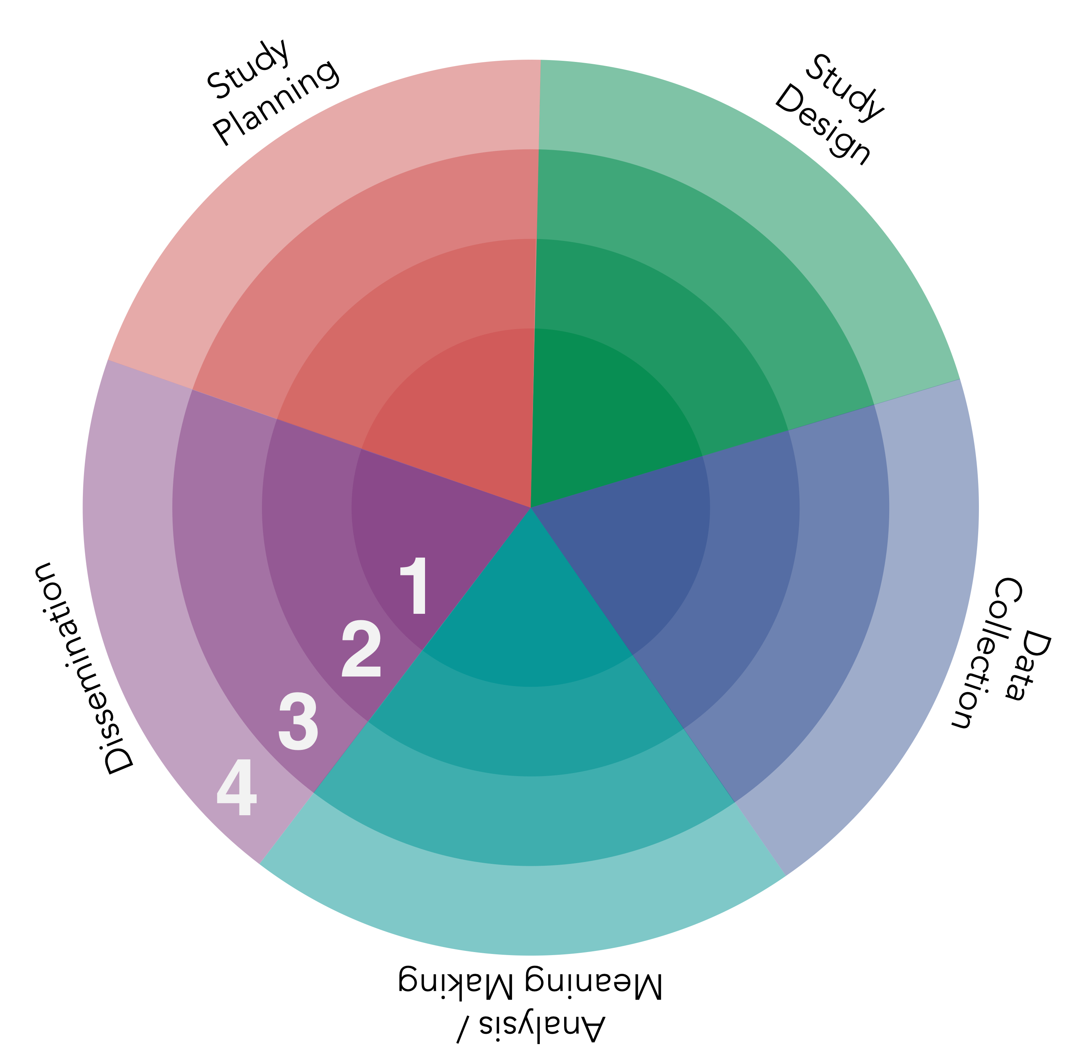
June 2026 LEP Cop
Ripples:
1 = Self
2 = Team
3 = Organization
4 = Community & Policy
Notes:
Describe
https://canva.link/rzbvzo1f5x0l0td

Slide 7
REM Mapping Process
June 2026 LEP Cop
Small group discussion questions
  Where have you seen impacts in each ripple?
  What unexpected things have happened as a result of your involvement in these efforts?
Notes:
Brainstorm with each other looking at REM map
To drop in chat: Thanks Kalen!
https://canva.link/rzbvzo1f5x0l0td
Break outs of 2-4 (depending on #s) and 12-15 minutes.

Slide 8
REM Mapping Process
June 2026 LEP Cop
Populate REM Map
  Add impacts to the image via stickies in left tool bar
  Chat – which have been particularly important/meaningful/impactful
  Chat - Share 1 next step for your team
  We will collate and share impacts
Notes:
Add stickies and move around to correct pie piece and ripple

Slide 9
Questions

