Slide 1
The Future of Educare Research
Educare Network Data Camp
December 7, 2023
Facilitated by Cynthia Jackson and Amanda Stein, Educare NCO
Gary Bingham, Educare Atlanta LEP
Iheoma Iruka, FPG-NEP

Slide 2

Agenda (8:30-9:45 AM)
Time | Topic or Activity
25 minutes | Cynthia & Amanda; Discussion of recent Network-level efforts focused on research, RPPs, and data
5 minutes | Questions & Comments
15 minutes | Gary: Reflections as the LEP rep on the Educare Steering Committee and EREDS work group member
5 minutes | Questions & Comments
15 minutes | Iheoma: Reflections and recommendations for moving the field forward (i.e., field impact)
10 minutes | Questions, Comments, & Next Steps
Notes:
5 minutes
Review of Network-level efforts focused on research, RPPs, and data in the past 2 years
10 minutes
Reminder and progress update on the Re-envisioning Educare Research Ad Hoc Committee
5 minutes
Themes from key data sources
15 minutes
Cynthia: take-aways from 1-on-1 discussions with EDs

Slide 3
Where Have We Been?: Recent Network-Level Research-Related Efforts

Slide 4
Network Research-Related Activities in the Past 2 Years
Time Frame | Activity
January 2022 - May 2023 | EREDS’ development of and engagement around the Educare Research Agenda to Advance Racial Equity
April – May 2022 | BECF-led listening sessions with Educare executive leaders
August – November 2022 | Cindy Decker facilitated small group conversations with Educare executive leaders per BECF and EGC request
January – April 2023 | Cindy shared summary of feedback from Educare executive leaders with BECF, EGC, EREDS, and NEPs/LEPs
March – October 2023 | Educare schools completed Network Requirements Reflection Tool (including Core Area of Research, more on this today)
May – June 2023 | Launch of Educare Research Agenda to Advance Racial Equity
June 2023 | Cindy shared her ideas for a Next Phase of Educare Research Framework document and convened ad hoc committee
June – September 2023 | Cynthia had one-on-one conversations with Educare executive leaders (more on this today)
July – October 2023 | Transitioned convening and facilitation of Re-envisioning Educare Research ad hoc committee from Cindy to Educare NCO.
October 2023 – now | Re-envisioning Educare Research Ad Hoc Committee meets monthly
Notes:
Link to ED One-on-one Discussions Summary: https://community.startearly.org/educareshare/educare-research-evaluation-and-data-strategy-work-group/m/resources/3480

Slide 5
Re-envisioning Educare Research Ad Hoc Committee

Slide 6

Re-envisioning Educare Research
Ad Hoc Committee
Description/Purpose: A time-limited task force/ad hoc committee formed at the request of BECF and the former Educare Governance Council to develop a framework and make recommendations or decisions about what is needed to move into the next phase of research in the Educare Network.
Who: The ad hoc committee is comprised of 1) Educare program leaders with a strong interest and understanding of research and data use (largest proportion of membership), 2) Network researchers who have been involved in the Network’s governance structure and processes and helped to develop the research agenda, and 3) Educare’s Executive Director.
Deliverables: Present the framework and recommendations for a re-envisioned future for Educare research to the Executive Director
Notes:
Amanda to pose questions to the committee:
Are there other things we feel like this committee is responsible for accomplishing?
to better use data for school innovation while also impacting the national discourse – Cindy’s words
Are there things that this committee is NOT responsible for?
From Cynthia:
Wondering about relevance of local data that leaders mentioned compared to field facing impact. I think they were looking for more data analysis that would have a more significant and meaningful use locally. Would be great to confirm this as what the ad hoc committee's purpose and duty is.

Slide 7
Membership
NEP: Noreen Yazejian (FPG)
LEP: Gary Bingham (Educare Atlanta)
Educare Network Member Leaders:
  Cindy Decker (ED of Educare Tulsa)
  Paula Gates (ED of Educare OKC)
  Shawn Gerth (ED of Educare California at Silicon Valley)
  Mindy Zapata (ED of Educare Arizona)
  Tracye Fortin (ED of Educare Central Maine)
Educare NCO: Cynthia Jackson and Amanda Stein (Educare NCO)

Slide 8
Educare Mission & Vision Statements
Mission Statement
The National Educare Network of birth-to-five schools advances quality early learning through partnership and innovation around practice, policy and research so every child can thrive.
Vision Statement
Every family has equitable access to quality early care and education in their community, promoting positive outcomes for generations to come.

Slide 9
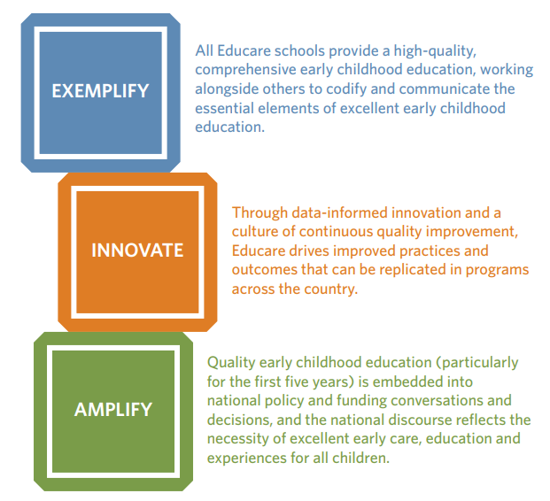
Educare Strategy (2022-24): The Building Blocks

Slide 10

Research Agenda Goals:
Elevate innovative research questions, methodologies, and practices with broad implications for practice, programs, policy, children, and families
Guide continuous quality improvement and provide both learning and celebratory opportunities
Impact the ECE field by informing about Educare’s efforts and findings that show promise for improving access, program quality, and outcomes of children, families, and the ECE workforce.
Notes:
Educare Research Agenda on Advancing Racial Equity: https://www.educareschools.org/app/uploads/2023/09/Educare-Research-Agenda-on-Racial-Equity_Final.pdf

Slide 11
Research Agenda:
Measures of Success
Study Implementation and Completion
  Multiple studies addressing racial equity with Network members are completed
  Research design elevates the voices of Black, Latine, and Indigenous scholars, workforce, families, and children
  More scholars of color lead or co-lead research and evaluation
  External funding is secured for racial equity research
Dissemination and Reach
  Accessible formats and strategies effective for disseminating research findings are identified
  Dissemination plans involve engagement with community members, Network members, and the broader ECE field
  Studies are cited by others in areas of practice, research, and policy
Use and Influence
  Educare data and research findings on racial equity are:
    Leveraged at the local RPP, Network, and national level
    Used by policymakers, program-level leaders, and ECE staff to guide programming, professional development, and continuous quality improvement

Slide 12
Ad Hoc Committee Efforts To Date
Reviewed and considered a draft framework and ideas prepared by Cindy
Reviewed data sources and discussed themes in terms of strengths to build on and potential areas for improvement
Drafting a vision statement for the future of Educare research
Generating and prioritizing action steps and activities to move the Network toward this vision
Prioritizing near-term research questions to be asked and answered with Network members and data
Planning for engagement of Network members and their research partners
Drafting recommendations for the Educare ED, ESC, and LLC Board

Slide 13
Data Sources & Synthesis

Slide 14

Data Sources to Drive the Future of Educare Research
Summary of BECF Listening Sessions
Summary of Cindy Decker’s group conversations with Educare leaders
Educare Research Agenda to Advance Racial Equity
  RPP commitments/action steps
  Logic model (in progress)
Network Requirements Reflection Tool ratings and responses – especially those focused on Research & Field Impact
Cynthia’s one-on-one conversations with Educare executive leaders
LEP CoP meetings

Slide 15
Network Research & Data-Related Strengths to Build On
Implement the new research agenda to advance racial equity.
Leverage common data from through Educare National Evaluation for writing grants and reports to funders.
Leverage common data through the Educare National Evaluation to support Network members in functioning as learning organizations.
Leverage common data through the Educare National Evaluation to contribute to shared accountability as well as celebration among Network members.
Invest in and support RPP relationships and routines with the LEP.
Invest in and support the RPP’s role in facilitating and supporting data driven practices as part of continuous quality improvement.
Emphasize data utilization in the Educare model framework and Network Requirements.
Support the workforce in their data utilization efforts through the RPP and Essential Practices of Educare trainings.
Conduct and amplify research to give the Network legitimacy and set us apart externally in the field of ECE.
Notes:
Not the only strengths. The ones mentioned/addressed most often in the data sources that we synthesized.

Slide 16
Network Research & Data-Related Areas for Improvement
Network Member Driven Focus
  E.g.: The Network’s research-to-practice and research-to-policy mechanisms are specified, strong, and driven by Network members.
  E.g.: The Network makes research design and measurement decisions based on the problem we would like to solve or what question we would like to answer (rather than starting with what data would we like to have).
Quantity & Timing of Research
  E.g.: The Network's research infrastructure allows Network researchers to be timely and responsive to the needs of Network members and issues in the field.
  E.g.: Network researchers produce more and better research/data products for Network members and the field.
Reach & Relevance
  E.g.: Network research findings and data/measures are more relevant to Network members and local audiences.
Funding & Financing
  E.g.: Network members have a clearer line of sight and opportunities to inform the use of funds for Network-level research and data-related activities.

Slide 17
Cynthia’s Reflections

Slide 18
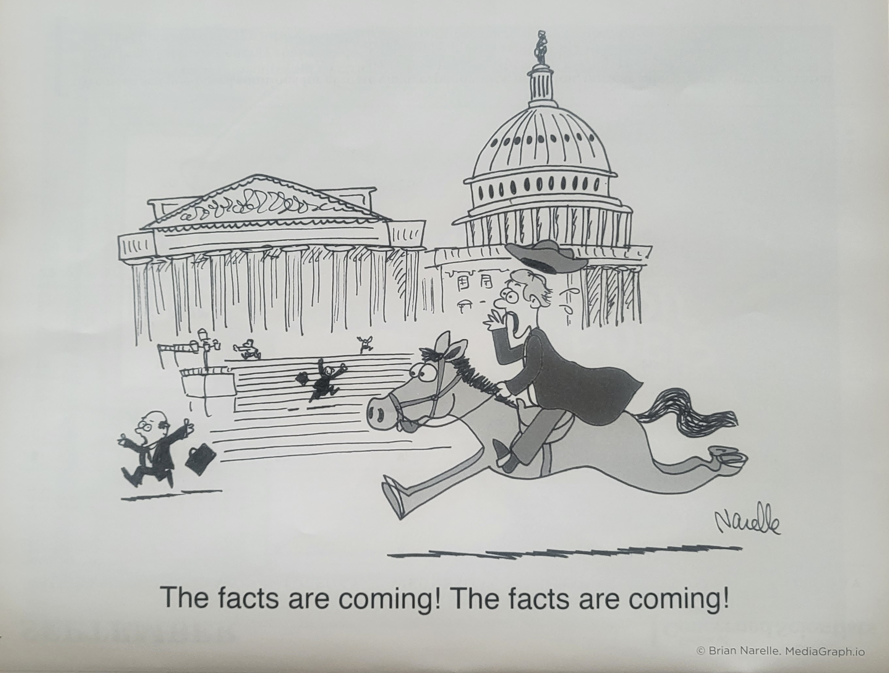
Educare Network Data Camp

Slide 19
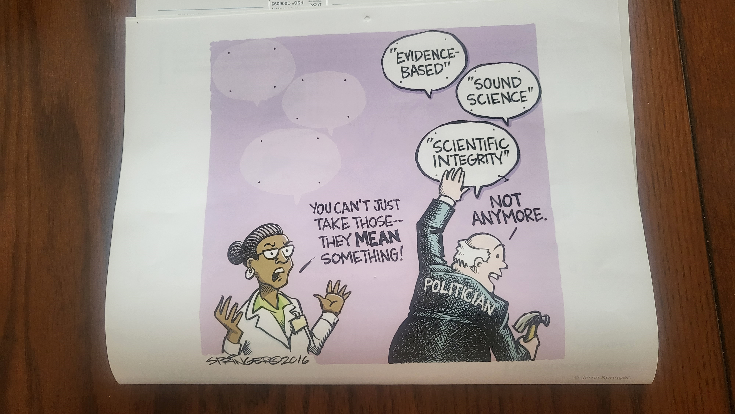
Current Political Environment

Slide 20

Executive Director/CEO One-on-One Discussions
Timeline: May to September 2023
Purpose of Discussions:
Gauge understanding of the governance structure shift
  From Educare Governance Council (EGC) to the Educare LLC Board that is connected to Start Early
  Transitioned the EGC Members to the Educare Steering Committee
  (Advisory body to the Executive Director)
Gauge Network Health and Leader Engagement

Slide 21
ED/CEO Discussion Questions
  How do you think we can leverage the Network to have a more significant impact?
  What would make the Network Value Propositions beneficial or more meaningful to your organization?
  What are your school's/organization’s priorities over the next 3-5 years?
  What would you identify as your area(s) of expertise that you or your organization would be willing to lead the Network on?

Slide 22
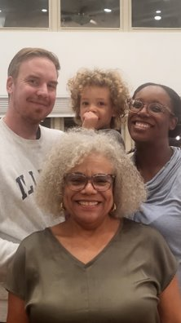
Executive Director/CEO One-on-One Discussions
Connections within the Network
  Educare recognition has been beneficial in grant applications and school tours
  The nationwide reach of the Network has provided Executive Directors with great resources, credibility, and a broad audience
  There are opportunities to learn from other schools in sustainability efforts
    Collaborative Fundraising
  “One of the most powerful things is getting somebody in one of those buildings and seeing how their image of childcare or daycare changes in an hour.”

Slide 23
Executive Director/CEO One-on-One Discussions
Priorities over the next 3-5 years
  Major Common Themes:
    Fundraising, full enrollment, increase family & community engagement in policy, program, and research
  Staffing & Workforce Development
    Addressing challenges in staffing, absenteeism, workplace culture, and the workforce
  Individual School Priorities
    High-quality teaching and learning, leadership development, succession planning, funding, professional development, advocacy & policy, board development, and NAEYC accreditation

Slide 24
Executive Director/CEO One-on-One Discussions
Cost of Research & Evaluation
  Executive Directors find value in research as it provides reference material to families and funders regarding the significance of high-quality ECE
  The most common challenge Executive Directors face is funding the cost of research (the local evaluation partnership)
  “The part we’re really struggling with is the data and evaluation piece of fully funding that part.”

Slide 25
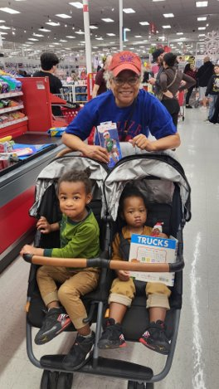
Executive Director/CEO One-on-One Discussions
The Direction of Data
  Executive Directors support increasing research efforts but are concerned with the current direction, specifically regarding the local utility of research
  Executive Directors highlighted the gap between data serving national interests and local communities
    “Publications still feel a degree or two removed [from schools].”

Slide 26
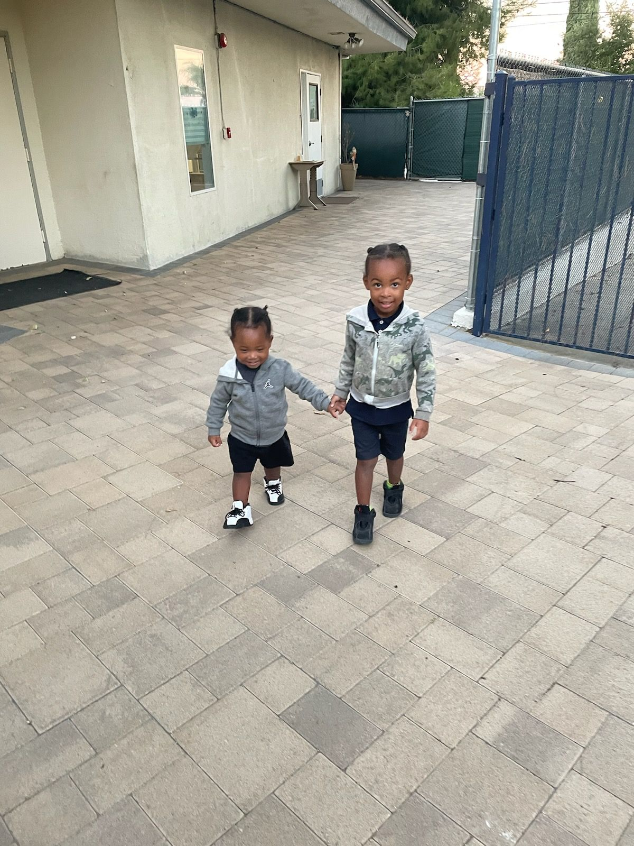
Next Steps
Future of Educare Research Ad Hoc Committee Recommendations
Continued commitment to the Research Practice Partnerships as a Network Requirement
Solution-focused discussion with NEP/LEP's and School ED's/CEO's
Resolving challenges identified
Solidifying the future state of Research Practice Partnerships
Celebrate!
Better understanding of local LEP and Leader Relationships and local needs/requests
  Required data collection for National data set
  Identifying and understanding local data requests/needs

Slide 27
Gary’s Reflections

Slide 28
Iheoma’s Reflections

Slide 29
Questions?

Slide 30
Wrap-Up & Next Steps

