Slide 1

Educare Learning Network:
Procedures Old and New 2019-2020 episode 2
Tuesday, February 18 and Friday, February 28, 2020

Slide 2
Welcome
FPG welcomes Kalen Grosskopf
Roll call
New staff

Slide 3
Agenda
Staff survey timeline
Spanish committee
Spring parent survey timeline
Ongoing discussions
Next steps

Slide 4
Recap – November conversation
Take the revision of the evaluation as an opportunity to re-examine and recommit to timelines and processes
Identify desired changes to timelines, processes, and products
Consider timelines and processes in relation to the whole
Start a discussion, plan the steps needed to finish the discussion
  Include LEP staff members and school stakeholders
  Consider available staffing and funding
Notes:
Products such as datasets
Noreen talked this morning about how well the evaluation committee is functioning – they are airing preferences and needs, even opposing ones, listening to each other, and sometimes giving ground.
We can do a parallel process with some of the nitty gritty stuff. Maybe everyone will get a little of what they want, and if there are things we want that we don’t get, at least we will feel we’ve been heard.

Slide 5
Proposed change:
Staff Survey 2019-20
Shorter data collection window: March 9-April 30 (instead of April 1-June 30):
LEPs update staff in FPG system including current position by March 5
Emails with survey links distributed to staff March 9*
If using paper, ship to FPG by April 30
Lost sheep accepted any time and included in future reprocessing, but every site should participate by April 30
FPG staff enter paper surveys by May 15
DMAC runs reports by June 1 for review/corrections/TOC
Reports on SharePoint JUNE 15
Notes:
A couple of sites need to provide contact information for the survey – respond to Diane.
Let us know if you need a different release date.
We’re hearing that schools and LEPs wish they could receive staff survey results for their school and ALL much earlier. We provided preliminary staff survey reports in August this year, but for some sites, that wasn’t early enough to be useful for fall planning.
Discussion at data camp resulted in a proposal to shift the staff survey even earlier (Prior to spring break) and parent survey after spring break to maximize the distance between fall and spring (see next slides). LEPs would like datasets as well as reports.
If we TENTATIVELY agree to these dates, we have to consider alongside all the other demands. ALL stakeholders must be considered.

Slide 6
Reminders
Emails to school staff:
IMPORTANT: will be in the subject line
Let us know if you need to schedule a different release date. Then alert your school.
Mindfulness and Mastery Study:
Your consent is attached to this survey (electronic and paper)
IF YOU USE PAPER SURVEYS – make sure you use the version that includes the consent
Notes:
Questions?

Slide 7
Proposed change:
Staff Survey 2020-21
Shorter data collection window: March 15-April 15 (instead of April 1-June 30):
Evaluation Committee finalize survey questions by Dec. 15
Spanish translation and review process completed by Feb. 1
Programming by DMAC completed by Feb. 15
FPG tests program in late February/early March
LEPs update staff including current position by March 5
Emails with survey links distributed to staff March 15
If using paper, ship to FPG by April 15
Lost sheep accepted any time and included in future reprocessing, but every site should participate by April 15
Reports on SharePoint May 31 (DMAC runs reports by May 15 for review/corrections/TOC)
Notes:
We’re hearing that schools and LEPs wish they could receive staff survey results for their school and ALL much earlier. We provided preliminary staff survey reports in August this year, but for some sites, that wasn’t early enough to be useful for fall planning.
Discussion at data camp resulted in a proposal to shift the staff survey even earlier (Prior to spring break) and parent survey after spring break to maximize the distance between fall and spring (see next slide). LEPs would like datasets as well as reports.
If we TENTATIVELY agree to these dates, we have to consider alongside all the other demands. ALL stakeholders must be considered.

Slide 8
Spanish Committee
Chairs: Blanca Gonzalez (TUL) and Silvia Niño (MIA)
Members: Gaby Guerrero (KAN), Katelyn Hepworth (LIN), Sarah Rasher (WDP), Marcela Sweeny (WDP-school director), Linda Soto (FPG)
Revisions to Spanish Spring Parent Surveys
Recommendations to Evaluation Committee re. PLS.

Slide 9
2019-20 Spring Parent Survey Timeline
Shorter data collection window: April 15-June 15 (instead of April 1-June 30):
Spanish translation and review process completed by Jan. 31
Programming by DMAC completed by Feb. 28
FPG tests screens in March
LEPs / Schools distribute to parents in April
LEPs complete data entry by July 15
Lost sheep accepted any time and included in future reprocessing, but every site should participate by July 15
Reports on SharePoint August 31
Notes:
We hear that spring parent survey data would be more useful if it were reported earlier. These take longer than staff surveys because all are on paper and must be entered by LEPs.
Responses: Original proposal of April 1-3) was too tight. Spring break in April. Earlier is not a good idea because of the need for time to elapse after fall interview. Collection is challenging and may need to continue into June.
Schools and LEP staff should be consulted about these dates. Even if so, we have to consider alongside all the other demands.

Slide 10
2020-21 Spring Parent Survey Timeline
Shorter data collection window: April 15-June 15 (instead of April 1-June 30):
Evaluation Committee finalize survey questions by Dec. 15
Spanish translation and review process completed by Jan. 31
Programming by DMAC/updates by designer completed by Feb. 28
FPG tests screens in March
LEPs / Schools distribute to parents in April, collect by June 15
LEPs complete data entry by July 15
Lost sheep accepted any time and included in future reprocessing, but every site should participate by July 15
Reports on SharePoint Aug. 31
Notes:
We hear that spring parent survey data would be more useful if it were reported earlier. These take longer than staff surveys because all are on paper and must be entered by LEPs.
Responses: Original proposal of April 1-3) was too tight. Spring break in April. Earlier is not a good idea because of the need for time to elapse after fall interview. Collection is challenging and may need to continue into June.
Schools and LEP staff should be consulted about these dates. Even if so, we have to consider alongside all the other demands.

Slide 11
Ongoing Discussions
When proposed National Evaluation is approved, we will discuss:
ITERS-3 training
Collecting more details about classroom observer reliability
PLS reliability committee
  And much more!
Notes:
ITERS-3 will be another topic to discuss, especially if we do sampling or stagger collection.
CLASS – there is an interest in collecting data about reliability…Clayton shared some details of what they do.
PLS – volunteers for a PLS reliability committee – Barb, Holly/TUL, Dale

Slide 12
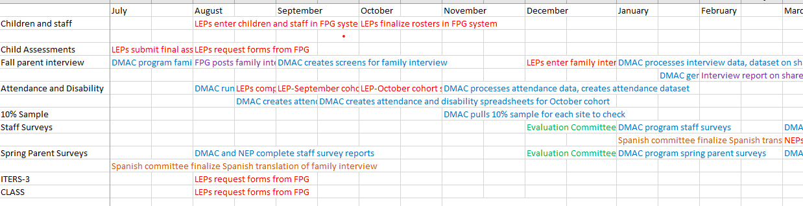
Task-dependent Timeline
Notes:
Ultimately we would like to compile a task-dependent timeline showing the tasks by stakeholder across time and across instruments.

Slide 13
Next Steps
Update your staff in the FPG system – including new positions/promotions – by March 5
Finish entering fall 2019 data and rosters
Help us calculate response rates for 2018-19 – watch for emails
Read the Research and Evaluation Advisory Committee report to know what the National Evaluation will look like starting 2020-21 (report to be released very soon)
If you are attending the Network Meeting in New Orleans, please respond to the email requesting input into the agenda
Attend a data webinar either March 10 or 12 – and reply to an email about response rates

