Slide 1
Books Children Love
About Race and Cultural Heritage
Educare Teachers, Mentor Teachers, Family Engagement Staff, Gisele Crawford, and Kalen Donahue
December 7, 2023

Slide 2
Staff Surveys Spring 2023
Books children love
Educare classrooms include many books, including some books that reflect children’s race and cultural heritage and some books that introduce them to people who are different from them. Is there a book of either of those types that children especially love?
En los salones de clases de Educare hay muchos libros, entre ellos algunos que reflejan la raza, la herencia cultural de los niños y otros que les muestran personas diferentes a ellos. ¿Hay algún libro de alguno de esos géneros que en especial les guste a los niños?
Notes:
There are so many books on this topic, and many lists of them. Which ones do children reach for? Which ones do toddlers pick up and carry to someone to read to them? When a preK teacher opens a book at circle time, do children go YAY!

Slide 3
Response Rates
Books children love
Survey Type | Responses-Book Question | Responses-Overall Survey | Rate
Teacher | 334 | 721 | 0.46
Mentor Teacher | 29 | 70 | 0.41
Family Engagement | 32 | 104 | 0.31
All Types | 395 | 895 | 0.44
Notes:
2023

Slide 4
Types of Responses
Books children love
191 did not name a specific title but made another type of comment
Cultural Socialization (13) I’ve realized children love books where there’s characters that look like them or talk about their culture!
Practices (15) During our freedom literacy walk, we selected a variety of books by Black authors. The children took part in each display and I saw many children and families enjoying many of the books.
Respect Others/Value Diversity (20) How people look around the world is something I observed children love to see and read.
Notes:
There are so many books on this topic, and many lists of them. Which ones do children reach for? Which ones do toddlers pick up and carry to someone to read to them? When a preK teacher opens a book at circle time, do children go YAY!

Slide 5
Types of Responses – “No”
Books children love
94 responses:
No N/A None
Can’t think of one particular book?
I can’t think of a book.
Not a specific one that they love.
Not in my classroom
I haven’t noticed
Not at this time
I can’t think of anything
I honestly don’t have one specific book in mind.
No. They like books with trucks and animals.
Not that I am aware of
Not really a specific book.
I can’t think of one at this time.
Nope.
Not especially.
No, not at the moment
Not really.
…First I need to see if they have them in the classroom…
Notes:
Is there one that children particularly love?
In addition to the 387 who did not respond to this question at all.

Slide 6
Types of Responses – “No”
Books children love
In the infant & toddler room I am in there is 1 book.
We do not have many Spanish books in the classroom. Our classes favorite book is Brown Bear, Brown Bear probably because it is the only one I have props for.
No books about culture as of now.
I feel like we need more books about people of different races as themselves.
We do not have books that reflect children’s race and cultural heritage.
Checking on this as required in an Educare form completed during the…CLASS observation, such books are rarely found on the shelves of most Educare classrooms. (mentor teacher)
94 responses (cont.):
We need more LGBTQ, inclusion, and racial books.
We need more books on these topics – there are not very many in the building, and if there are, they are not easy to find. Would love to have some in my classrooms, but usually when I ask for specific books to be ordered, they do not get ordered.
Our selection is very limited.
No. They need to add more books to the library so we can read them in the class.
Notes:
Is there one that children particularly love?
Educare concerns
“No” responses came from every site* (SEA few surveys)

Slide 7

Books!
Books children love
214 respondents named from one to eleven book titles
Every site
From 1 – 18 respondents per school (mean = 8.56)
250 titles, about 1.2 different books per respondent)
Antiracist Baby
Little Blue & Little Yellow
Little People, Big Dreams series
All Are Welcome
Peanut Butter & Cupcake
Please, Baby, Please
Dream Big Little Leader
Little Legends: Exceptional Men in Black History
Come On, Rain!
The Big Umbrella
I Am Enough
Notes:
Is there one that children particularly love?
This FES person limited herself to these 11 titles…

Slide 8
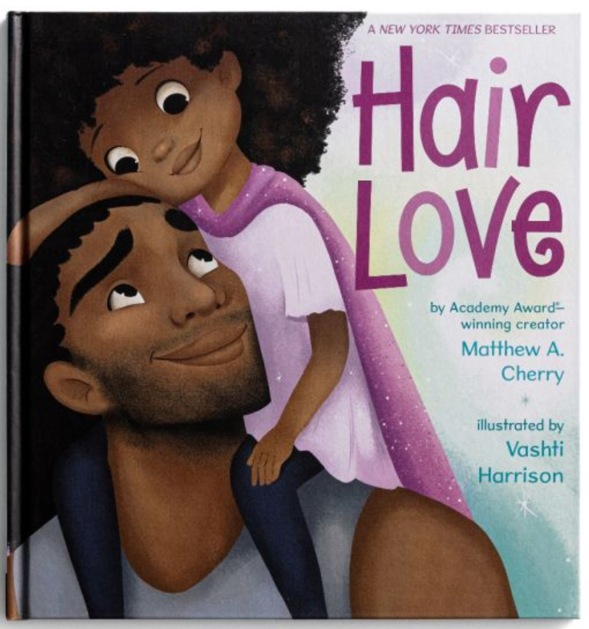
Hair Love and more hair…
Books children love
Hair Love, 40 mentions, 11 sites
I Love My Hair, 12 mentions, 7 sites
Hair Like Mine, 4 mentions, 1 site
Don't Touch My Hair, 2 mentions, 1 site
My Hair, 2 mentions, 2 sites
Big Hair Don't Care, Curls, Good Hair, Hair, My Hair is Beautiful, The Hair Book, I Love My Beautiful Hair, 1 mention, 1 site

Slide 9

Other favorites…
Books children love
I Am Enough, 20 mentions, 12 sites
The Colors of Us, 10 mentions, 8 sites
All Are Welcome, 9 mentions, 5 sites
Global Babies, 9 mentions, 5 sites
It’s OK to be Different, 9 mentions, 7 sites
Our Skin: A First Conversation about Race, 8 mentions, 3 sites
Antiracist Baby, 7 mentions, 4 sites

Slide 10
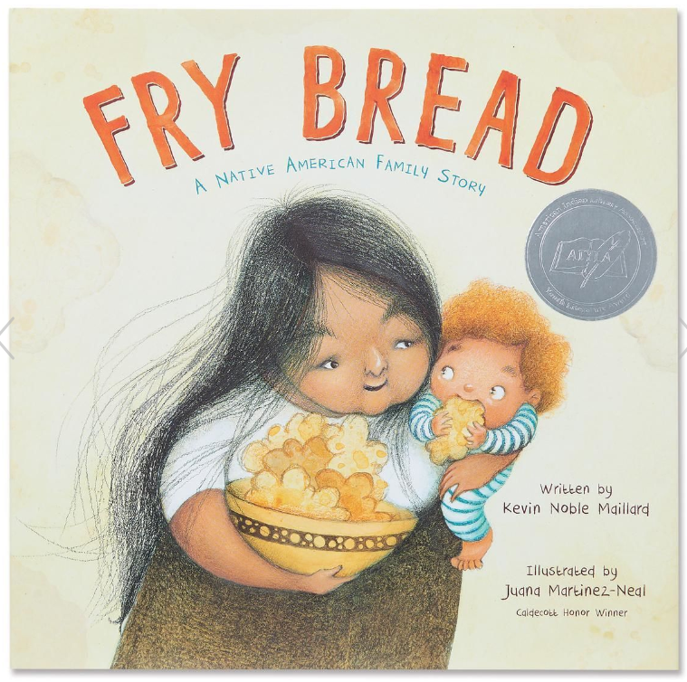
Other favorites…
Books children love
Fry Bread: A Native American Family Story, 6 mentions, 2 sites
Skin Like Mine, 6 mentions, 2 sites
I Like Myself, 5 mentions, 5 sites
Children Around the World, 4 mentions, 4 sites
The Skin I’m In: A First Look at Racism, 4 mentions, 3 sites
Ezra Jack Keats books – 8 mentions, 2 sites

Slide 11
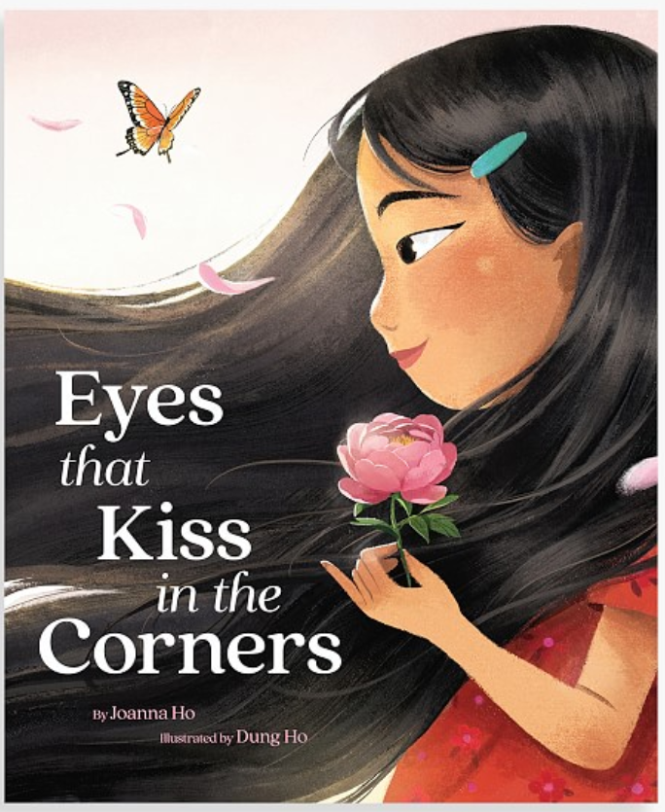
Future Network Favorites?
Books children love
One mention:
Eyes that Kiss in the Corners
Quinceañera
Pride Colors
On Our Street: Our First Talk About Poverty
Chuukese Alphabet
Hana's Hundreds of Hijabs
My Nose, Your Nose

Slide 12
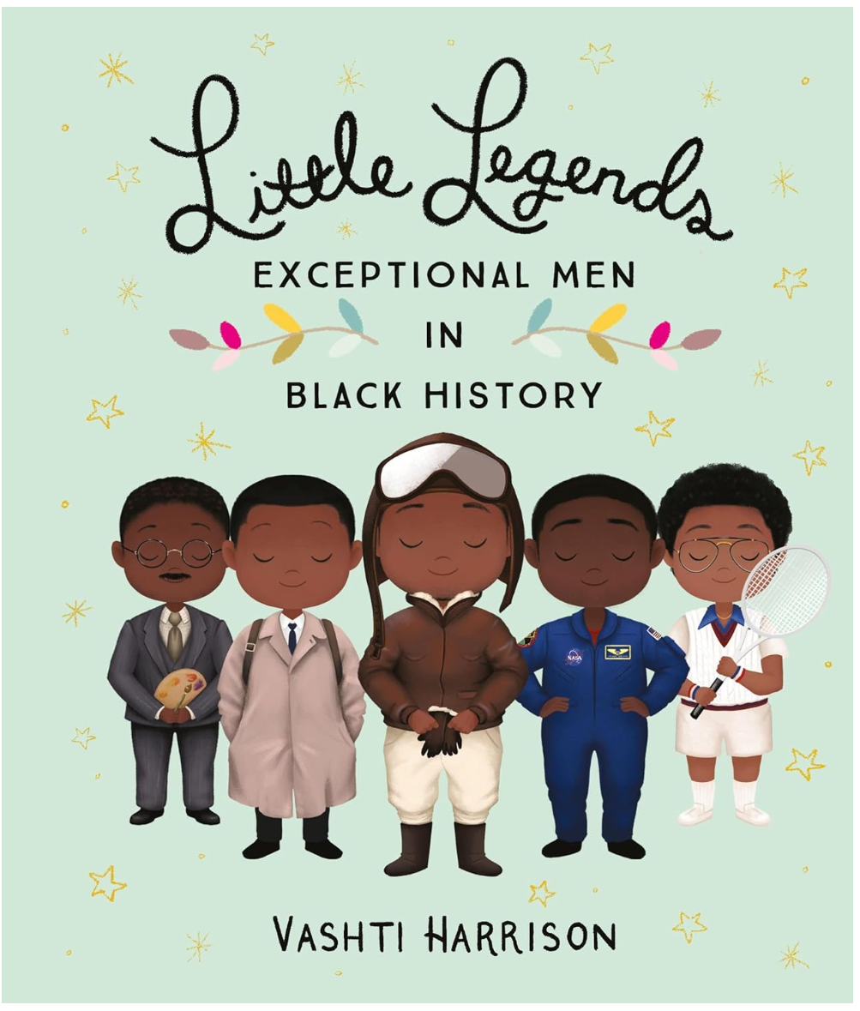
Future Network Favorites?
Books children love
One mention:
Little Legends: Exceptional Men in Black History
Shades of Black: A Celebration of Our Children
Sulwe
Grandma's Hats
Basketball Dreams
I Am Black

Slide 13
How to write a question…
Books children love
In 2023, we asked, “…Is there a book of either of those types that children particularly love?”
27 people answered…
Yes.
In 2024, we will ask, “If there’s a book of either of those types that children especially love, please share the title and author:

Slide 14
