Slide 1

Racial Equity in Educare
August CoP 8/12/2022
Adapted and facilitated by Dr. Allison De Marco of the Educare National Evaluation Partner at the Frank Porter Graham
Child Development Institute, University of North Carolina – Chapel Hill. ©2022

Slide 2

Overview
Positionality Statements
Tools and metrics to track our progress

Slide 3


Positionality Statements
How do the identities of the authors relate to the research topic and to the identities of the participants and how are these identities are represented in the scientific record/journals? (Roberts et al., 2020).
Include whatever is most relevant for readers to know about specific to a research study or review (nothing is mandated, author must consent to share)
Collaborative example: “When the manuscript for this article was drafted, one author self-identified as U.S. Black-White American, and four authors self-identified as U.S. White American.”
See more examples here: https://onlinelibrary.wiley.com/pb-assets/assets/14756811/Positionality-Statements-1621354517813.pdf
Source: Roberts, S. O., Bareket-Shavit, C., Dollins, F. A., Goldie, P. D., & Mortenson, E. (2020). Racial inequality in psychological research: Trends of the past and recommendations for the future. Perspectives on psychological science, 15(6), 1295-1309.
Notes:
https://onlinelibrary.wiley.com/pb-assets/assets/14756811/Positionality-Statements-1621354517813.pdf

Slide 4
Instructions for ECRQ Special Issue
Submissions should be framed using a strengths-based, non-deficit lens and include seminal research in the field, as well as research by scholars of color with expertise (and prior publications) from the above-noted list of topical areas. In the cover letter, please briefly indicate your author teams’ positionality, meaning articulate how your point of view, identity, or experience might intersect with the research study.

Slide 5
Positionality Statement
XB, PhD. DrXB (she/her/ella) is a Puerto Rican, cisgender, non-disabled, woman racialized as white and linguistically minoritized for her perceived accenteness. She also is a first- generation college student, lived in an under-resourced community for most of her life, and her brother has Cerebral Palsy. When she moved from Puerto Rico at 11 years old, she was erroneously placed in special education for not speaking English. Professionally, Dr. XB was trained as a bilingual speech-language therapist where she worked with children diagnosed with communication impairments in early intervention and school settings. She has a doctorate in Communication Sciences and Disorders, with a focus on early literacy and bilingualism. Together, these intersecting personal and professional identities have positioned her as both an insider and outsider, depending on the context. These positionalities impact her perceptions and understanding of this world, and most specifically, the societal context in which young children and families who are racially and linguistically minoritized exist and thrive.
Notes:
Homework – write your own statement
Did folks do this? How did it go? Does anyone want to share?
I discussed with and shared resources with a student for a manuscript.

Slide 6
Moving forward: Co-developing metrics/indicators for a report card for the network and each site
Notes:
We want to co-create something to track our progress. I’m going to share a few ideas and then would love to hear some others and then use some small groups to talk through what might work and what metrics we’d like to see.

Slide 7
Example 1: Self-Assessment Checklist
To track R & E Division progress
To guide our individual projects
Qualtrics-based
Completed by individuals or teams
Items on the tool rated on a 4-point scale:
      Haven't Started Yet (1),
      Plans Exist to Use (2),
      In Place and Evidence of Use (3),
      Part of our Routine and We Could Model for Others (4).
Open-ended questions on planned next steps
Notes:
> Scale based on previous equity checklists

Slide 8
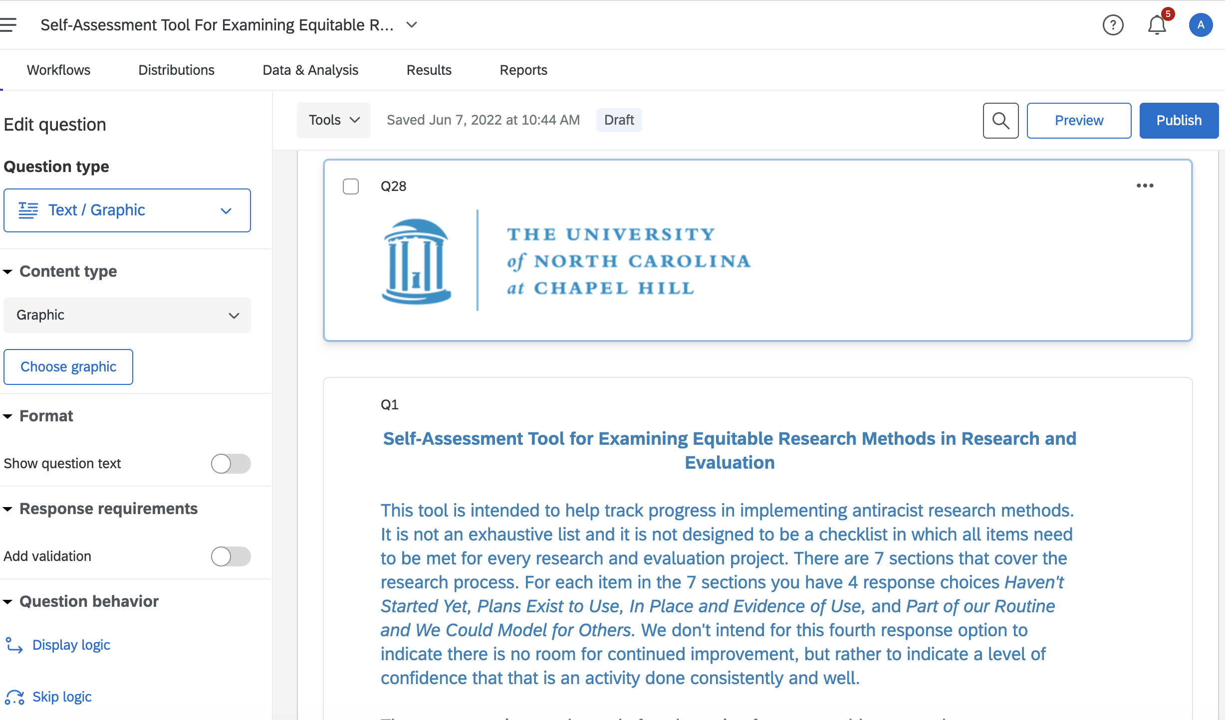
Notes:
Note – not an exhaustive list and invited respondents to list other things they are doing.
All studies not expected implement all items – for example, when using secondary data, no say over data collection
Reviewed by IRB and exempt

Slide 9
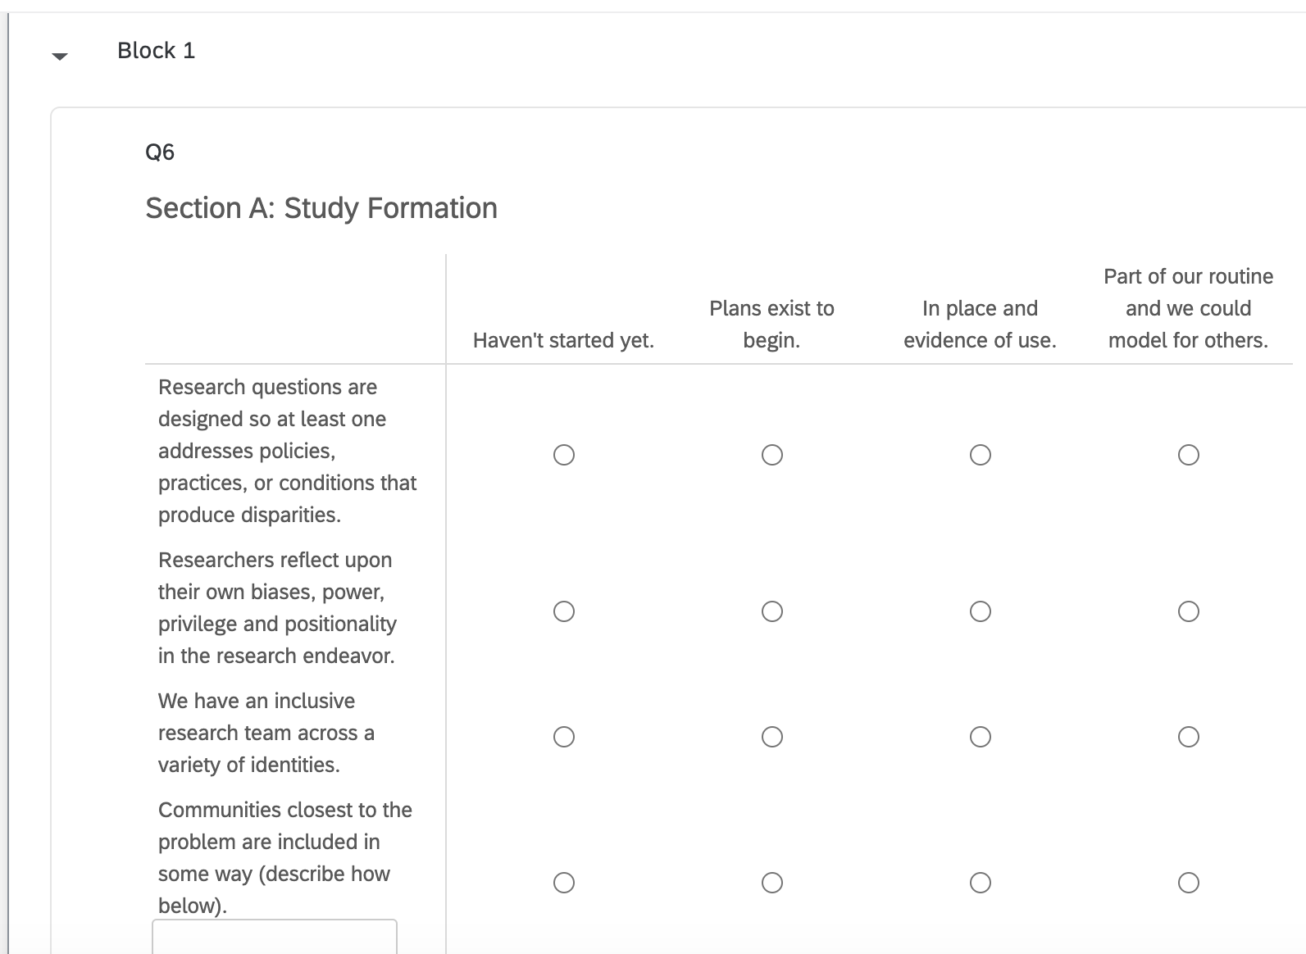
Notes:
7 Sections: Study Formation, Design, Data Collection, Analysis/Interpretation, Discussion/Recs, Dissemination, Next Steps/Follow-up (how we could have done better)

Slide 10
Example 2: White Coats for Black Lives Racial Justice Report Card (UC Davis Med School)
14 metrics like student representation, faculty representation, grade disparity, campus policing, patient access, anti-racist IRB policies
  Each is scored with evidence
Recommendations
  Areas of strength
  Reform efforts
  Areas for improvement
Notes:
https://health.ucdavis.edu/diversity-inclusion/PDFs/Racial-Justice-Report-Card_FINAL_2020.pdf

Slide 11
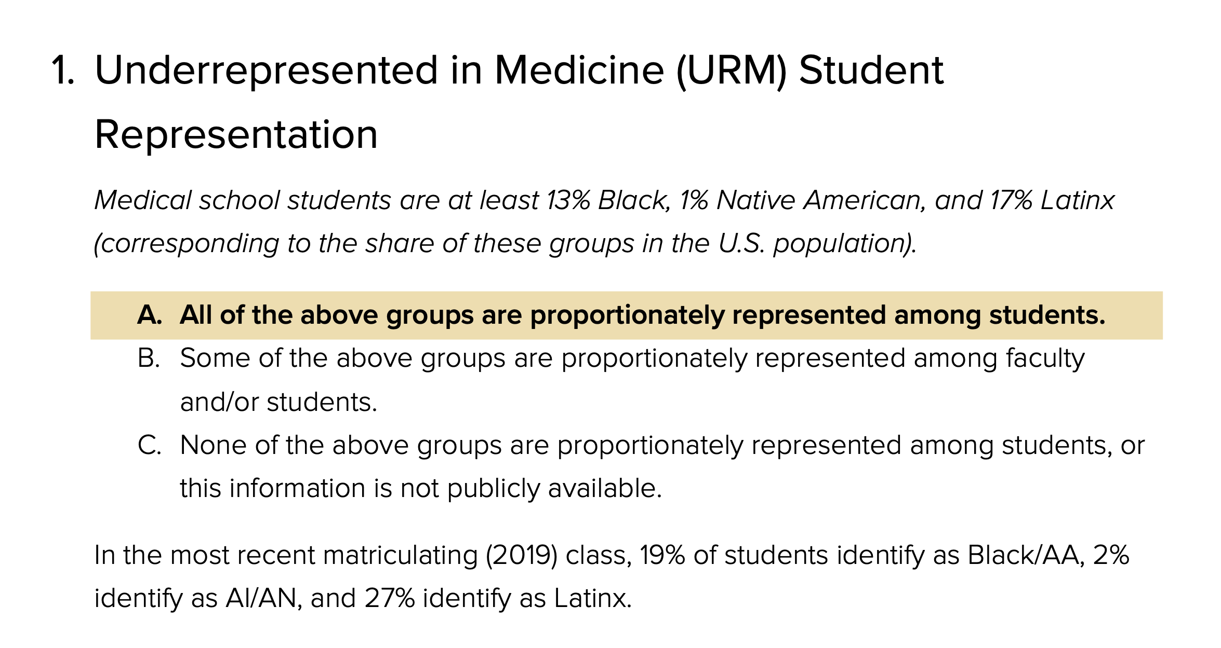

Slide 12
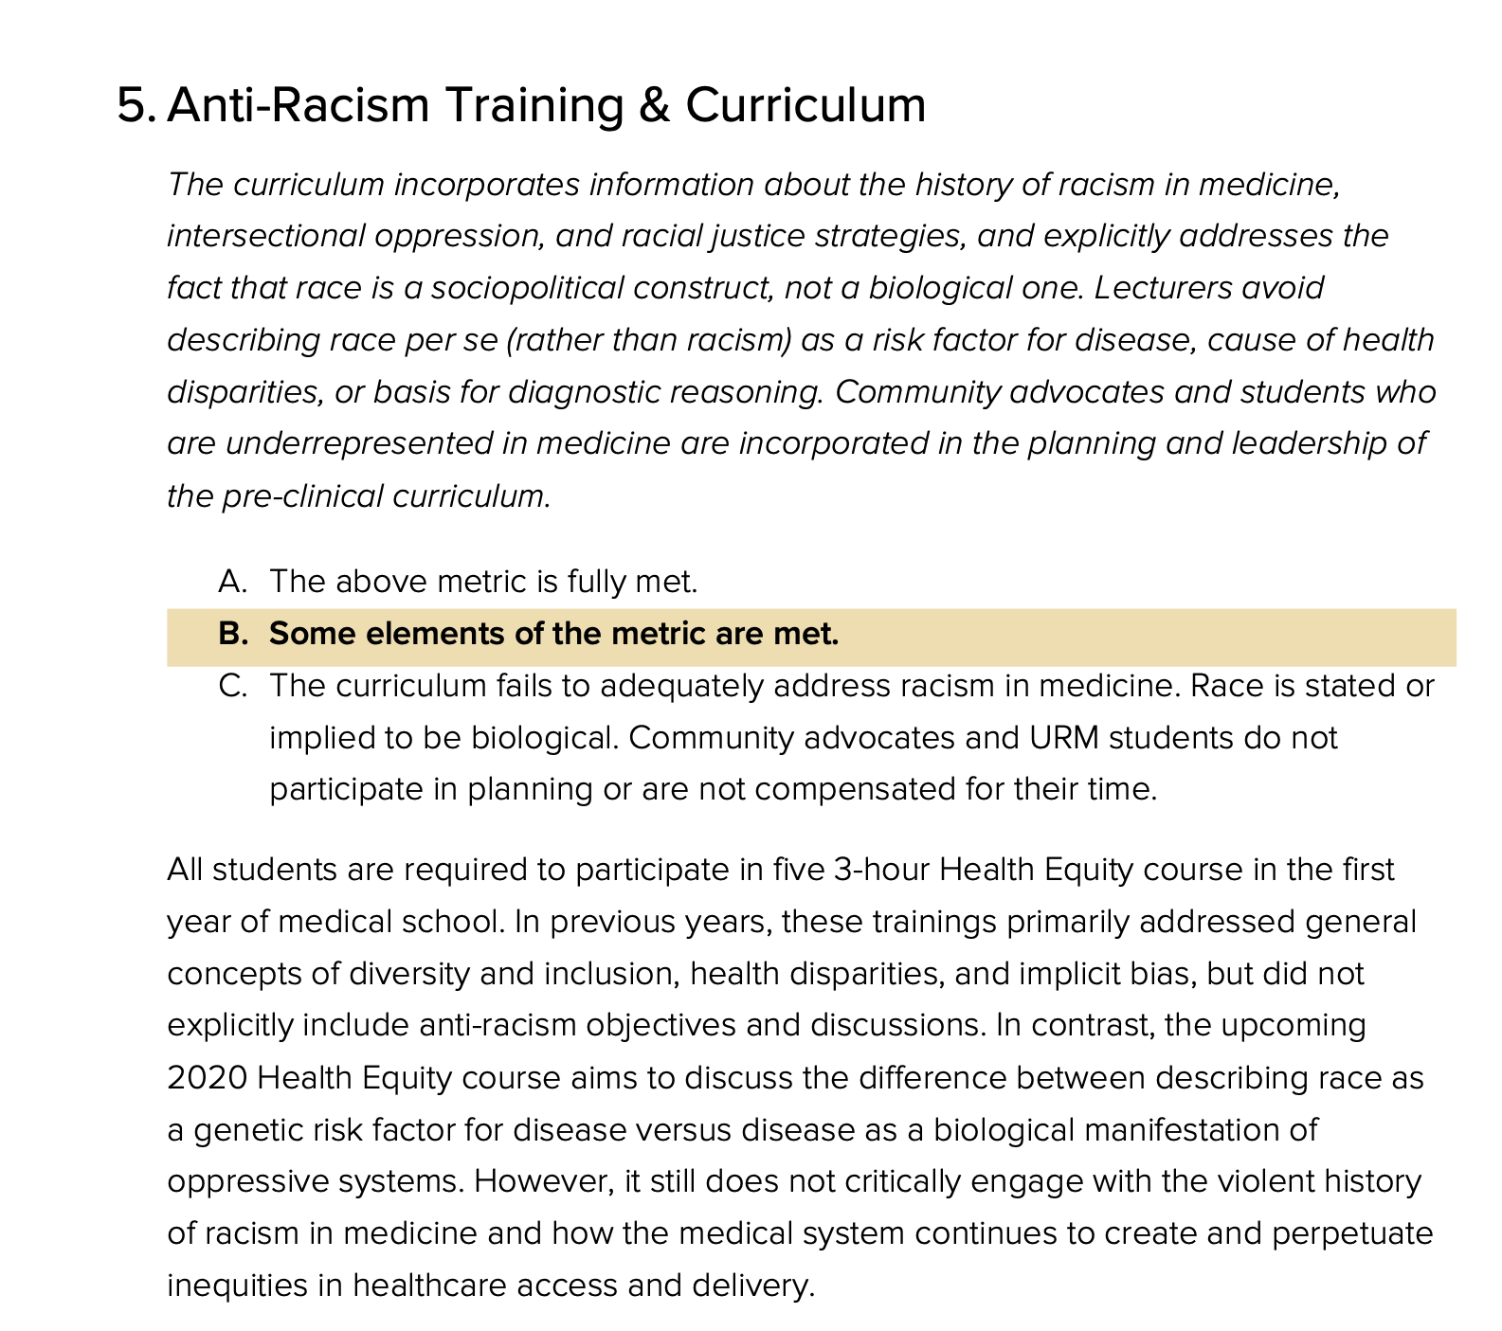

Slide 13
Discussion:
Full group:
  Other examples or tools you are already using?
Small groups:
  What metrics might make sense for us?
  What would be a useful format?

