Slide 1



Advancing Equity for all in Educare - Modifying language for these times
Aug CoP 8/8/2025
“I often think the gap in our speaking about and for justice, or working for justice, is that we forget to advocate for what we love, for what we find beautiful and necessary. We are good at fighting. But imagining and holding in one’s imagination what is wonderful and to be adored and preserved and exalted — that’s harder for us, it seems.” Ross Gay

Slide 2
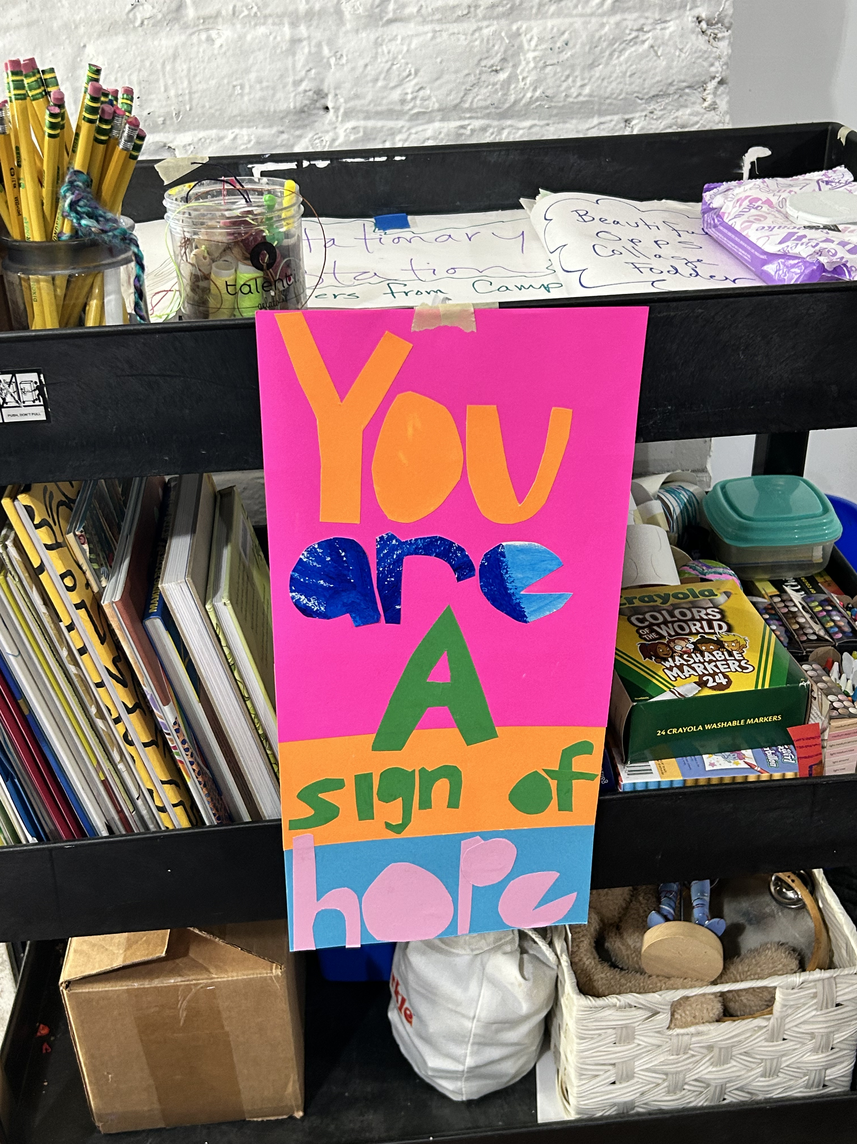

Overview
Review 2 resources
  Thorn Run Partners
  Spitfire
Share other resources or ideas
Workshop activity using reframe resources
Notes:
First Focused on being responsive to admin priorities
Second, focuses more on reaching audiences outside of our base (but still considered persuadable)

Slide 3
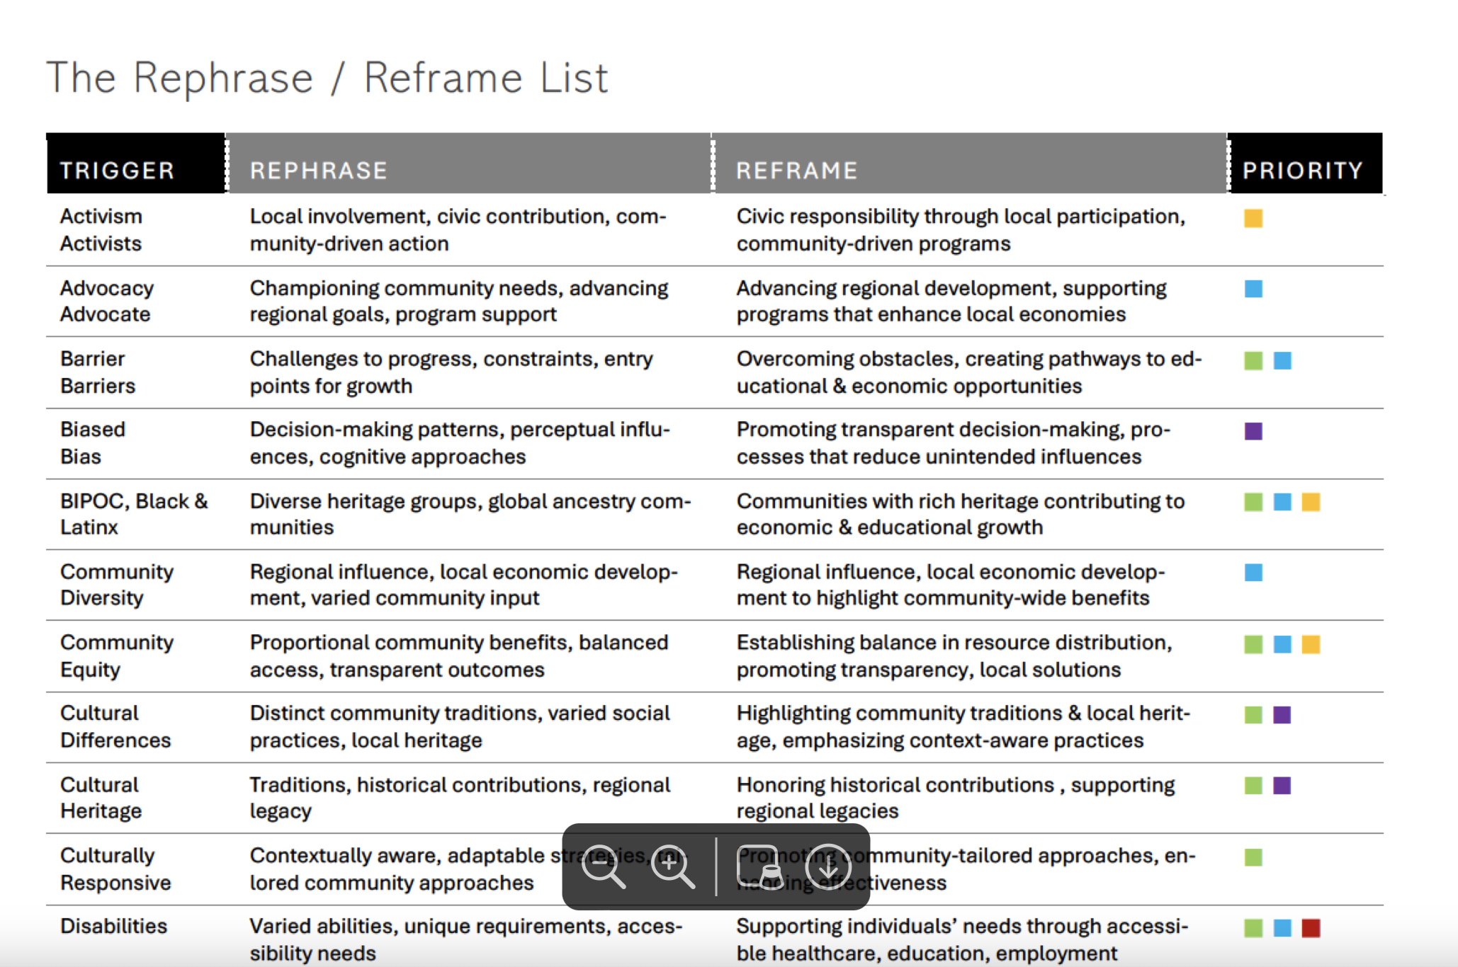
Thorn Run Partners:
“Re-messaging Strategies: Grant writing Guidance for an Evolving Political Landscape”
Notes:
Green = Educational and Inst. Reform

Slide 4
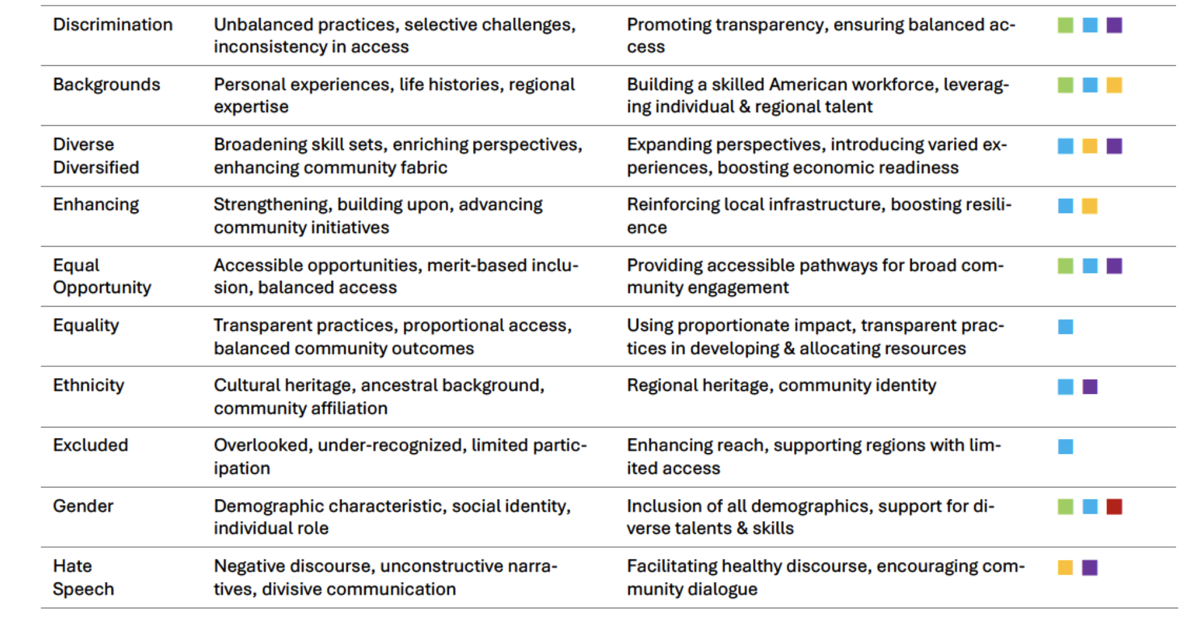
Thorn Run Partners:
“Re-messaging Strategies: Grant writing Guidance for an Evolving Political Landscape”
Notes:
Green = Educational and Inst. Reform

Slide 5
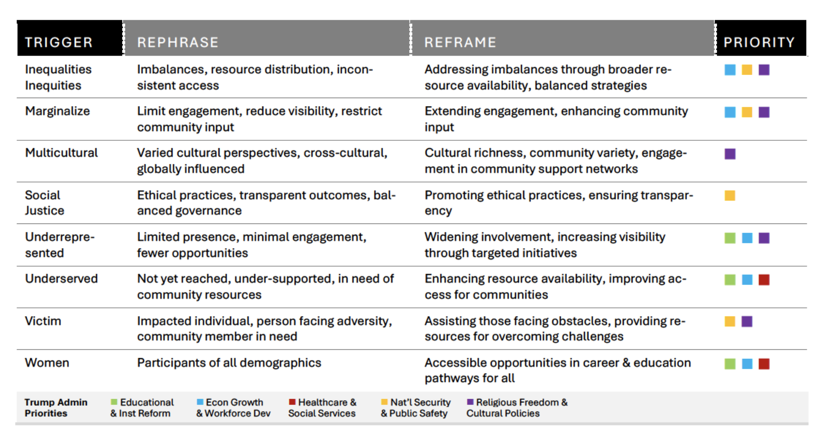
Thorn Run Partners:
“Re-messaging Strategies: Grant writing Guidance for an Evolving Political Landscape”
Notes:
Green = Educational and Inst. Reform

Slide 6
Spitfire “Shift Terms, Not Values: Reaching Persuadable Audiences on Diversity, Equity, and Inclusion in Higher Education”
“We were successful at increasing support for the concepts behind DEI, however, when using language that describes the values and benefits of diversity, equity and inclusion efforts without naming them as such.”
“Replacing specialized jargon with common words that people use in their daily lives is a communications best practice.”
“…we have the opportunity to build support around shared values by shifting our language.”

Slide 7
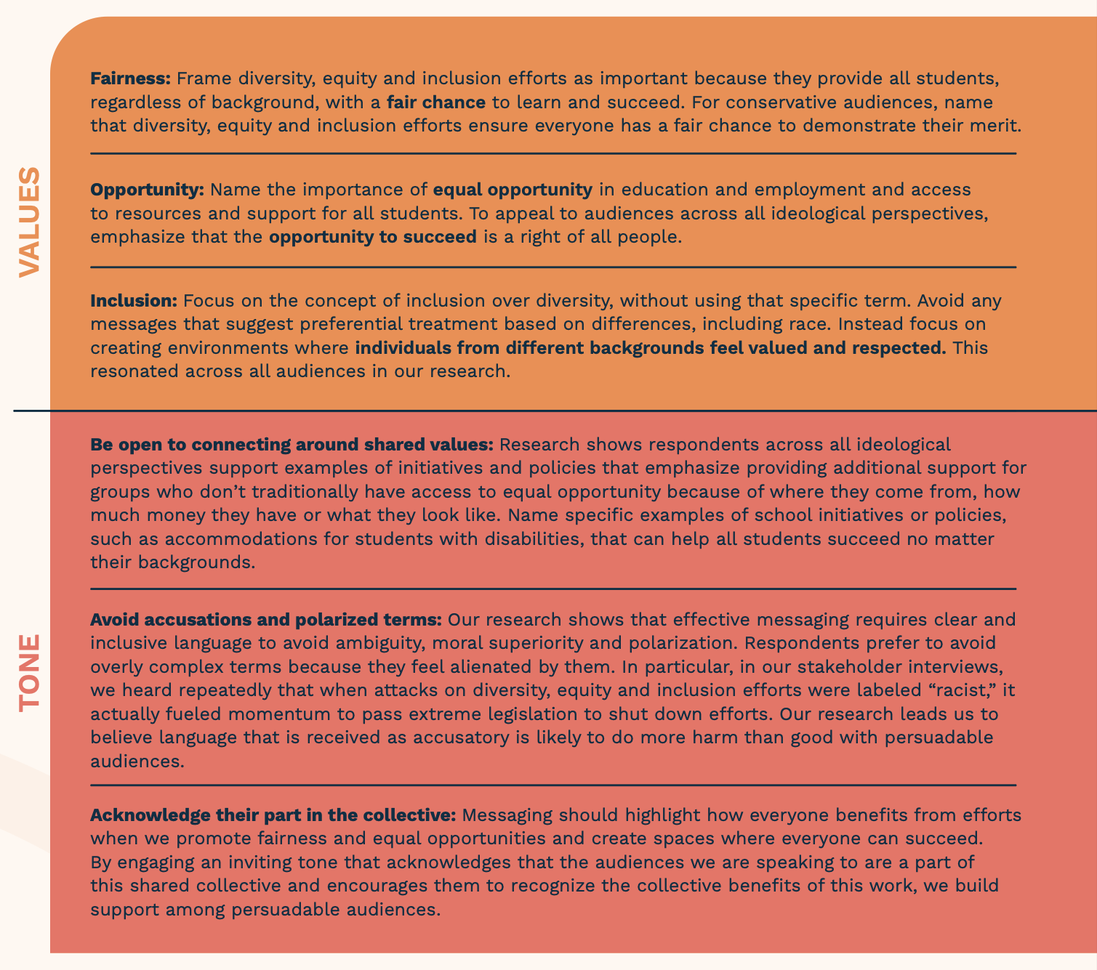
Spitfire “Shift Terms, Not Values: Reaching Persuadable Audiences on Diversity, Equity, and Inclusion in Higher Education”

Slide 8
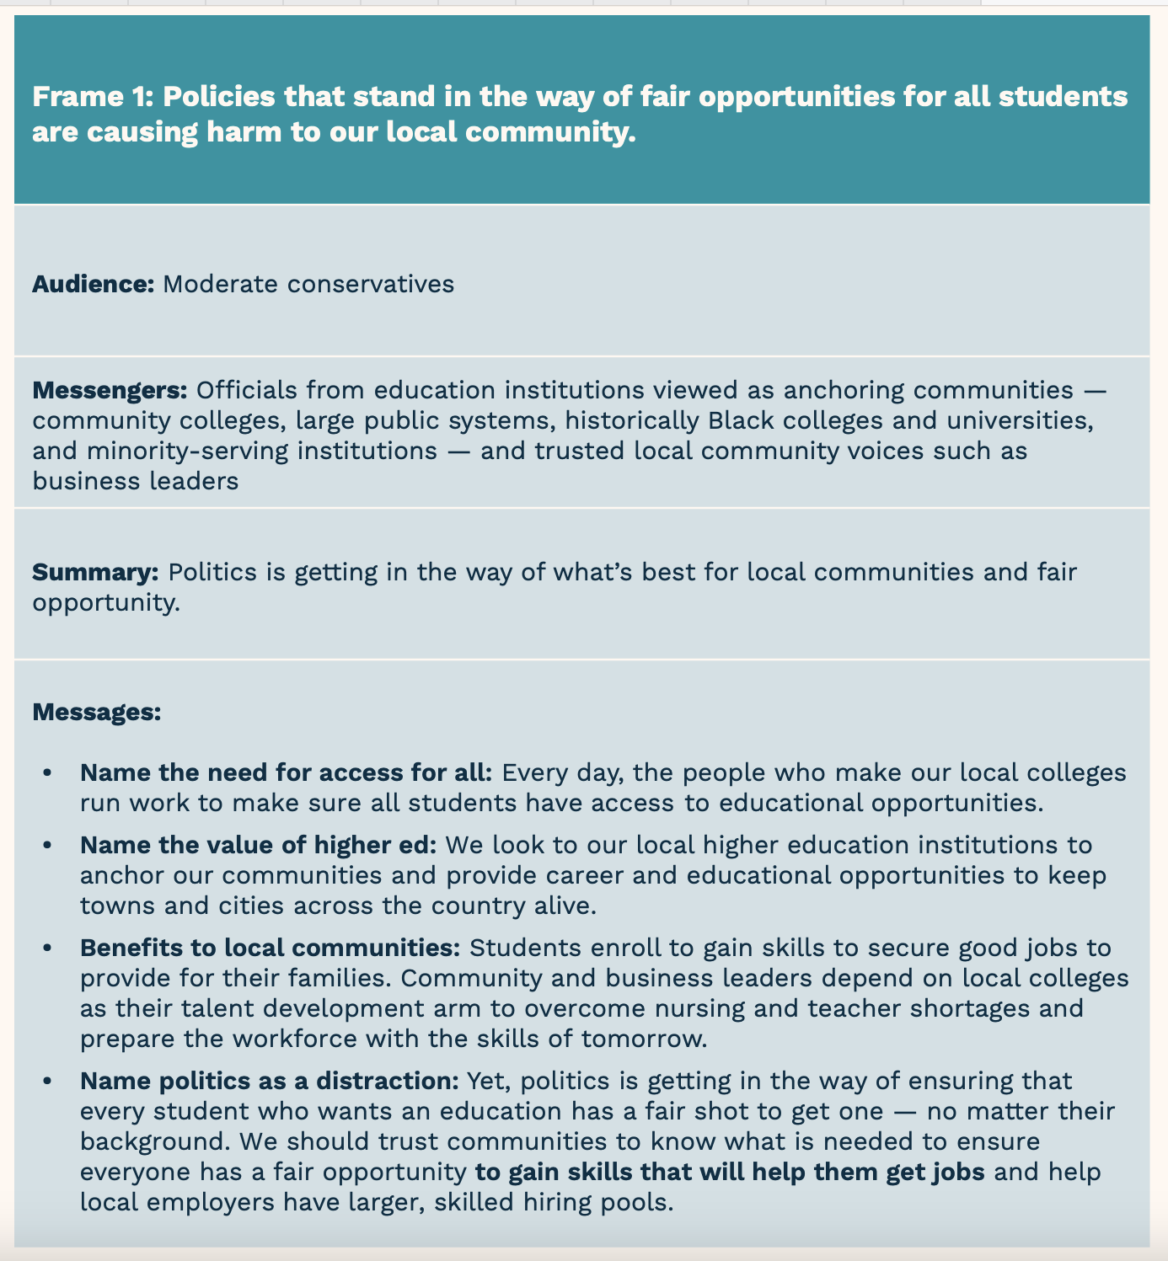
Spitfire “Shift Terms, Not Values: Reaching Persuadable Audiences on Diversity, Equity, and Inclusion in Higher Education”
Notes:
Note – focused on higher ed

Slide 9
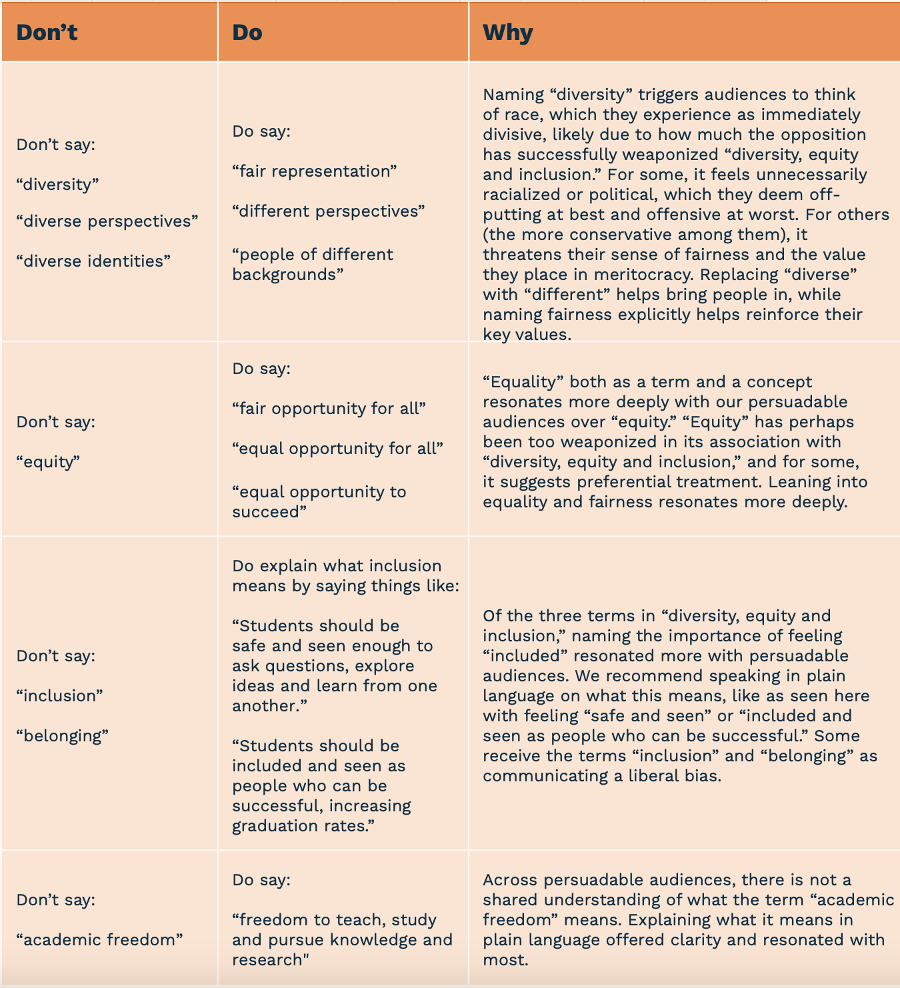
Notes:
Note – focused on higher ed

Slide 10
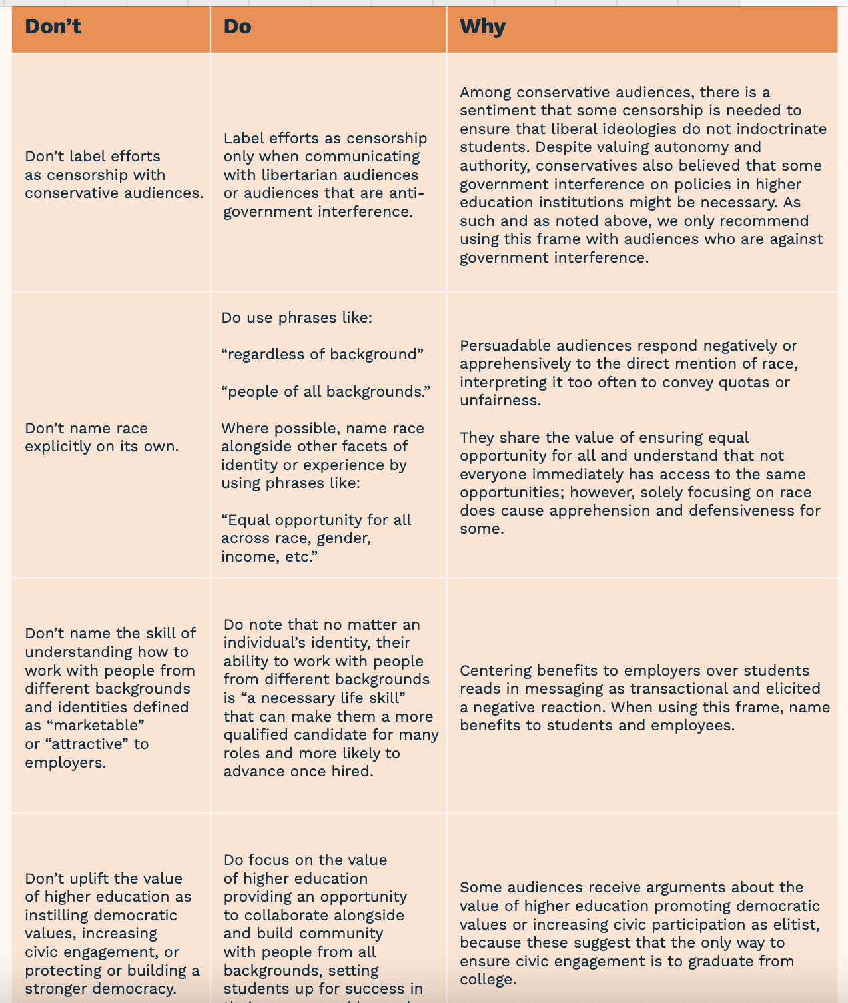
Notes:
Note – focused on higher ed

Slide 11
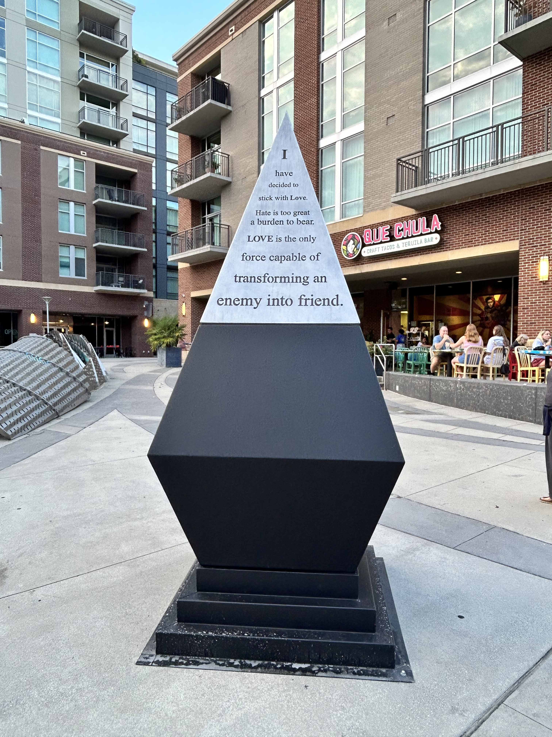
Reflecting & Sharing:
Other resources or ideas?
Take a few minutes to note what resonates with you.
Notes:
Reflect/journal
Share out time

Slide 12

Discussion
What is useful from each?
What is missing?
What would we want to add?
Notes:
Share plan
Give folks 3-5 minutes to reflect
Launch breakouts.
~12 minutes
Not sharing back our stories!

Slide 13

Small Group Workshopping
Try replacing “trigger” words with some of these phrases (perhaps using the research agenda or the recent CoP paper or anything you choose).
    Example: The Educare Network’s Research Agenda: Advancing Racial Equity TO The Educare Network’s Research Agenda: Advancing Equal Opportunity for All
Notes:
file:///Users/allisondemarco/Downloads/KCI_FI003156346%20(3).pdf
Download from: https://kiss.kstudy.com/Detail/Ar?key=4145510
Don’t try to do big sections – just try a headline or few key sentences.

Slide 14

Closing question: What could our next steps be?

