Slide 1
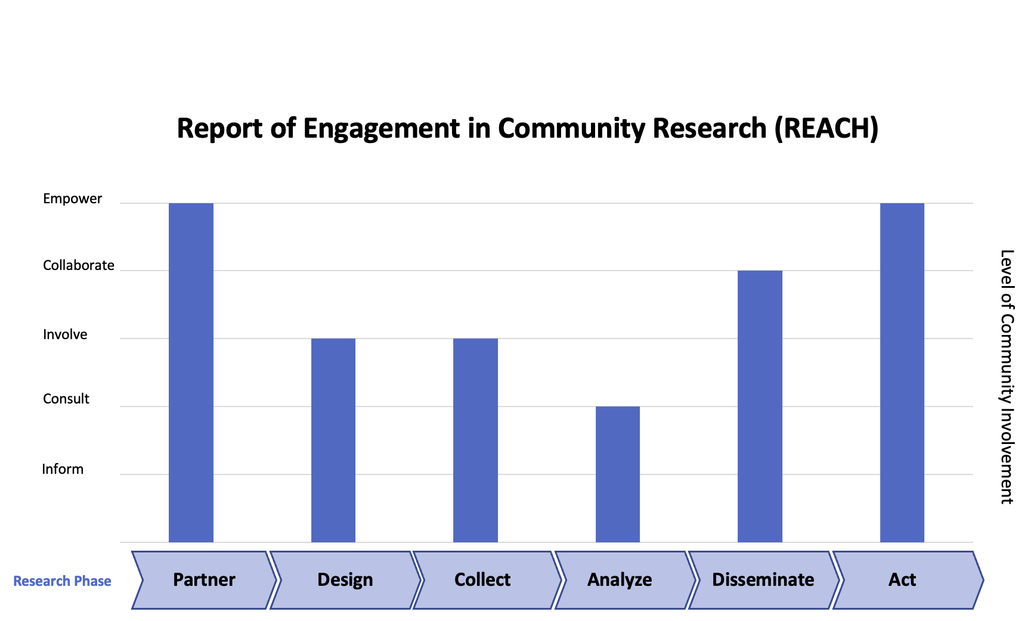
Introduction to the REACH Tool: Report of Engagement in Community Research
Racial Equity in Educare
April 2026 CoP 4/10/26
Notes:
Links to share:
Tool description: https://www.cctst.org/reach-tool
Link to TEACH tool template
https://www.cctst.org/_files/ugd/70d51a_3762f34717ef4bb7a883d8c8124d697c.docx?dn=CEC-REACH-Tool_Template.docx

Slide 2
Overview
Introduction to the REACH Tool
Key Elements
  Research Phases
  Level of Community Involvement
How it works!
Trying the tool in teams
Connects to Research Agenda Principle 7: Actively and meaningfully involve community
Adapted from: Jacquez, F., & Vaughn, L. (2025). The Report of Engagement in Community Research (REACH) Tool:
A Strategy to Promote Transparency and Improve Planning in Community-Engaged Research. Journal of Participatory
Research Methods.

Slide 3

Report of Engagement in Community Research (REACH)
To enable community-academic research teams to self-assess and publish precisely how and when the community was involved during each phase of a project’s research process.
Use to plan collaborative projects, check in on roles and responsibilities, and concisely summarize the role of community partners in published work
Consists of a graph to illustrate community engagement along the research timeline and space to briefly describe who was involved and how.
Notes:
Use to plan collaborative projects, check in on roles and responsibilities during the research process, and concisely summarize the role of community partners in journal articles and other published work
The tool consists of a graph that illustrates community engagement along the research timeline as well as a space to briefly describe who was involved and what they did.

Slide 4
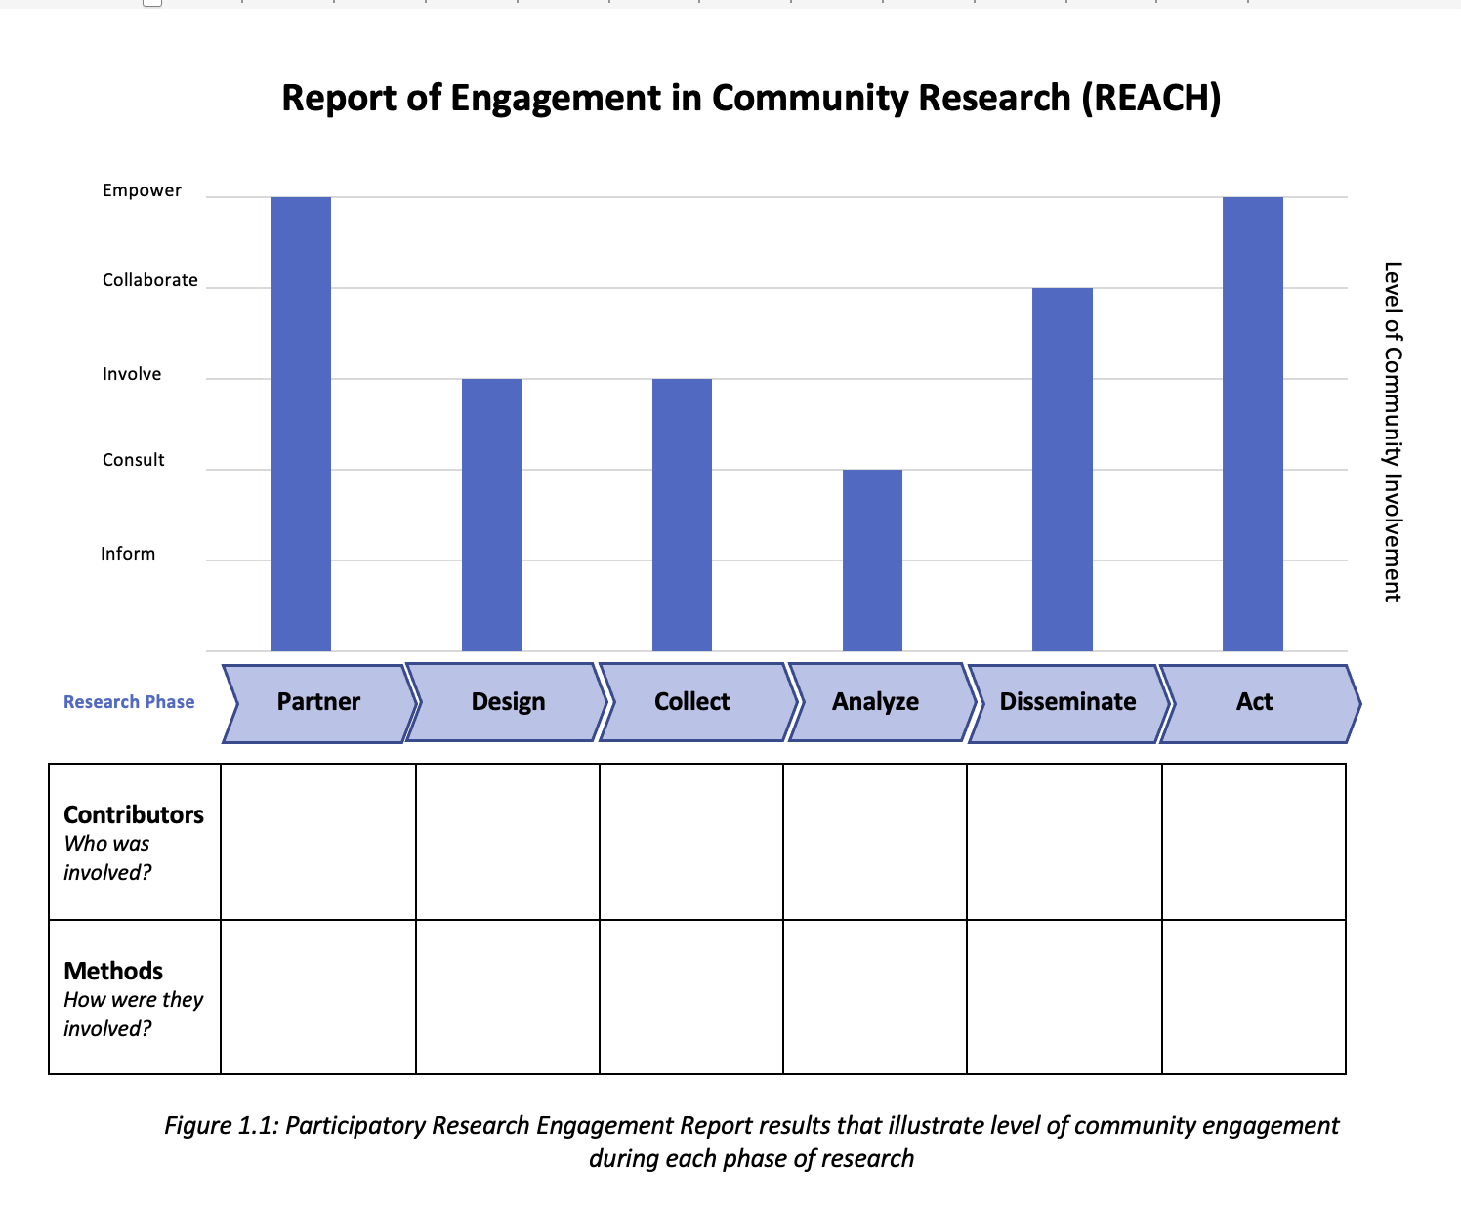
Notes:
Link to TEACH tool template
https://www.cctst.org/_files/ugd/70d51a_3762f34717ef4bb7a883d8c8124d697c.docx?dn=CEC-REACH-Tool_Template.docx

Slide 5
Horizontal Axis: Research Process
Partner - involves bringing different stakeholders together to discuss problems and the targeted opportunity space. It also includes finding partners and building relationships with other like-minded stakeholders.
Design - involves developing a strategy for the study and determining how the research should be conducted. It also involves selecting which stakeholders will be included in the following phases of the research.
Collect - involves all types of data collection.
Analyze - involves analysis and interpretation of the collected data.
Disseminate - involves dissemination of research findings.
Act - encompasses any action taken because of research findings to enact change.

Slide 6
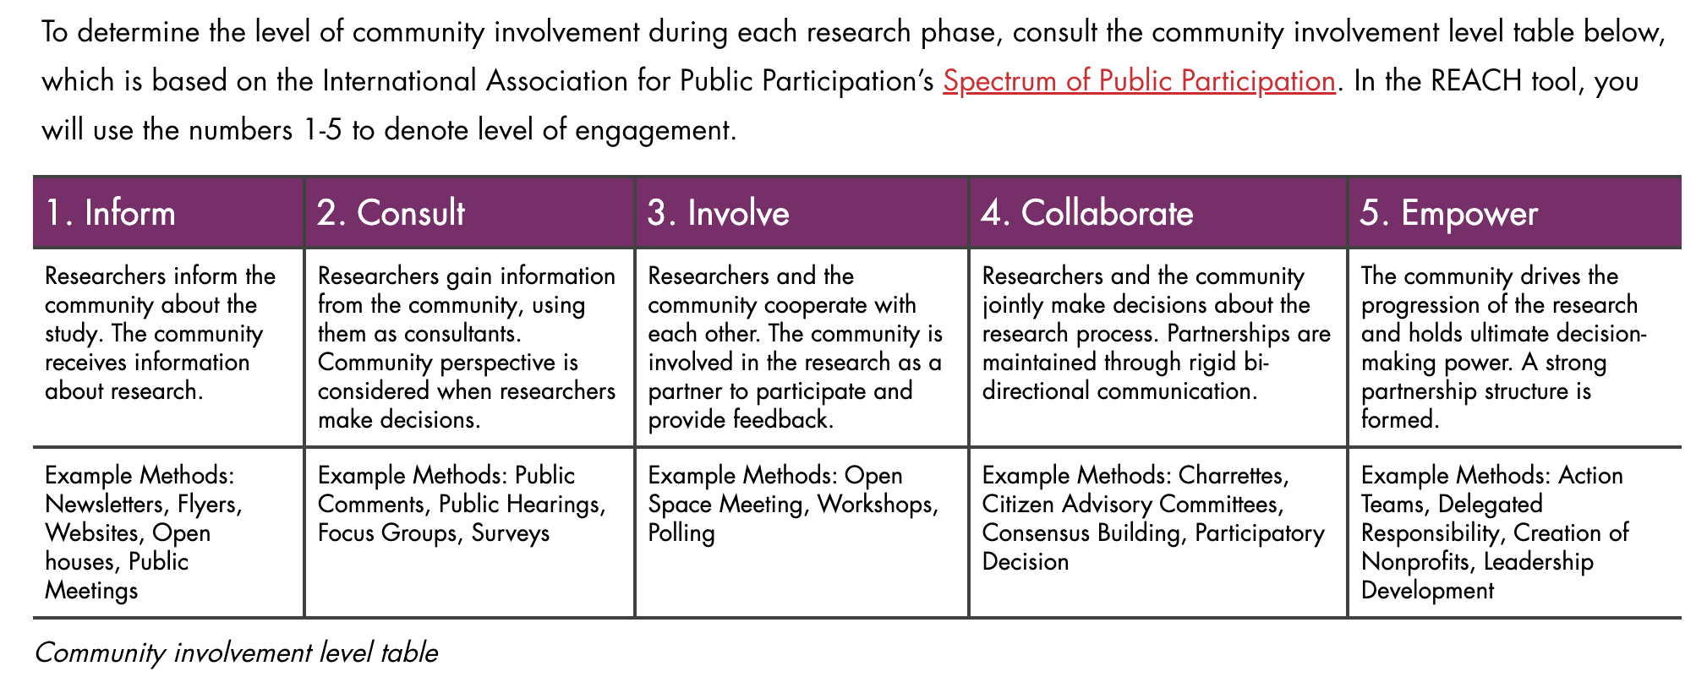
Vertical Axis: levels of community involvement

Slide 7
Research Phase | Primary Engagement Level | Secondary Engagement Level | Tertiary Engagement Level
Partner | 5
Design | 3
Collect | 3
Analyze | 2
Disseminate | 4
Act | 5
 | Put your engagement levels in this column for each research phase on a scale from 1 to 5 (see below for scale) | If you used other methods during a phase with different engagement levels, add those in subsequent columns and drag the outlined box to contain the adjacent column(s). Color code your responses in the document to explain your processes.
Engagement Level | Engagement Level Name | Participation Goals | Promise to the Public
1 | Inform | To provide balanced and objective information to assist them in understanding the problem, alternatives and/or solutions. | “We will keep you informed.”
2 | Consult | To obtain feedback on analysis, issues, alternatives, and decisions. | “We will listen to and acknowledge concerns and aspirations, and provide feedback on how public input influenced the decision.”
3 | Involve | To work with the public throughout the process to make sure that concerns and aspirations are considered and understood. | “We will work with you to ensure your concerns and aspirations are directly reflected in the decisions made.”
4 | Collaborate | To partner with the public in each aspect of the decision-making process including the development of alternatives of their preferred solution. | “We will look to you for advice and innovation in creating solutions and incorporate your recommendations as much as possible.”
5 | Empower | To place final decision-making in the hands of the public. | “We will implement what you decide.”
Notes:
This is the excel chart we will use to edit the graph! The graph is in Word.
You’ll see I edited this: for the “Partner” research phase I rated it a 5 “empower” and accordingly through all 6 phases, based on the descriptions in the table below.
Link to TEACH tool template
https://www.cctst.org/_files/ugd/70d51a_3762f34717ef4bb7a883d8c8124d697c.docx?dn=CEC-REACH-Tool_Template.docx

Slide 8
EDIT the Reach Graph!
1. Launch the Word template
2. Right-click the graph and select edit data.
3. An Excel sheet will open with sample data along with supplementary instructions.
4. Input numbers between 1-5 in column B labeled Primary Engagement Level depending on the level of community involvement for the indicated phase. The bar chart in Word will update to show the level of community engagement accordingly.
Notes:
Move to Word and Excel templates and demo

Slide 9
Let’s give it a try!
  Breakout groups by site
  Launch Word document (link in chat)
  Right click graph to launch Excel chart
  Add engagement level (1-5) in top blue column labeled “Primary Engagement Level”
  In Word tool, add some description to “Contributors” and “Methods” boxes for each research phase

Slide 10
How’d it go?
    Does anyone want to share their graph?
    What did you think of the REACH tool?
    Would you use it in a publication?

Slide 11

Closing question: What could a next step be?

